Slide 1
DIFFUSION TENSOR IMAGING
DR. AMIT KHARAT
DR. AARUSHI GUPTA
DR. JACOB JEESON

Slide 2
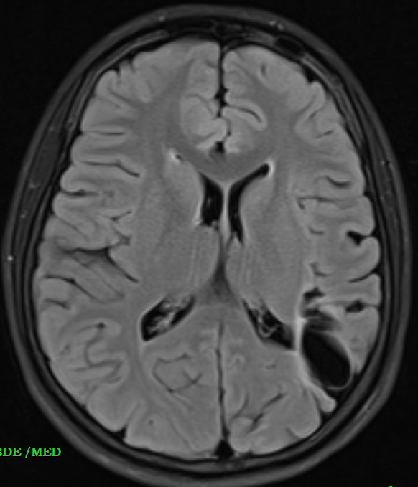
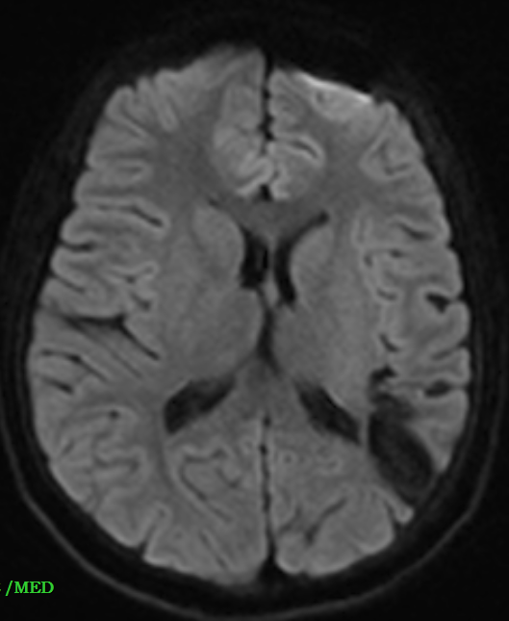
CASE 1
Known case of seizure disorder (not on treatment) – associated with tightening of limbs , frothing from mouth , uprolling of eyes
T1WI
T2WI
DWI
FLAIR
Notes:
Left parietal lobe shows a mass lesion which shows CSF signal intensity on all sequences with perilesional hyperintensities on T2 – suggestive of cystic encephalomalacia with surrounding gliotic changes

Slide 3
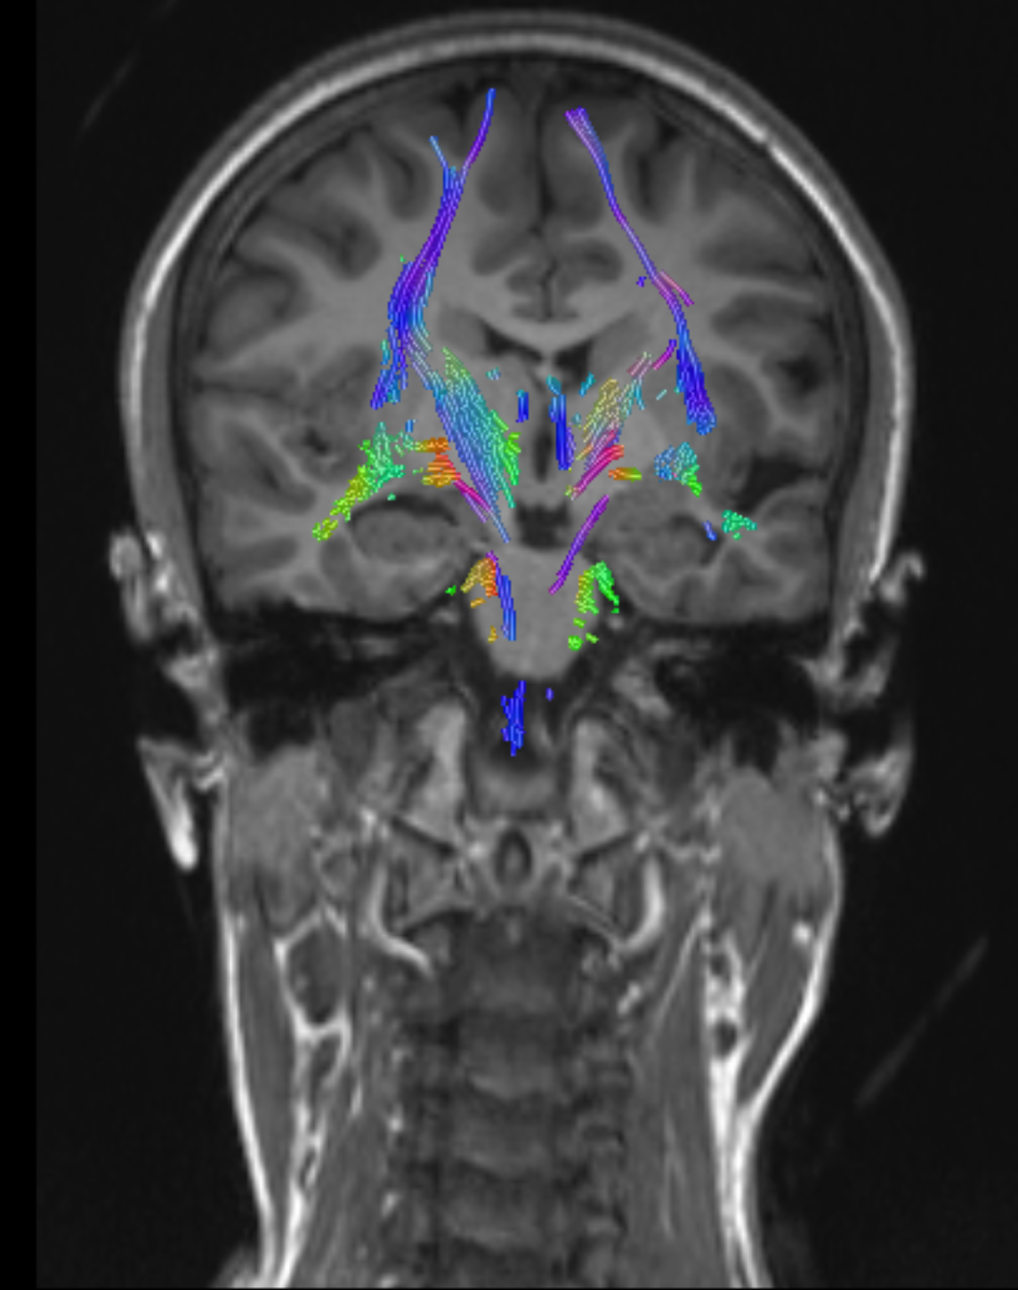
Notes:
When we did DTI for the same patient , it shows decreased volume of left occipitofrontal fasciculus – suggestive of desctruction of fibres.

Slide 4
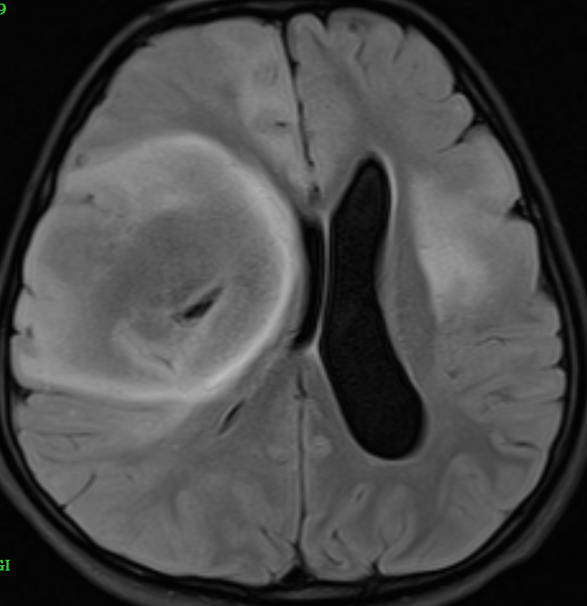
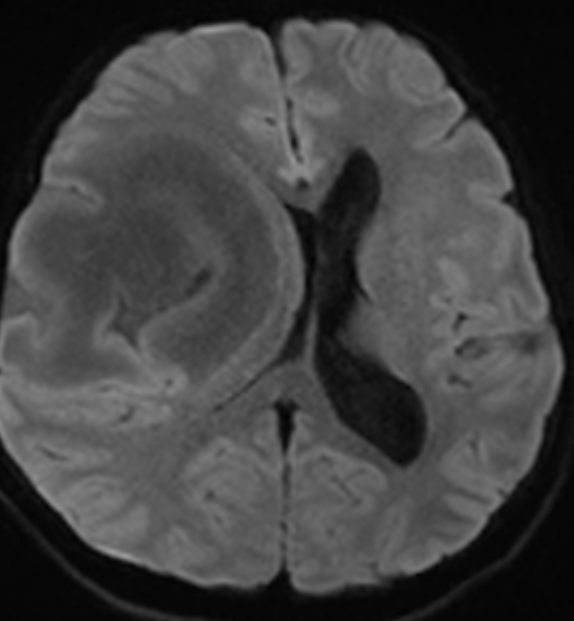
CASE 2
C/O recurrent seizures - Once every 10-15 days
T1WI
T2WI
FLAIR
DWI
Notes:
WELL DEFINED LESION IN RIGHT FRONTO-TEMPORAL REGION IN CORTICAL AND SUBCORTICAL WHITE MATER. CAIUSING MASS EFFECT ON RIGHT GANGLIOCAPSULAR and right lateral ventricle with midline shift and compensatory dilatation of left Lalteral ventricle WITH HETEROGENOUS POST CONTRAST ENHNANCEMTN WITH increased choline peak on spectroscopy - features suggestive of MALIGNANCY, LIKELY diffuse low grade astrocytoma OR gliomatosis cerebri.

Slide 5
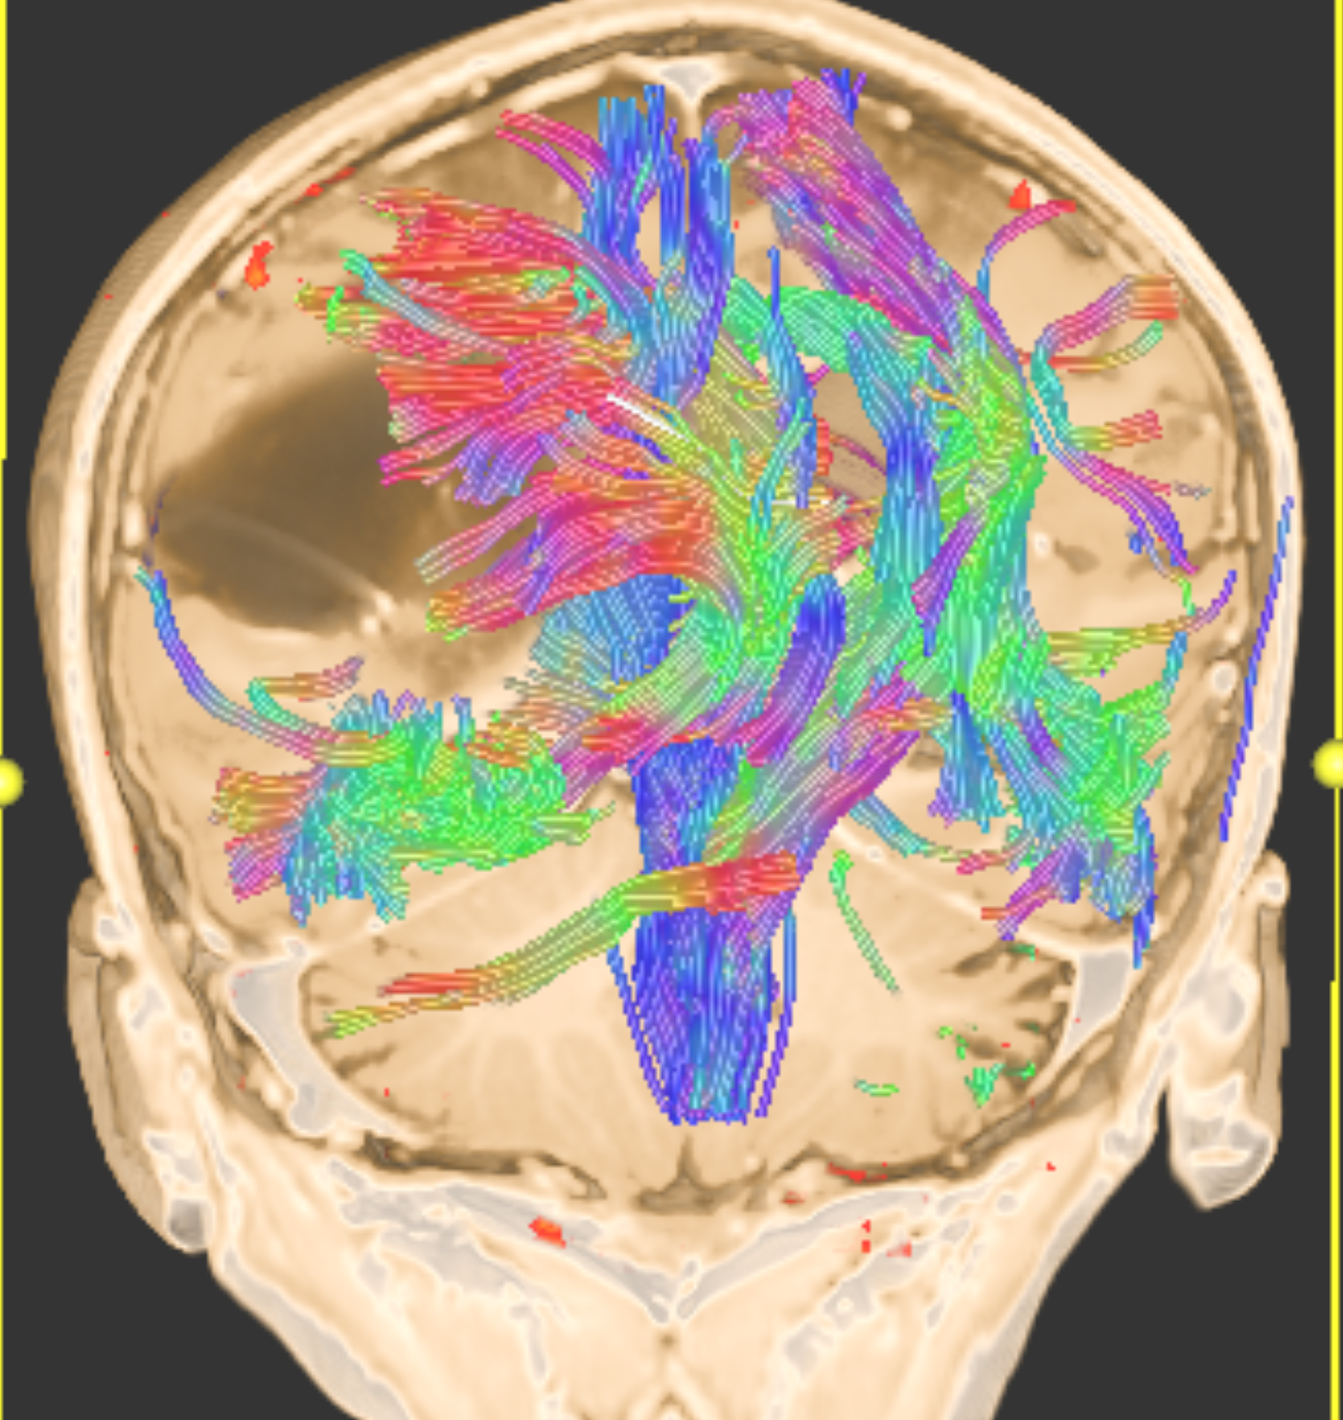
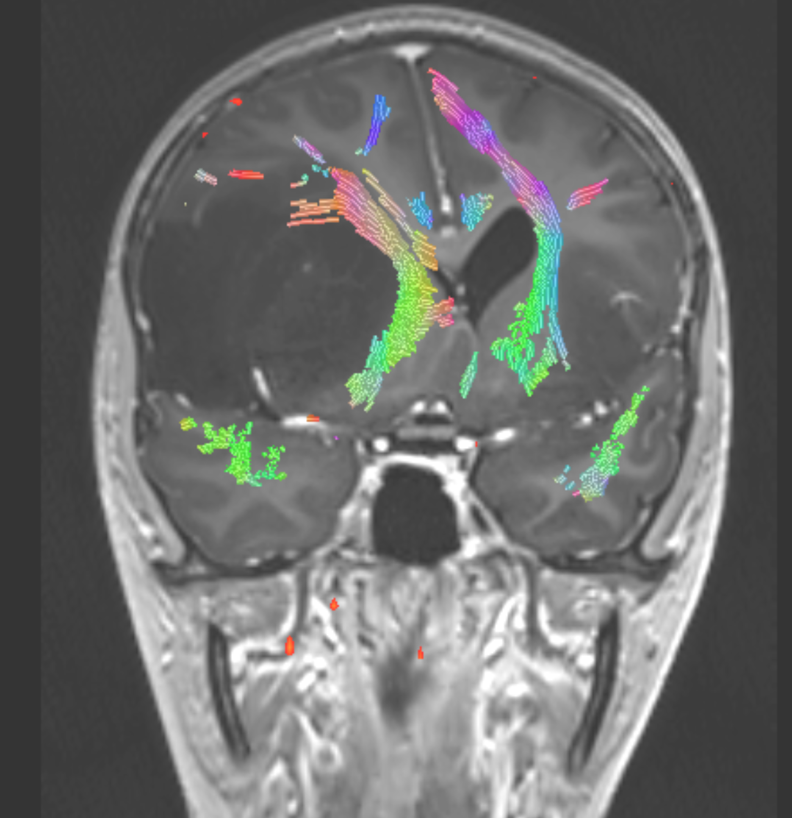
Notes:
On performing DTI for this patient , deviation and reduction in volume of right cingulum and superior and inferior occipitofrontal fasciculus is noted

Slide 6
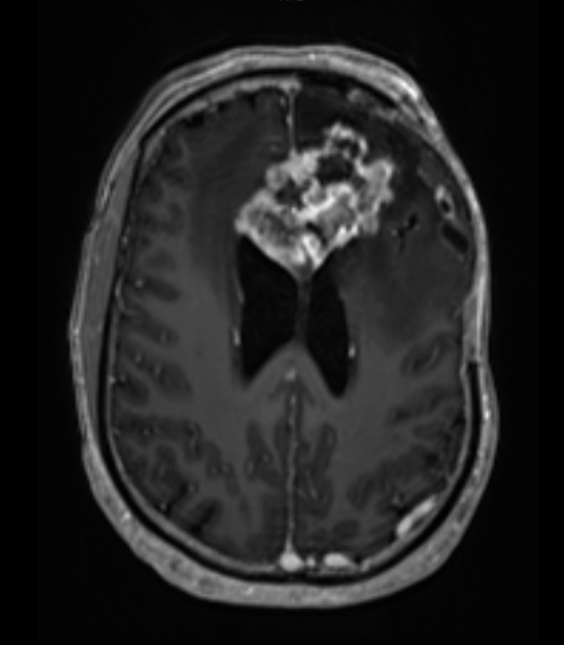
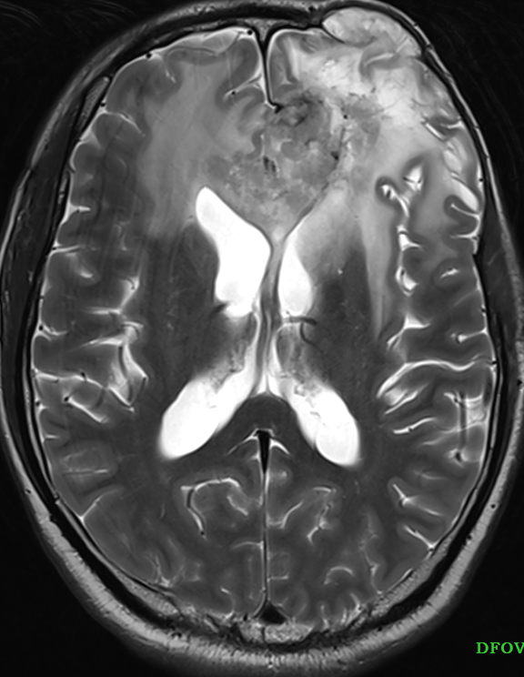
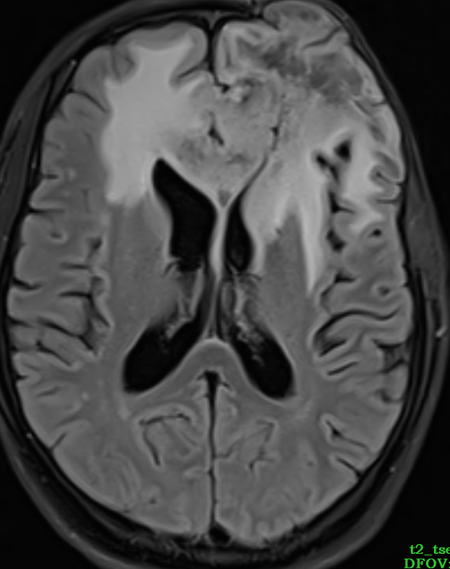
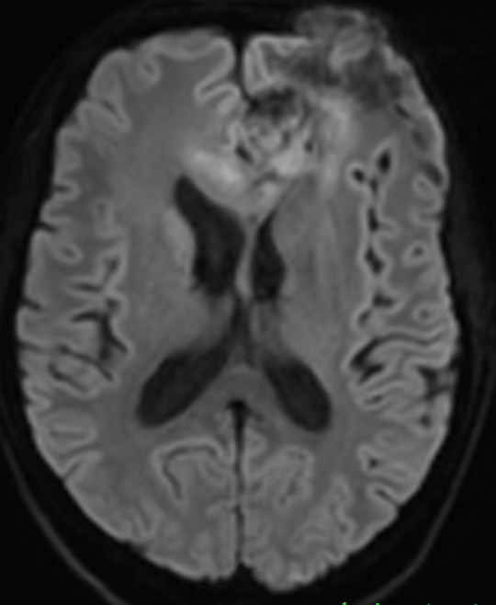
CASE 3
O/C/O anaplastic astrocytoma 4 months back
C/O headache and giddiness since 1 month
T1WI CE
T2WI
T2 FLAIR
DWI
Notes:
On doing MRI , we saw heterogeneously enhancing mass occupying the left frontal lobe with crossing over to the right side via the genu of corpus callosum.

Slide 7
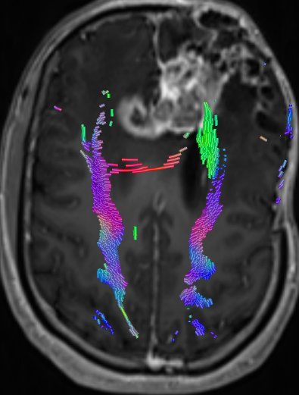
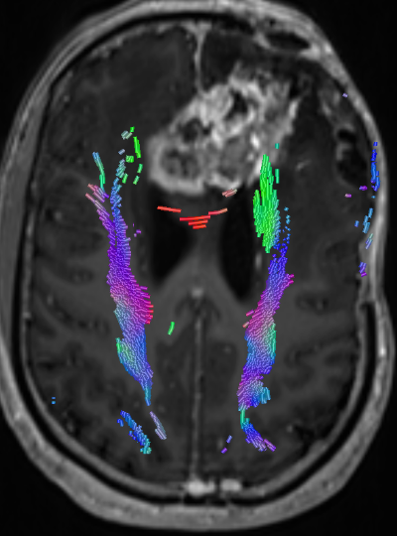
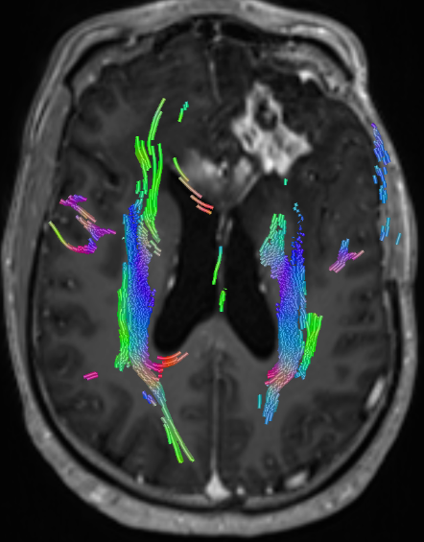
Notes:
There are serial sections taken from top to bottom showing gross destruction and displacement of corpus callosum fibres

Slide 8
INTRODUCTION
Notes:
Good afternoon again everyone. We have already seen the clinical applications of DTI.
Now let us discuss how to report these scans. But before diving into that, why are we discussing this topic today.
So recently as we all know, our college acquired the new state of the art 3Tesla MRI machine.

Slide 9
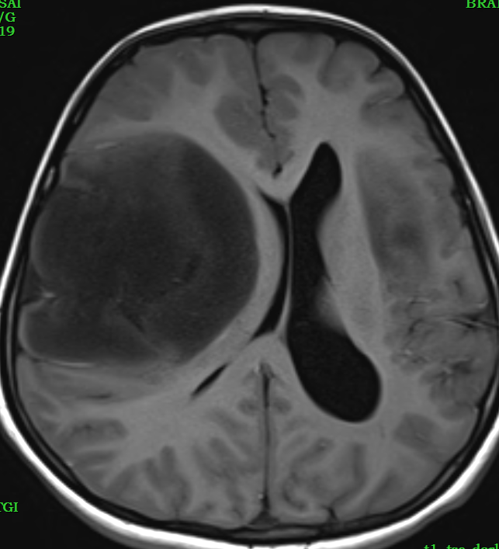
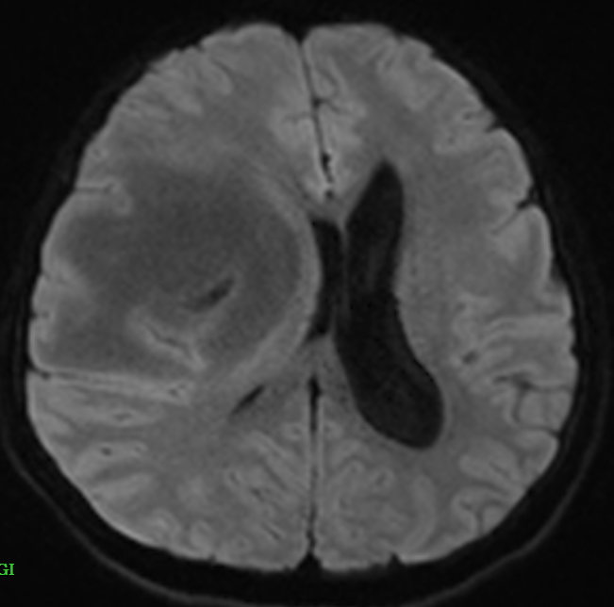
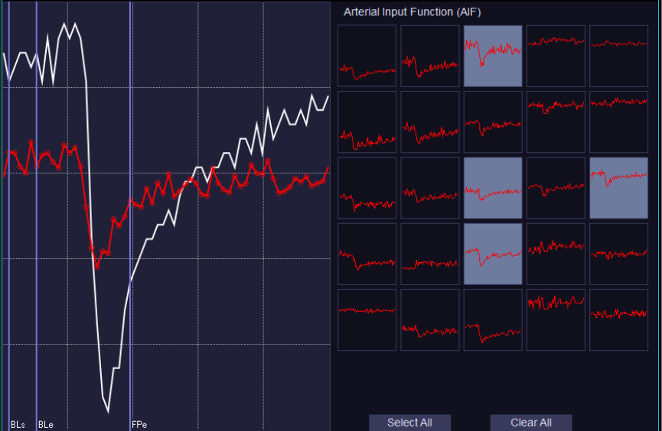
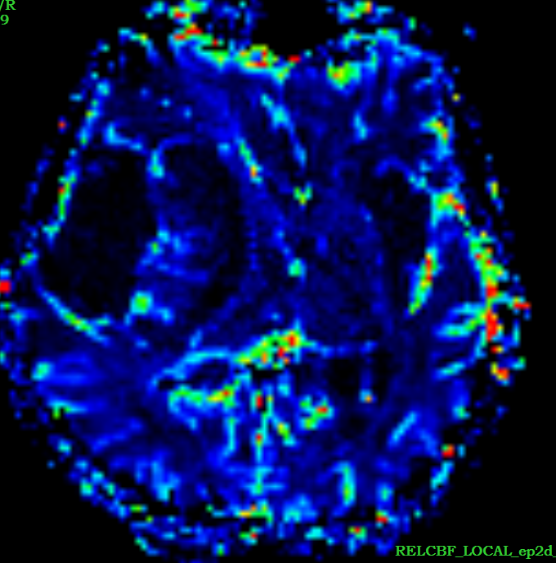
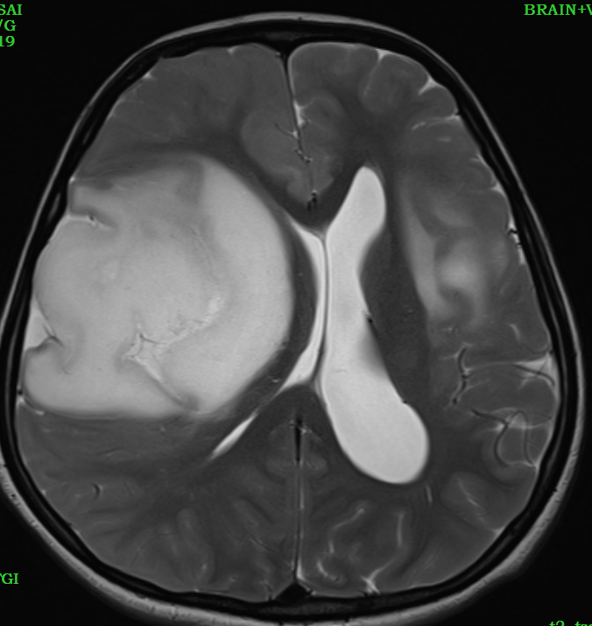
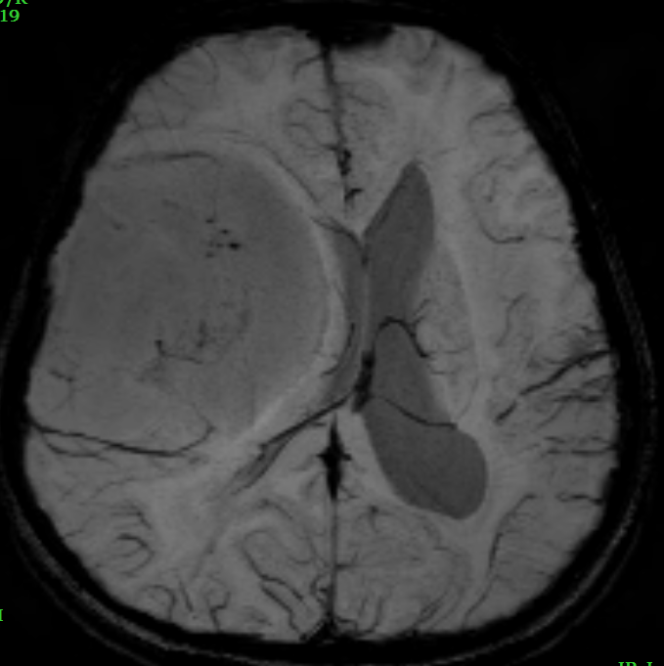
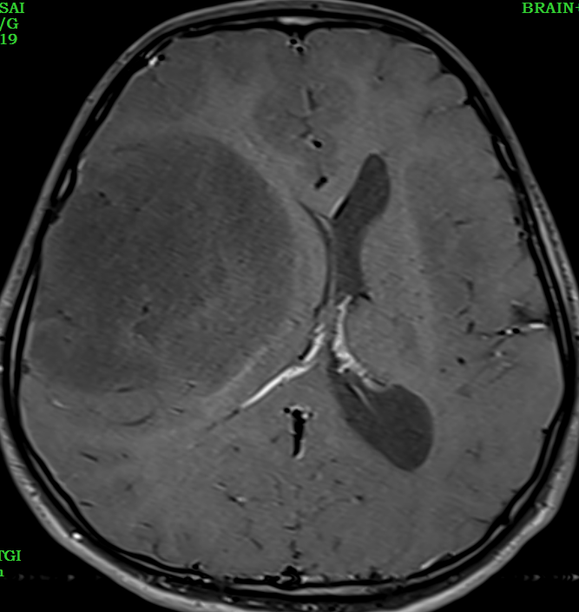
BRAIN TUMOR PROTOCOL
T1WI
DWI
PERFUSION
T2WI
SWI
Functional MRI
FLAIR
POST CONTRAST
Notes:
The newly acquired functions include – perfusion MR which tells us about the vascularity of the lesion.
Functional MRI which is done to look for involvement of various motor and sensory areas.

Slide 10
Diffusion tensor imaging
Notes:
And finally Diffusion tenor imaging. The physics behind which is a little complicated but to simplify it, we basically run the diffusion sequence in 256 planes, thereby making the images very accurate. Since the data is acquired in 3 Dimensions, we can actually see the direction and thickness of different tracts. These images are difficult to report, thus to make it easier for the radiologists, the DTI imahes are post processed by the technicians to give me images that look like this.

Slide 11
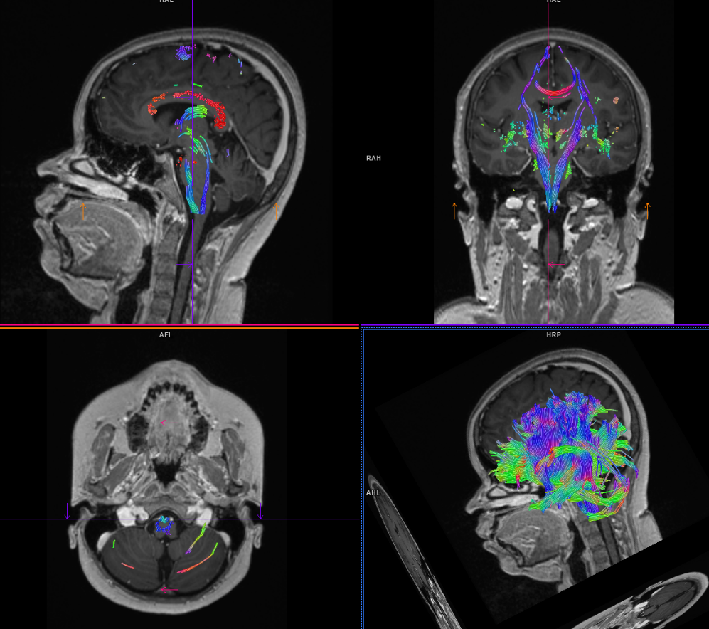
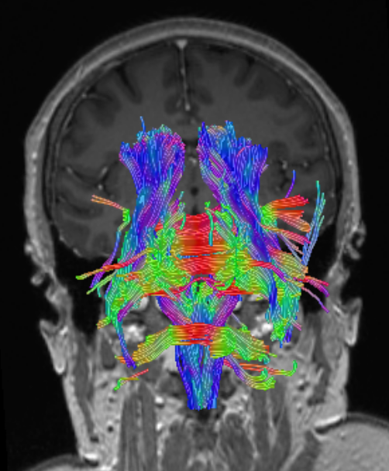
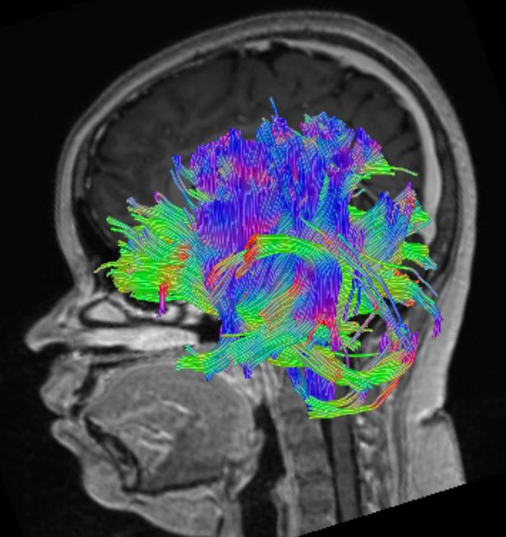
TRACTOGRAPHY
Notes:
Now that we have obtained this data, how do I analyze it.
We will now be talking about the colour coding of the tracts, then their anatomy and finally their pathological involvement.

Slide 12
Color hue indicates direction as follows:
Red – left to right
Green – anterior to posterior
Blue – superior to inferior
Notes:
Since the information is 3-Dimensional, we colour code the tracts based on their directions.

Slide 13
Types of white matter tracts
1. Projection fibers - tracts connecting the cortex with other area in the CNS such as the deep nuclei, brainstem and cerebellum.
2. Association fibers – These connect different areas in the same hemisphere (also known as intrahemispheric tracts).
3. Commissural fibers – These connect the same cortical areas in opposite hemispheres.
Notes:
Our brain is composed of multiple white matter tracts. These can be classified as follows :

Slide 14
Commissural fibers – Corpus callosum
Notes:
Since these connect two hemispheres, they run from right to left and are coded in the colour red.
So in caases of GBM and lymphoma, which cross the hemispheres, we can see the degree of involvement of these fibres using this technique.
This image is showing us the corpus callosum in an anatomical specimen, then as DTI images and finally as the processed tractography.

Slide 16
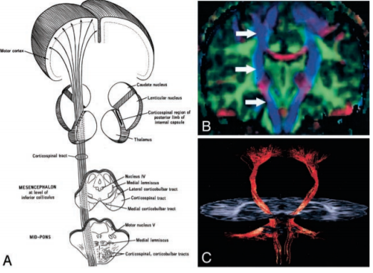
Projectional fibers – Corticospinal tract
Notes:
Since these connect cerebral cortex to other structures such as brainstem and cerebellum. They run from superior to inferior, they are coded in the blue colour.
So in cases of Wallerian degeneration in huge infarcts, we can see the thinning of theese tracts in the side involved.
This image is showing us the cortico spinal tract in an anatomical diagram and as blue in tractography.

Slide 17
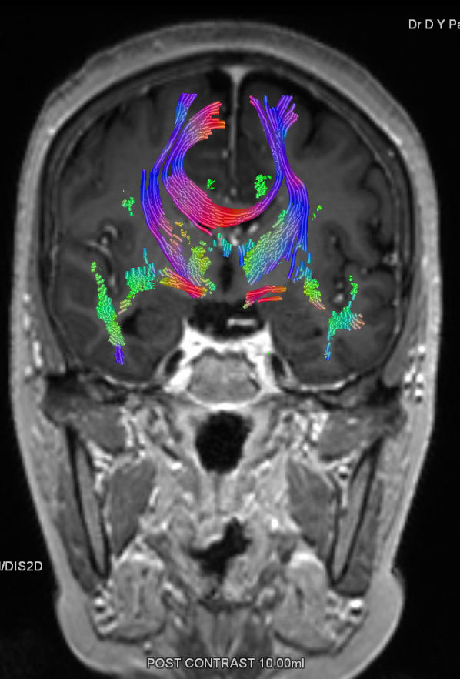

Slide 18
Association fibers – Superior longitudinal fibers
Notes:
These connect different parts of the same hemisphere. They run mainly from anteior to posteior, however these change direction according to the anatomy of the brain.
This image is showing us the superior longitudenal fasciculus cortico spinal tract in an anatomical diagram and then as DTI images. If you notice carefully the tract is turnign from green to blur as the direction of fibres changes from snterior posterior to supero inferior.

Slide 19
Notes:
Occipito frontal fibres on the left are destroyed

Slide 20
How to interpret the images?

Slide 21
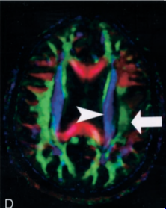
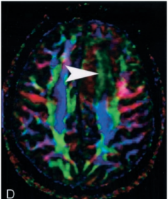
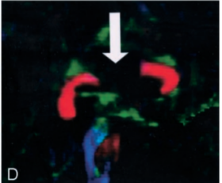
Notes:
Pattern 1 consists of normal or only slightly decreased FA with abnormal location and/or direction resulting from bulk mass displacement. This is the most clinically useful pattern in preoperative planning because it confirms the presence of an intact peritumoral tract that can potentially be preserved during resection
Pattern 2 is substantially decreased FA with normal location and direction (ie, normal hues on directional color maps). We frequently observe this pattern in regions of vasogenic edema, although the specificity of this pattern is not yet known; further study is needed to determine the clinical utility of this observation.
Pattern 3 is substantially decreased FA with abnormal hues on directional color maps. We have identified this pattern in a small number of infiltrating gliomas in which the bulk mass effect appeared to be insufficient to account for the abnormal hues on directional maps. We speculate that infiltrating tumor disrupts the directional organization of fiber tracts to cause altered color patterns on directional maps
Pattern 4 consists of isotropic (or nearisotropic) diffusion such that the tract cannot be identified on directional color maps. This pattern is observed when some portion of a tract is completelydisrupted by tumor. This pattern can be useful in preoperative planning in the sense that no special care need be taken during resection to preserve a tract that is shown by DTI to be destroyed.

Slide 22
Summary
Require:
preoperative or intraoperative mapping of the tumor
Alongside functional MRI
To give the neurosurgeon a road map to the possible operative route.
Can also be used for congenital white matter tract abnormalities.
With use of DTI, both the degree of anisotropy and the local fiber direction can be mapped voxel by voxel, providing a new and unique opportunity for studying WM architecture in vivo.
Notes:
To summarize, DTI is the new cool brian navigation devise of the white matter tracts where the MRI is the navigation machine and the radiologist the ship s navigator.

Slide 23
THANK YOU

