Slide 1
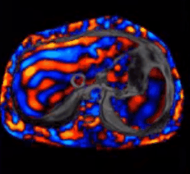
MR liver lab and MR Elastography - How do we stand to benefit?
Dr. Shibani Saluja
Dr Nikhith Soman

Slide 2
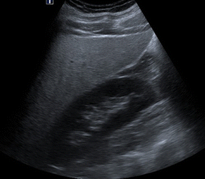
CASE
A 30 year old male patient came for regular health check up.
USG Abdo-pelvis revealed Grade II Fatty liver.
Following which he was advised MRI to assess the liver.
MRI liver lab (fat quatification) and MR Elastography was done.

Slide 3
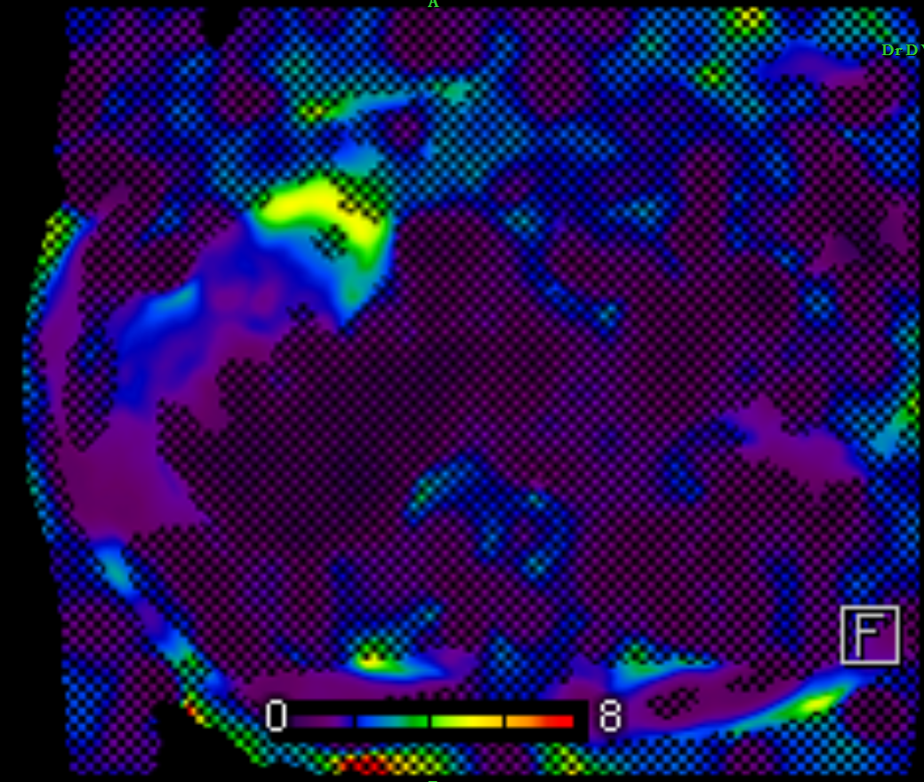
Soft
Hard

Slide 4
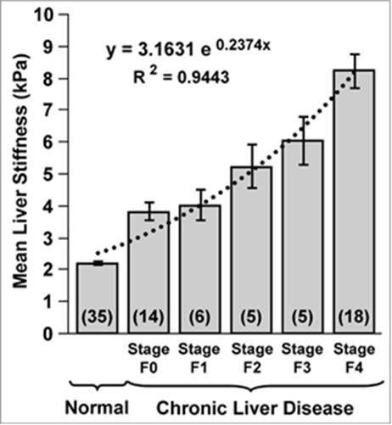
Findings
The stiffness in measured in kilopascals.
Average of the 4 ROI will be 2.9kpa
Referring to the scale, this belongs to Stage F0 of fibrosis.
**Yin et al. Clin Gastroenterol Hepatol 2007;5:1207–1213.

Slide 5
MR Liver lab

Slide 6
Findings
The fat was quantified using the auto generated segmentation volume.
Segmentation volume = 33.1% fat.
Average fat percentage in four ROI = Average value=28 %
Histogram value of a specific ROI= 27.5%
Moderate fatty liver (Grade II) with 33.1 % approximate fat. content.
*MRI Steatosis Grading: Development and Initial Validation of a Color Mapping System

Slide 7
Technique
Fat quantification –Liver Lab
MR Elastography of liver
Notes:
I l be discussing these techniques,their intrepration and the benefits.

Slide 8
What is MR Elastography ?
It is a new MRI-based biomarker-
for characterizing tissue stiffness non-invasively
useful in detecting the silent stage of early fibrosis which is a prequel to irreversible fibrosis and then cirrhosis.
What is fat quantification of Liver?
It is a non-invasive method using MRI sequences –
For evaluation of fat of the entire liver
to give an objective value which is 95% accurate as comparable to histopathology.

Slide 9
MRE Scan Technique
Notes:
How do we do mr elastography?this technique includes 3 steps-first generating mechanical waves asecond imaging of propagating waves and third is generation of elastograms
PATIENT POSITIONING:-
The subject will be scanned in supine position.
A source of vibration (passive driver )is placed on the surface of the
body to generate mechanical waves in the tissues of interest.
The passive driver is placed over the right lower chest wall at the level of xiphisternum in midclavicular line. The passive driver is held in firm contact with the body wall using an elastic band. The passive driver is connected to the active driver, which is located outside the scan room, via a plastic tube.
SEQUENCE USED:-
2D gradient-echo sequences with cyclic motion-encoding gradients (MEG) for MR elastography
Siemens liver lab sequences for quantification of fat in liver.

Slide 10
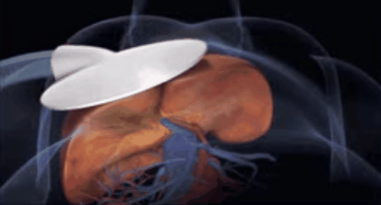
STEPS IN MRE
1. Generating Mechanical Waves in Tissue
Notes:
SEQUENCE USED:-
2D gradient-echo sequences with cyclic motion-encoding gradients (MEG) for MR elastography
Siemens liver lab sequences for quantification of fat in liver.

Slide 11
2. Imaging the Propagating Waves
Notes:
After running the sequence we get wave image.
Principle of Mr elastography is based on these propagating waves.

Slide 12
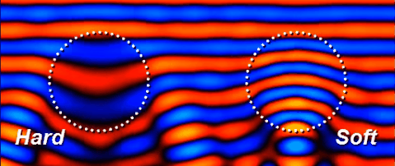
MR Elastography : Principle
MR Elastography : Principle
Notes:
We can see mechanical waves propagate more rapidly in stiffer tissue and more slowly in softer tissue.
If the waves are applied continuously ,speed of propagation is reflected in wavelength.
Tissue stiffness increases wavelength becomes longer.

Slide 13
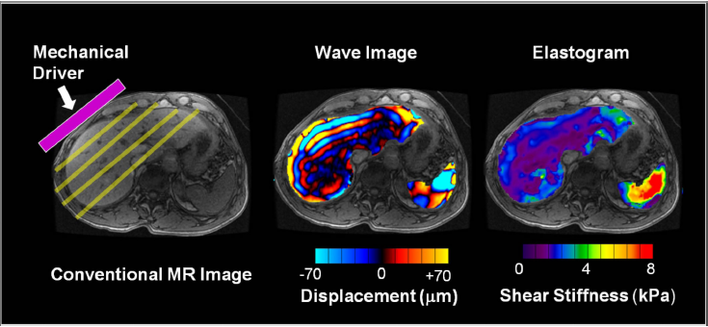
3. Generating Elastograms
Notes:
After the wave image elastograms are processed automatically with an “inversion algorithm” to create quantitative images
depicting the stiffness of tissue. This stiffness is calculated in the form of kilopascals(0-8)
MRE is performed in three steps. (a) A source of vibration is placed on the surface of the
body to generate mechanical waves in the tissues of interest.
(b) A special MRE pulse sequence with synchronized motion encoding gradients is used to image the micron-level
cyclic displacements caused by the propagating waves. The wavelength of the shear waves
is longer in stiffer tissues and shorter in softer tissues.
(c) The wave images are then automatically processed with an “inversion algorithm” to create quantitative images
depicting the stiffness of tissue. (For these illustrations, the portions of the wave image and
elastogram corresponding to liver and spleen have been superimposed on a conventional
MR image.)

Slide 14
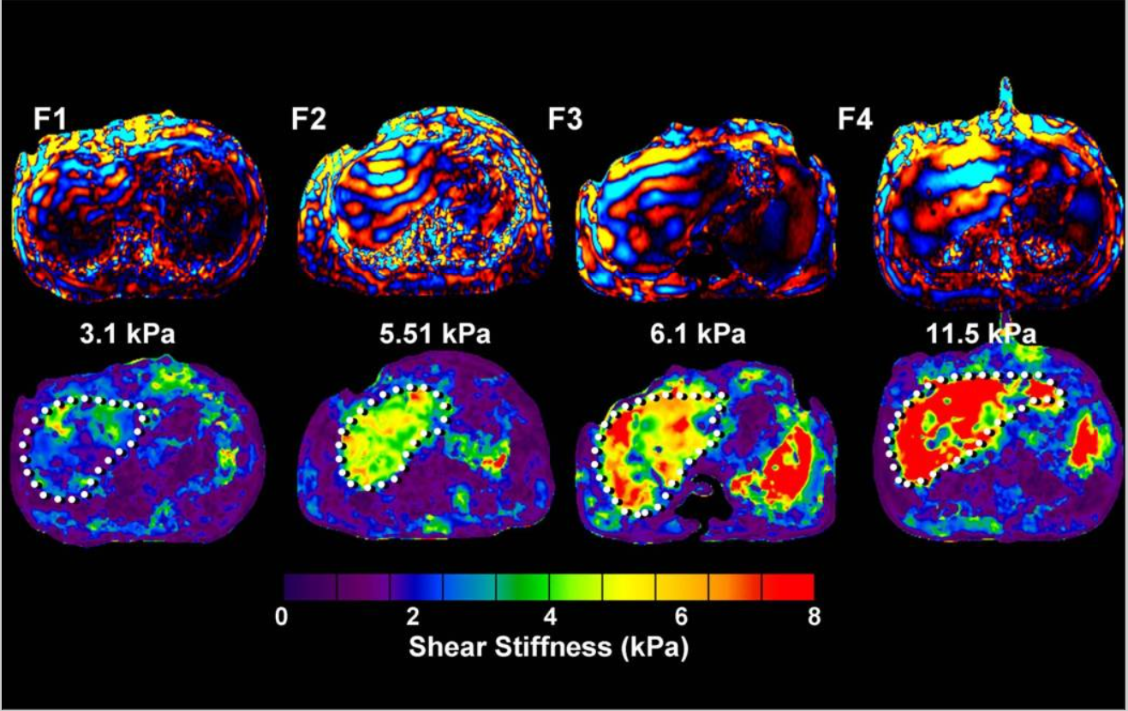
Interpretation
Yin et al. Clin Gastroenterol Hepatol 2007;5:1207–1213
Notes:
The stiffness value in kilopascals is then graded according to this metavir classification as ashown.
Lets take an example from image 1-the sheer stiffness of this liver is 3.1kpa which is graded as f1 with the help of this bar diagram. If the patient is in Stage f0-f1 it means he is in reversible stage.
The main objective of this advanced MRI technique detect any changes of early fibrosis which can be crucial in preventing progression and complete reversal with adequate lifestyle modification

Slide 15
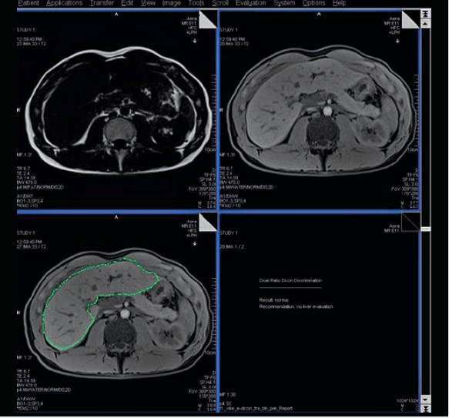
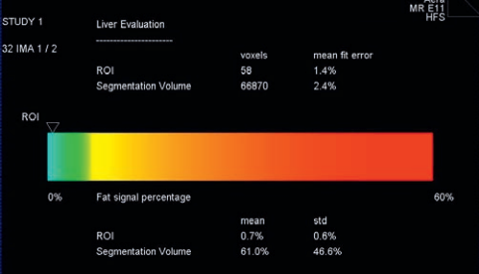
Liver Lab
Notes:
LiverLab gives us fat quantification in the form of percentage- consists of three sequences incorporated into the Abdomen Dot Engine protocol. The t1 vibe e-Dixon (First look Dixon), vibe q-Dixon (Multi-echo Dixon), and the HISTO (breath-hold spectroscopy) sequences are usually performed in conjunction with routine liver examination. LiverLab must be performed as a Dot Engine.
E-Dixon (Evaluation) it will tell if fat deposition is present and it will suggest to run liver lab. It’s a dual echo protocol and it does a in phase and opposed phase scan.
Check if the segmentation (green line ) is correct.
Q-Dixon (Quantification) – ROI CHECK IF IT CORRECT PLACED ON Q DIXON IMAGE. here we place a ROI and then the system will do entire automatic liver segmentation.
Small ROI in liver. It should be away from biliary, vascular system (portal or arterial system).
Ideally put Roi on the lower lobe
Histogram – Spectroscopy.

Slide 16
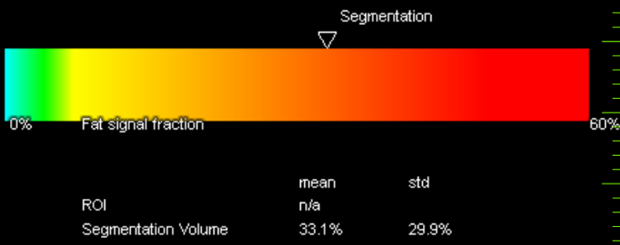
Interpretation
Fat quantification*
*MRI Steatosis Grading: Development and Initial Validation of a Color Mapping System
Notes:
After running the liver lab sequences we get automated fat signal percentage in the form of colour bar
The fat was quantified using the auto generated segmentation volume.
Segmentation volume = 33.1% fat.
As shown in this case the total percentage of fat is 33.1% which is graded as grade 2 fatty liver with help of the colour mapping system.
So if percentage is between 0-6-garde 0
7-26-grade 1
27-38-grade 2
>40-grade 3

Slide 17
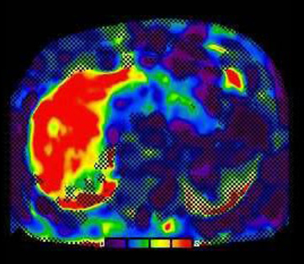
USG VS MRI ELASTOGRAPHY
USG Elastography
Small portions are sampled
obese patients and narrow intercostal spaces.
It’s a subjective method, performer bias
MR Elastography
Samples larger portions of the liver
Not limited by body habitus and ribs.
Standardized assessment of the liver independent of performer bias.
Quality is degraded in :
marked iron deposition
ascites.

Slide 18
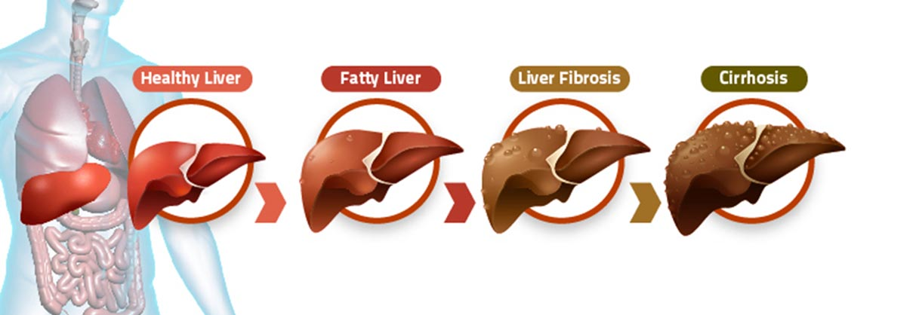
MRE as a screening tool
INCREASE IN LIVER STIFFNESS
The key is to detect the silent reversible phase of early fibrosis
Notes:
There is dramatic increase in patients diagnosed with non alcoholic fatty liver (10-15% fibrosis)due to sedentary lifestyle and unhealthy diet
Fatty liver is a very common diagnosis seen in ultrasonography reports which is often subjective and ignored due to lack sufficient data to assess the extent of the condition. The patient becomes symptomatic only in advances stages which is often irreversible.
Using advanced MRI technique we can now quantify the exact amount of fat in the liver as well as detect any changes of early fibrosis which can be crucial in preventing progression and complete reversal with adequate lifestyle modification.
The key is detection of the silent reversible phase of early fibrosis
Ideally it should be done with all the patients with fatty liver,but in our scenario atleast all patients with grade 2 should undergo.
Gold standard is Biopsy-Invasive, Sampling errors, inter observer variability and sample small portions of liver.
USG Elastography- only assess small part of liver, obese, inter observer variability

Slide 19
