Slide 1
CARDIAC SURGERY AND CARDIAC INTERVENTIONS IN PAEDIATRICS
Dr. Prerna Bhat (JR III)
Dr. Santosh Joshi (Paediatric Cardiologist)

Slide 2
CASE 1

Slide 3
CASE CAPSULE
Ms PRATIKSHA GADHAVE , 7 months,female child 3rd issue of a non consanguinous marriage came to the Paediatric OPD on 04/01/2019
History of one episode of unresponsiveness and up rolling of eyes four days back.
2DEcho done @Ahmednagar showed some mass in Right Atrium.
Patient opted to come to DYP hospital for further management.

Slide 4
IN OPD:
BABY WAS FOUND TO HAVE OBVIOUS CYANOSIS HOWEVER SHE WAS HEMODYNAMICALLY STABLE.
IN VIEW OF CYANOSIS BABY WAS SHIFTED TO PICU IMMEDIATELY.

Slide 5
IN PICU :
HR: 132/min RR: 40/min BP: 102/68 mmhg
SpO2
Right Upper Limb 56% on Room Air
Left Upper Limb 60% on RoomAir
Right Lower Limb 54% on RoomAir
Left Lower Limb 62% on RoomAir
Silent precordium
PanSystolic Murmur +, Normal P2
WITH PREVIOUS 2DECHO SHOWING RIGHT ATRIAL MASS AND CYANOSIS SO OBVIOUS IT WAS DECIDED TO GET REPEAT 2DECHO IMMEDIATELY.

Slide 6
Notes:
THIS IS AN APICAL 4 CHAMBER VIEW

Slide 7
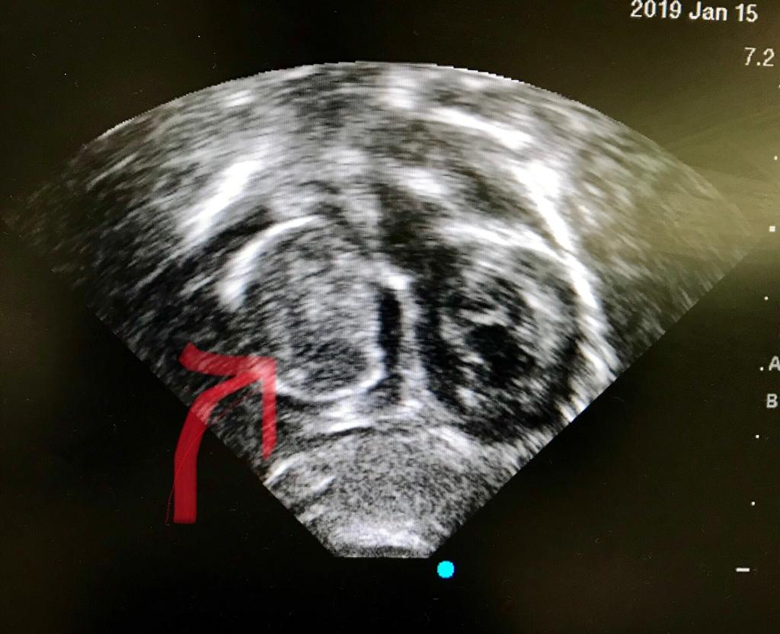
ECHO DONE SHOWED

Slide 11
What was unique with this case so far?????
Symptomatic Cardiac masses in children are rare.
Most common cardiac tumours in children are Rhabdomyomas.
Most of them do not cause any inflow or outflow obstruction and regress on their own.
So we had Young Infant- Wt: 6Kg- Huge RA Mass-Etiology Unknown-Obstructing RV inflow significantly
PRIORITY WAS REMOVAL OF MASS SURGICALLY

Slide 12
CASE was discussed with CVTS Team and they obliged by posting the case as soon as clearance was done. Parents of the baby were counselled about the urgency of situation.
Very next day morning Baby had Cardiac arrest
CPR was started
Baby was shifted to Cardiac OT in emergency and was put immediately on CardioPulmonaryBypass.
Tumour was removed Surgically.

Slide 13
Surgical Steps
Under General Anesthesia Midline Sternotomy followed by Pericardiotomy was done
Next an Aorto Bicaval cannulation and Cardiopulmonary Bypass
Right atrium opened

Slide 14
IVC CANNULA
SVC CANNULA
CLAMP ON AORTA WITH AORTIC CANNULA

Slide 15
MASS AFTER OPENING THE RIGHT ATRIUM

Slide 16
RA Tumor was excised with small rim of tissue(interatrial septum) around
Atrial septal defect closed with Pericardial patch

Slide 17
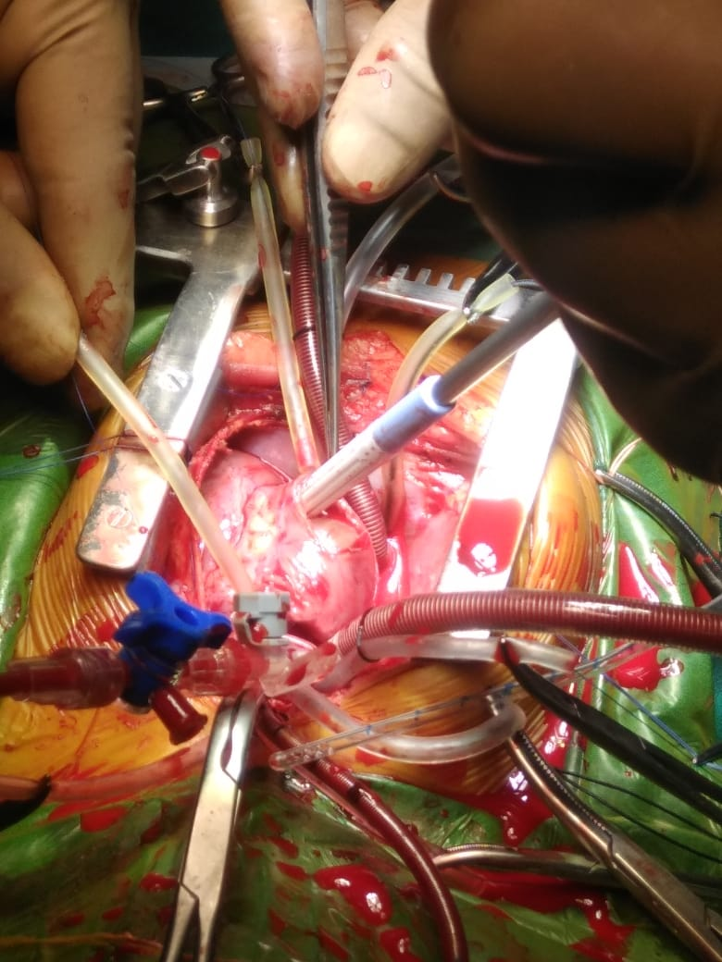
ATRIAL SEPTAL CLOSED WITH PERICARDIAL PATCH

Slide 18
Patient came off – CardiopulmonaryBypass easily
Shifted to CVTS Recovery Room
Extubated next day morning
Discharged on Day 7

Slide 21
WHY THIS CASE STANDS OUT????
TEAM WORK
TUMORS ARE RARE IN CHILDREN
CPR DONE AND SURGEONS CONTACTED
PEDIATRIC CARDIAC SURGICAL PROGRAMME
TUMORS WITH SUCH SIGNIFICANT OBSTRUCTION ARE EVEN RARE
SPLIT SECOND DECISION BY SURGEONS TO TAKE CHILD IN OT
EXTREME SYMPTOMS:
CARDIAC ARREST DUE TO INFLOW OBSTRUCTION
SUCCESSFUL OUTCOME IN A CHILD

Slide 22
CASE 2

Slide 23
PDA DEVICE CLOSURE: AN ALTERNATIVE TECHNIQUE

Slide 24
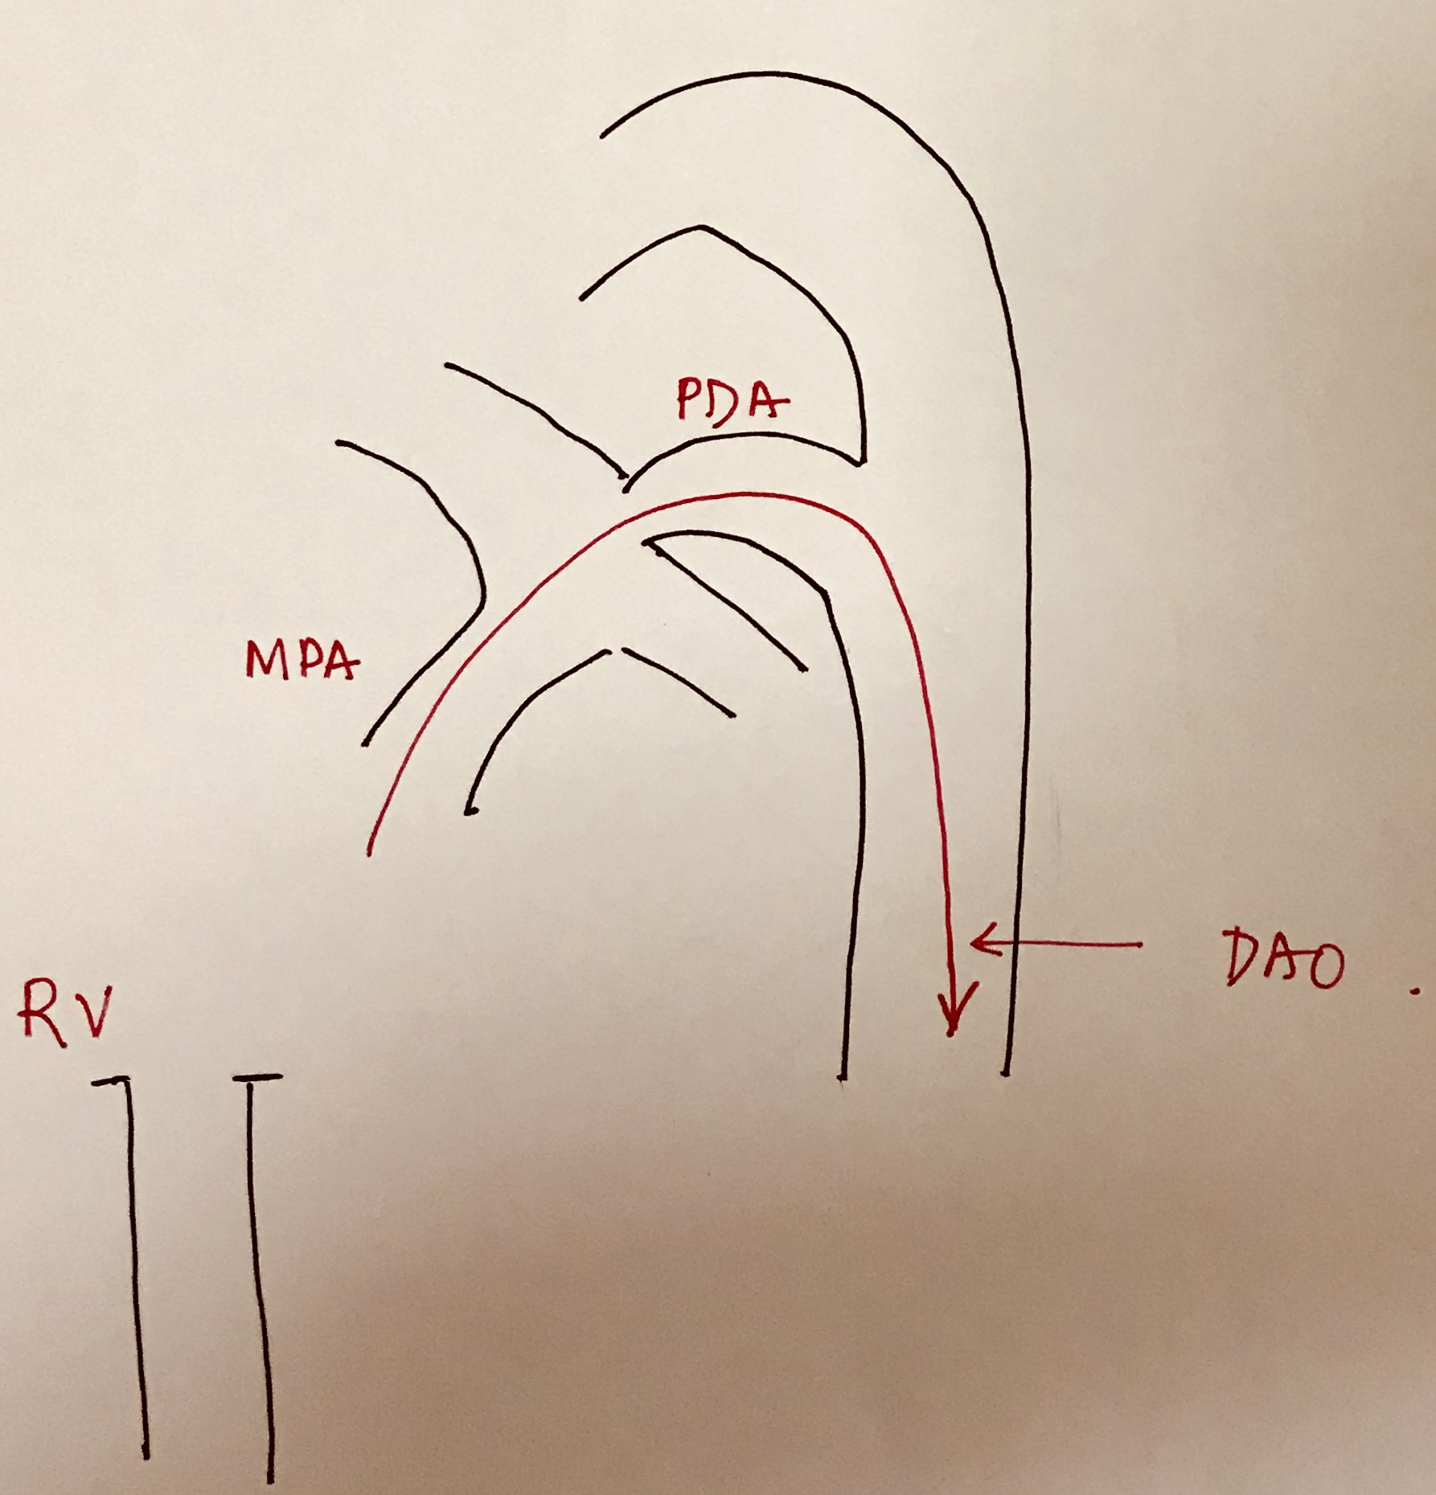
TRADITIONAL TECHNIQUE OF DEVICE CLOSURE
Notes:
AORTIC ANGIOGRAM
PDA IS CROSSED FROM RV SIDE WITH WIRE

Slide 25
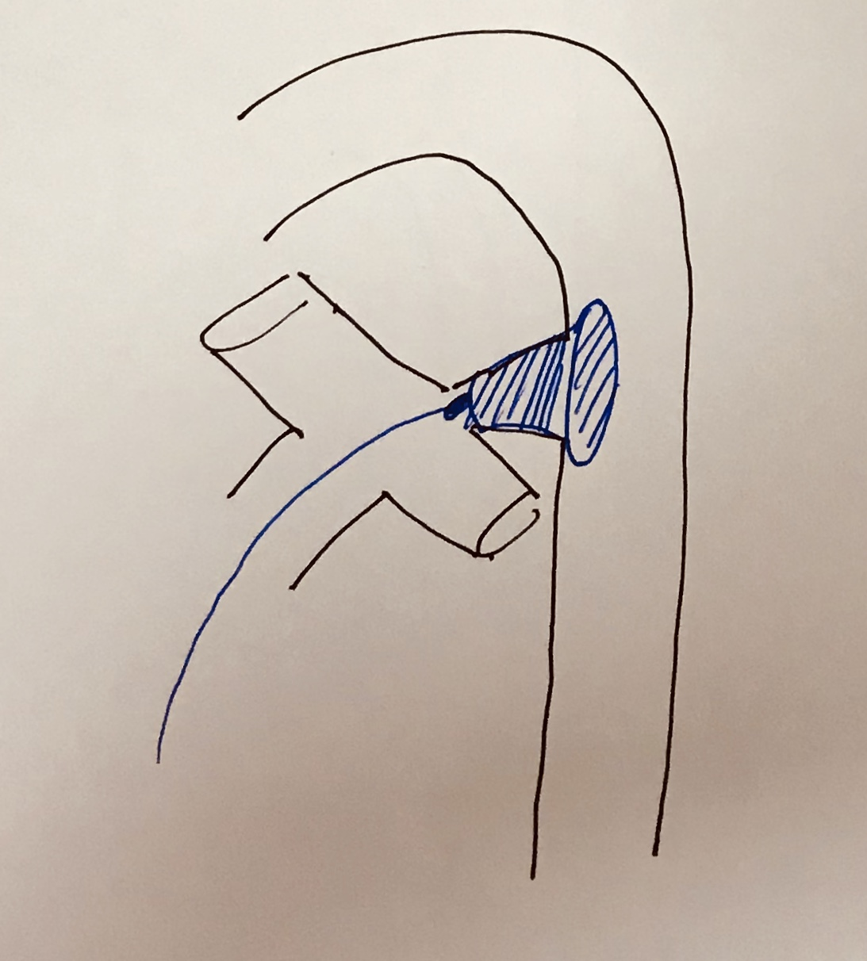
Notes:
ON WIRE LARGE SHEATH IS PUT IN WHICH DEVICE IS LOADED
THIS IS HOW DEVICE IS DEPLYOED

Slide 26
CASE CAPSULE
Miss Noor Sakina Sayyad ,1 year, female child k/c/o Patent Ductus Arteriosus with cleft lip and cleft palate was admitted to DYPatil Hospital on 29/01/2019 planned for device closure on 7/02/19.

Slide 27
ISSUES WITH THIS CASE:
WEIGHT 6kgs
ASSOCIATED MORBIDITIES
1)DYSMORPHISM
2)Cleft lip,cleft palate
3) Lissencephaly
NO ARTERIAL ACCESS

Slide 28
ISSUES WITH NO ARTERIAL ACCESS
PDA cannot be delineated properly
There are no anatomical landmarks available for deployment of device
Device needs to be deployed using real time echo & fluoroscopy guidance

Slide 39
POST PROCEDURE
UNEVENTFUL
BABY DISCHARGED AFTER 24 HOURS
BOON IN DISGUISE:
NO ARTERIAL ACCESS AVOIDS COMPLICATIONS OF ARTERIAL
CANNULATION

Slide 40
Why unique???
HIGH RISK PDA – Young child
DEVICE CLOSURE IS USUALLY DIFFICULT IN SUCH CASES- Low weight
MULTIPLE CO-MORBIDITIES
NO ARTERIAL ACCESS
REAL-TIME ECHO GUIDANCE REQUIRES GOOD CATHLAB TEAM-ANAESHTHETIST
OURS IS ONLY CENTRE IN PCMC WHICH CAN DO SUCH DEVICES

Slide 41
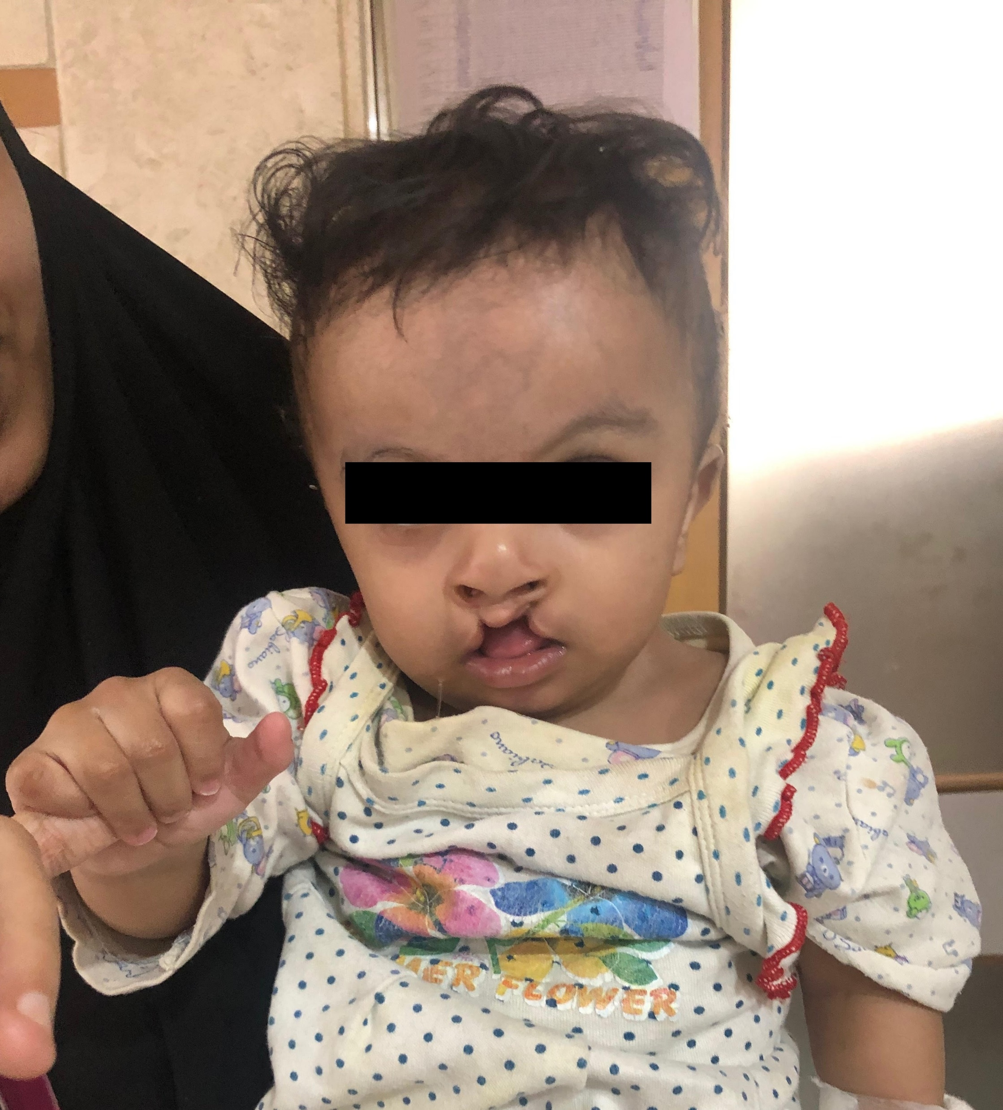
☺ THANK YOU ☺

