Slide 1
An Unusual Case of Hemiplegia
Dr Ridhima R Jakhotia
JR II
Department of MEDICINE

Slide 2
A 14 year old, adolescent
Chief complaints
Progressive left sided weakness of the body x 2-3 months
Generalized tonic clonic convulsion(GTCS) x 5 days

Slide 3
History
Patient had first episode of GTCS at the age of four months for which he was started on antiepileptics
The episodes continued as the treatment was irregular.
Each episode lasted for about 2-3 minutes
Associated with tongue bite.
Soiling of clothes.
Post-ictal loss of consciousness for approximately 5 minutes.

Slide 4
There was sudden onset weakness of left upper and lower limb 3 months ago.
The weakness was progressive.
CT scan of brain was suggestive of right cerebral hemisphere atrophy.
History of developmental delay.

Slide 5
Physical Examination
Gait - Hemiplegic
Hemodynamically stable.
Psychological examination suggestive of intellectual disability.
Mini mental status examination – Score – 15 suggesting moderate cognitive impairment.

Slide 6
Single large erythematous patch over right side of the face along the distribution of trigeminal nerve.
Eye examination - normal.
Intraocular pressure-normal.
Oral examination - Right sided gingival hypertrophy while the left side was normal.
No signs of bleeding from any site.

Slide 8
Investigations

Slide 9
X-ray Skull
TRAM TRACK CALCIFICATIONS

Slide 10
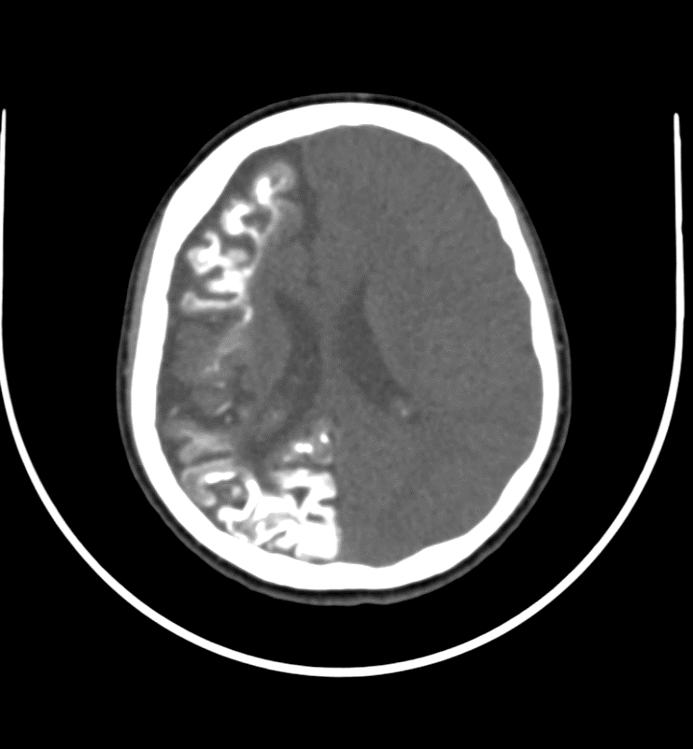
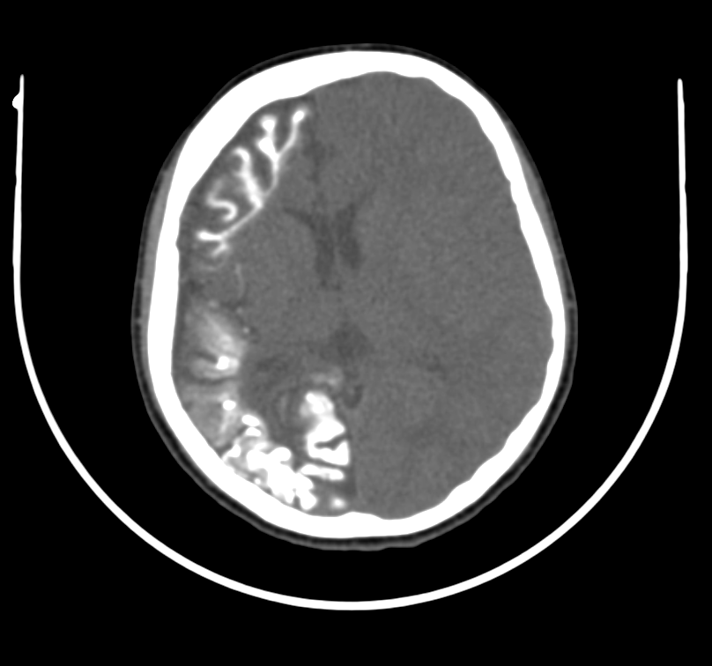
CT Brain

Slide 11
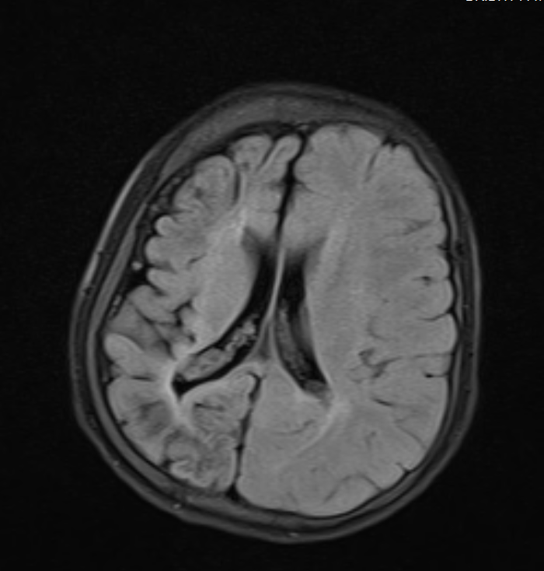
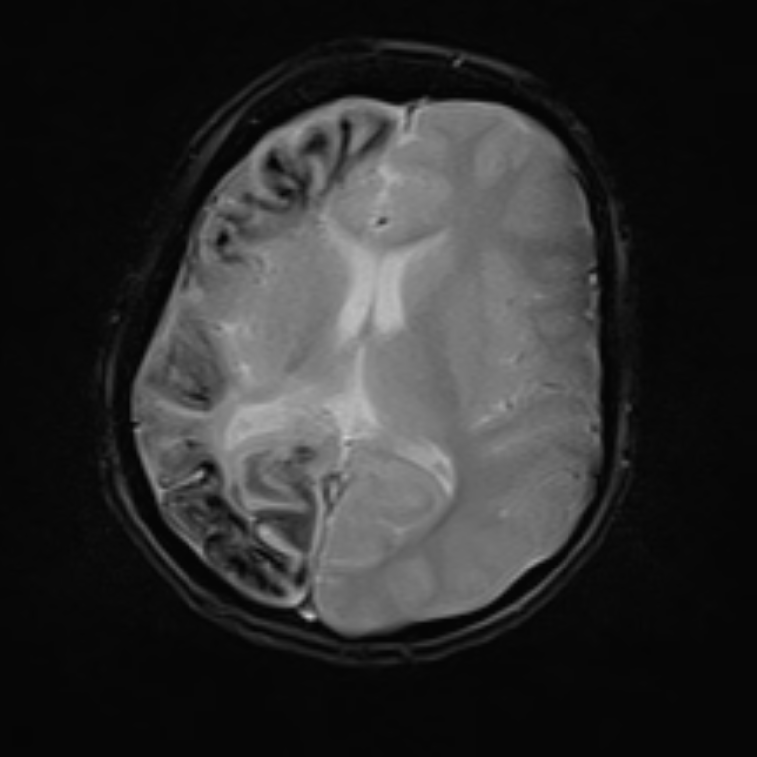
MRI Brain

Slide 12
EEG showed slow wave activity over the right side.
Based on the clinical history , physical examination and radiological evaluation ,a diagnosis of Sturge Weber Syndrome was made.

Slide 13
Treatment
Antiepileptics : Tab Carbamazepine 100 mg two times a day.
Maintain oral hygiene.
Physiotherapy
Professional counselling - to overcome their social problems and improve the outcome of the treatment.

Slide 14
He is regularly being screened for further complications like bleeding.
On his next visit after 3 months, the patient’s relative affirmed that there were no episodes of seizure and that he is taking antiepileptics regularly.

Slide 15
Discussion
Sturge Weber syndrome also known as Encephalofacial angiomatosis belongs to a group of disorders known as phakomatosis.
Incidence - 1 in 50000 persons.
W. Allen Sturge in 1879,described a child with sensorimotor seizures contralateral to a facial “port wine mark,” and Parkes Weber in 1922 gave the first radiographic demonstration of the atrophy and calcification of the cerebral hemisphere ipsilateral to the skin lesion.

Slide 16
It is a rare congenital but non-hereditary condition, and is characterized by presence of facial angioma ,ipsilateral leptomeningeal angioma and glaucoma.
Seizures - primarily partial motor or generalized tonic clonic type or both.
Refractory epilepsy - surgical procedures including focal cortical resection , hemispherectomy and corpus callosotomy.

Slide 17
Sturge weber syndrome is classified according to Roach’s scale : -
Type I – Both facial and leptomeningeal angiomas ; may have glaucoma.
Type II – Facial angiomas alone ; may have glaucoma.
Type III – Isolated leptomeningeal angiomas ; usually no glaucoma.

Slide 18
Intra-oral angiomas can cause bleeding.
When needed combination of gingivectomy and LASERS-NdYag should be used.
Facial angiomas can be treated using dermabrasion,various pulsed-dye lasers,pulse light sources.

Slide 19
REFERENCES
Adams And Victor’s –Principles of Neurology , 10th edition
Thomas-Sohl KA,Vaslow DF,Maria BL. Sturge-Weber syndrome:a review.Pediatr Neurol.2004 May. 30 (5):303-10
Sharan S ,Swamy B, Taranath DA,et al.
Port-wine vascular malformations and glaucoma risk in Sturge-Weber syndrome . J AAPOS 2009 Aug.13(4):374-8

