Slide 2
Dr. D. Y. Patil Medical College, Hospital
& Research Centre, Pimpri, Pune
&
Alumni Association
Of Dr. D. Y. Patil Medical College, Hospital
& Research Centre, Pimpri, Pune
Online Alumni Meet - 2020
Online Alumni Meet 2020

Slide 3
Date – 12th September 2020
Watch Live at 6 pm
Audience link for Zoom
Online Alumni Meet 2020
Meeting ID : 91387211002
Passcode: 669308
Please click the link below to join the webinar: https://dpu-edu-in.zoom.us/j/91387211002?pwd
=YTNtM2FyVEtRbXRWWkFQSi9VaGRGUT09 Passcode: 669308

Slide 4
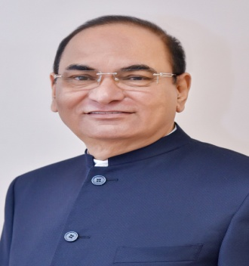
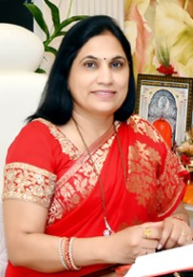
Patrons
Hon. Dr.P. D Patil
Chancellor, DPU Pune
Hon. Dr. Bhagyashree Patil
Pro Chancellor, DPU Pune

Slide 5
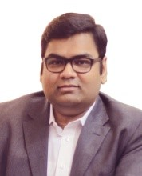
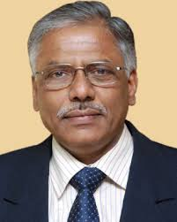
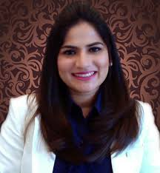
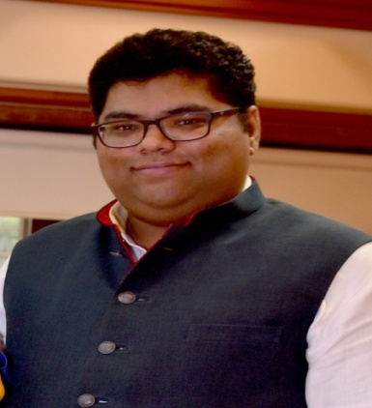
Guests of Honor
Dr. N. J. Pawar
Vice Chancellor, DPU Pune
Dr.Somnath Patil
Secretary , DPU
Pune
Dr.Smita Jadhav
Trustee, DPU
Pune
Dr. Yashraj Patil
Treasurer, DPU
Pune

Slide 6
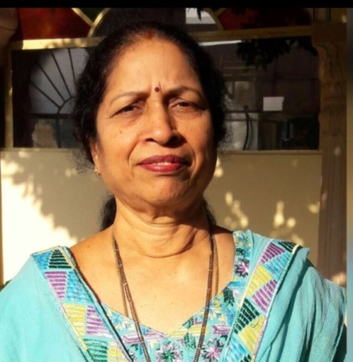
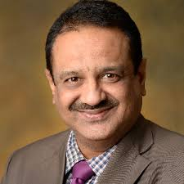
Organizers
Dr. (Brig) Amarjit Singh
Principal Director
& CEO
Dr. P. Vatsalaswamy
Director
Academics
Dr. J. S .Bhawalkar
Dean

Slide 8
Online Alumni Meet - 2020
Featuring ….

Slide 9
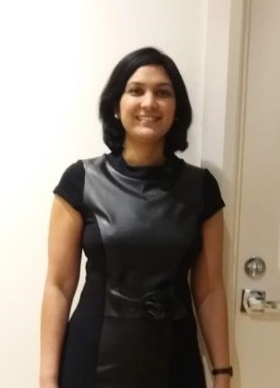
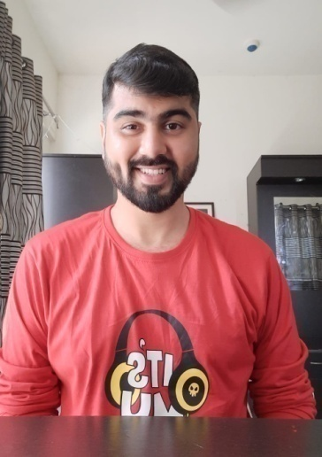
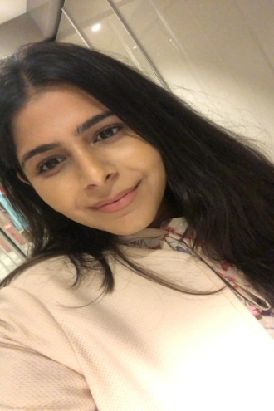
Hosts
Dr.Aabha Kalro
Batch 1997
Dr.Krushal Pabari
Batch 2012
Dr.Riddhima Malik
Batch 2014

Slide 10
Gulshan & Pooja

Slide 12
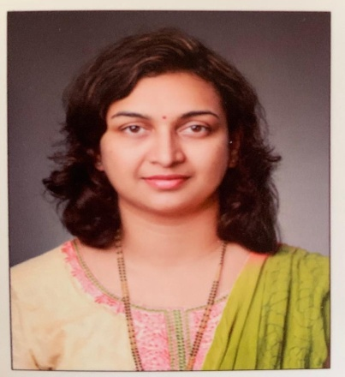
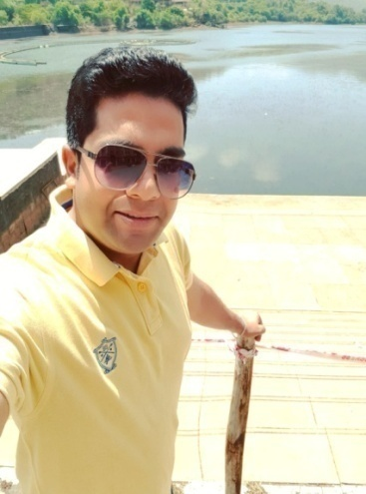
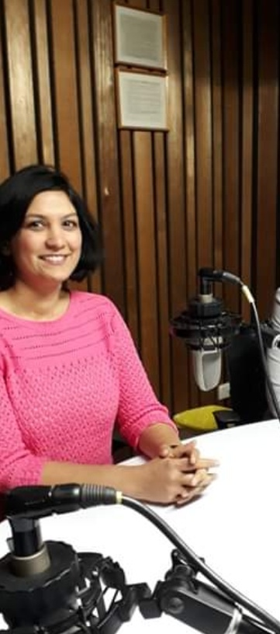
Dr.Kareeshma
Wadia
Batch 2002
Dr Aishwarya
Thakre
Batch 1998
Dr.Nilesh Agarwal
Batch 2012
Dr.Aabha Kalro
Batch 1997

Slide 13
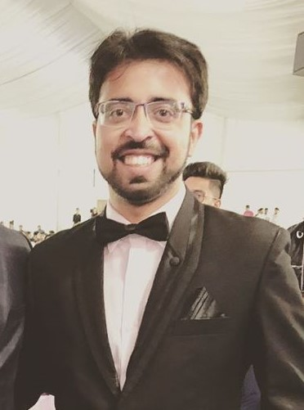
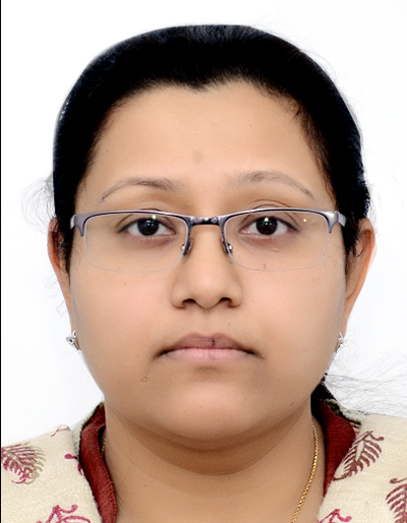
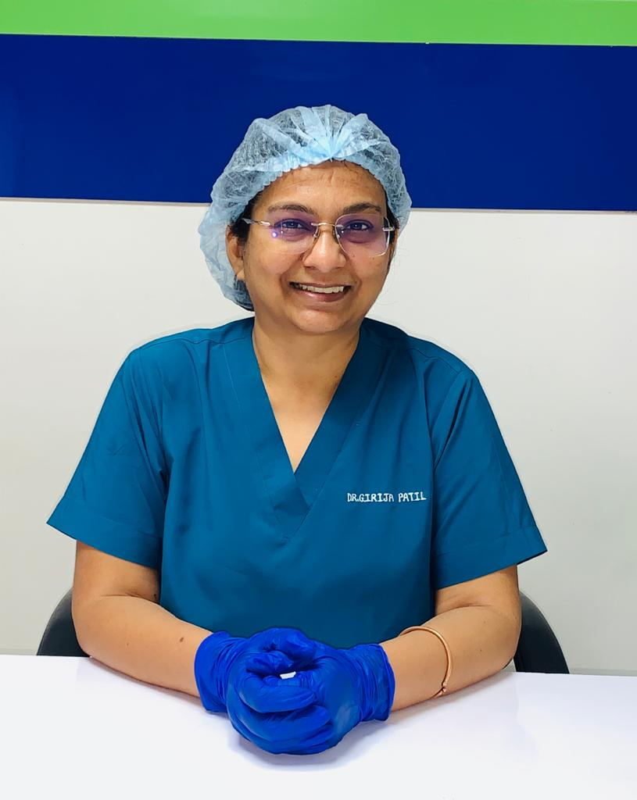
Dr.Rohan Rajwardhan
Batch 2012
Dr.Manjari Agarwal
Batch 1996
Dr.Rutuj Mali
Batch 2013
Dr.Girija Patil
Batch 1996

Slide 14
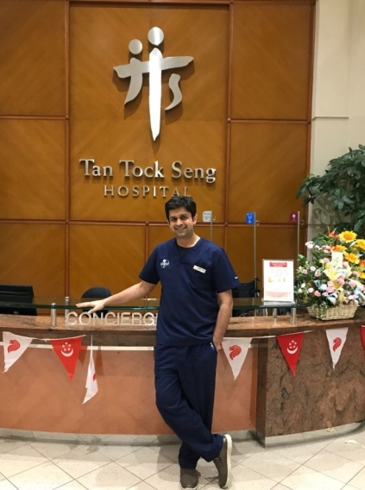
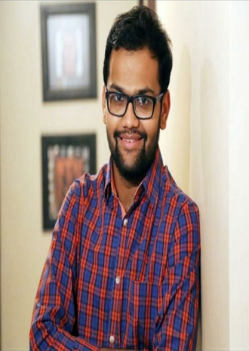
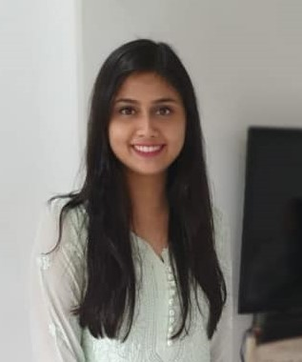
Dr.Sarang Gotecha
MS Batch -2009,2012
Dr.Rutuja Raktkanthiwar
Batch 2012
Dr.Nikhil Toshniwal
MS Batch 2017
Dr. Isha Oak
Batch -2012

Slide 15
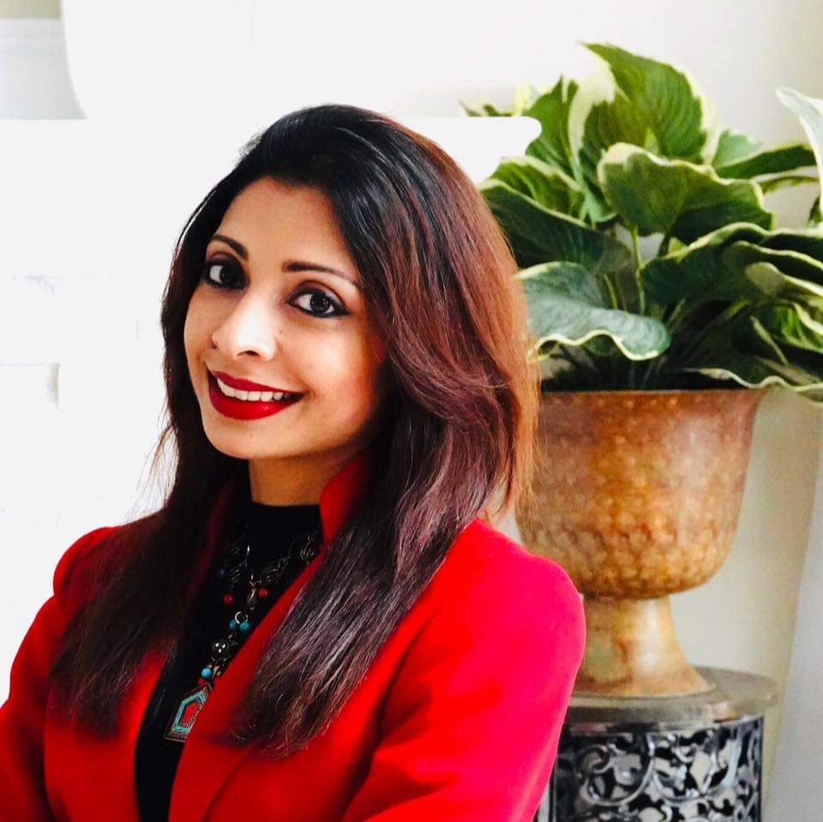
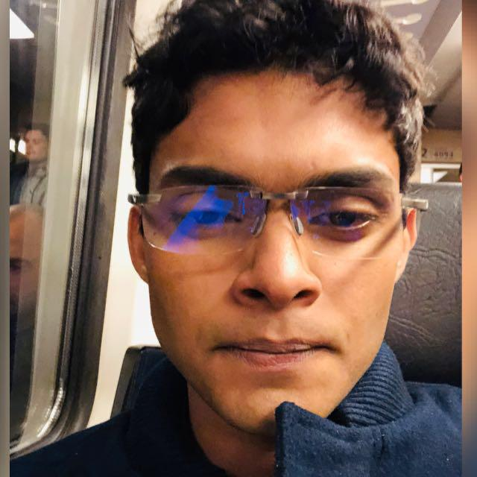
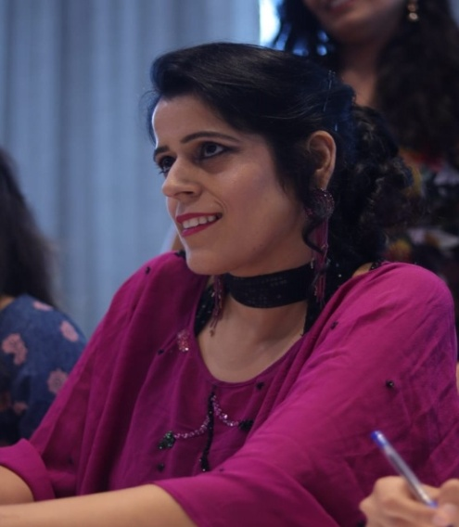
Dr. Kavyachand
Yalamudi
MD, Batch 2012
Dr.Renu Deshpande Joshi
Batch 1996
Dr.Anuj Nayak
Batch 2012
Dr.Ritu Malhotra Lokhande
Batch 1996

Slide 17
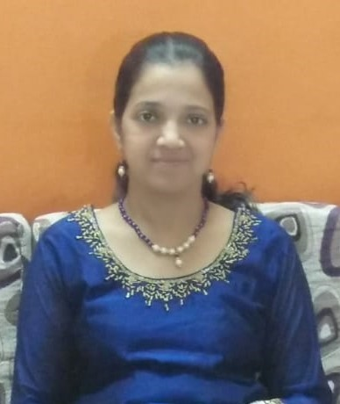
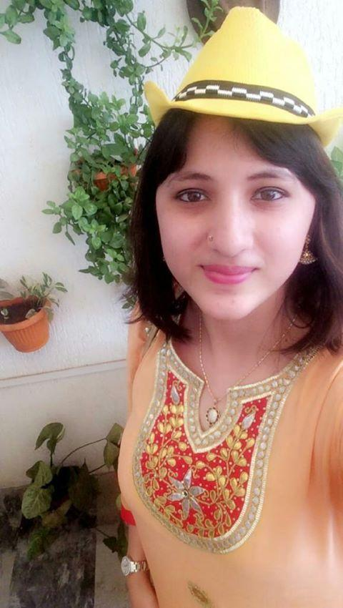
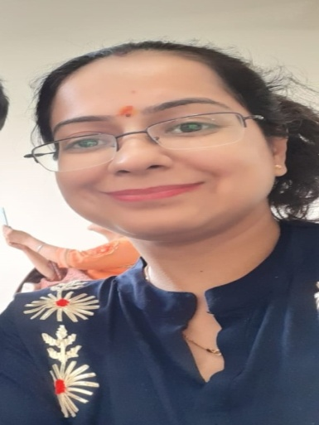
Dr.Dhrithi Mushthi
Batch 2014
Dr.Gayatri Kulkarni
Batch 1996
Dr.Riddhi Bora
Batch 2013
Dr.Jaspreet Kaur Nagpal
Batch 2000

Slide 19
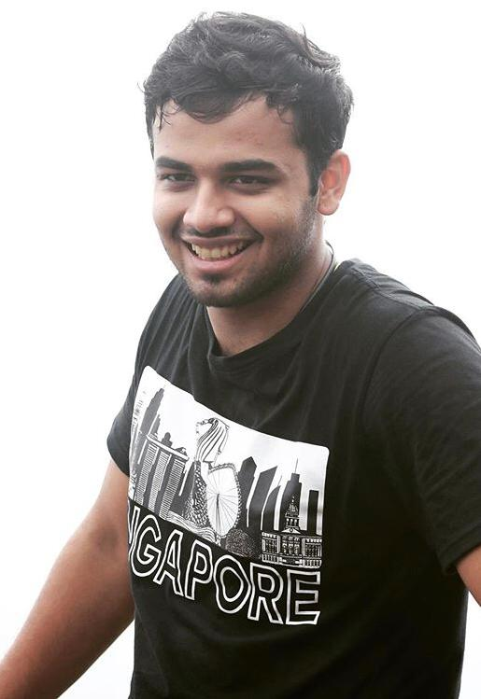
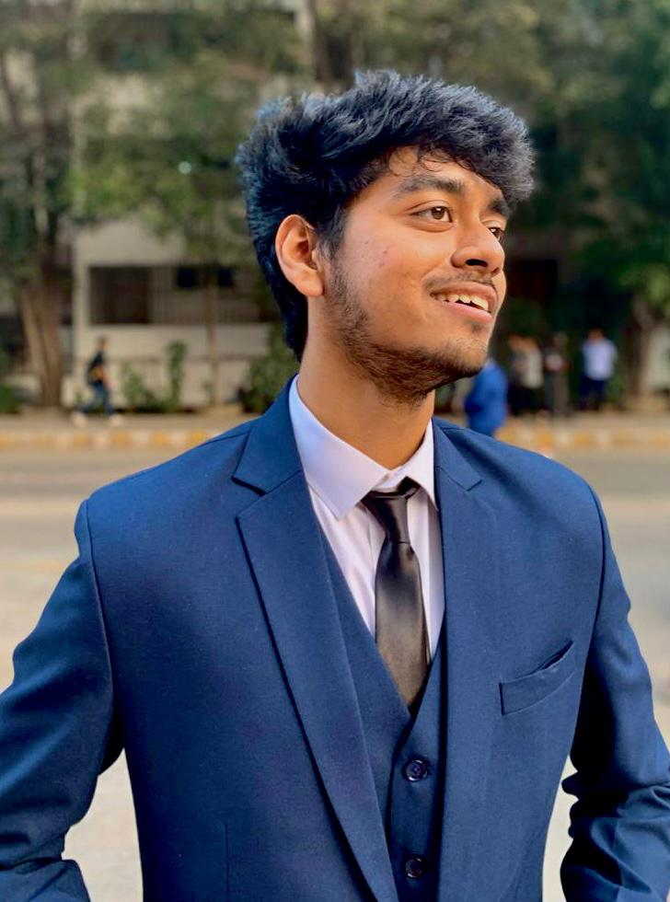
सफर...
Music by
Anand Godbole
Directed by
Dr. Srishti Mohapatra
Cinematography by
Prince Saha

Slide 20
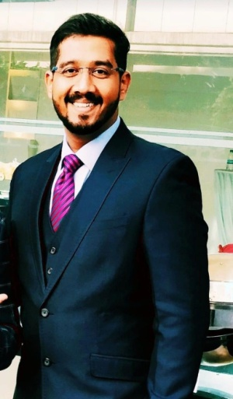
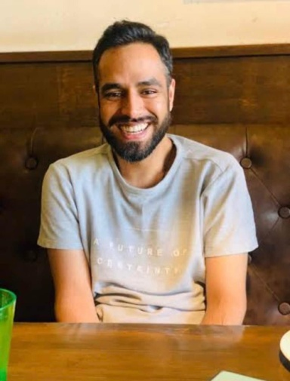
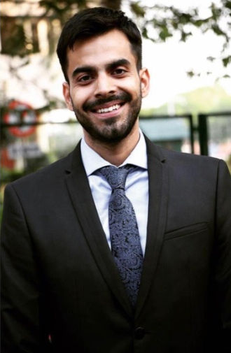
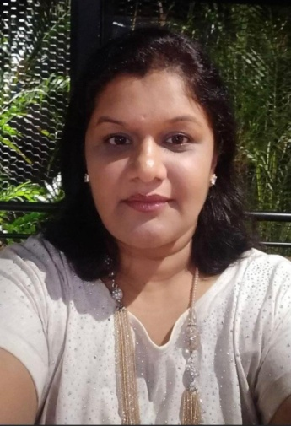
सफर...
Starring
Dr. Ashwin Deshmukh
Dr. Yashraj Patil
Dr. Asim Naik
Dr. Prashant Punia
Dr. Radhika Paranjpe

Slide 21
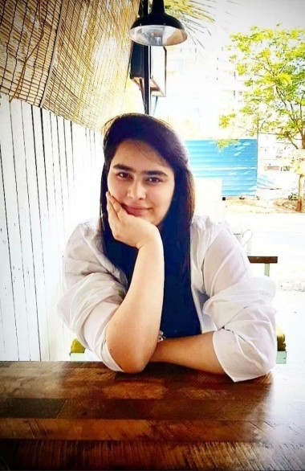
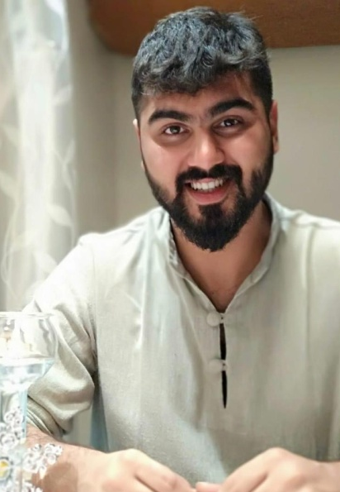
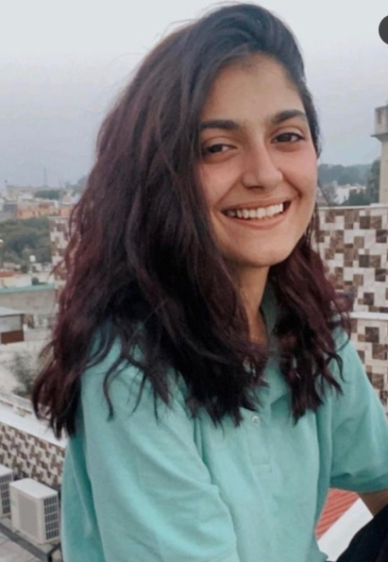
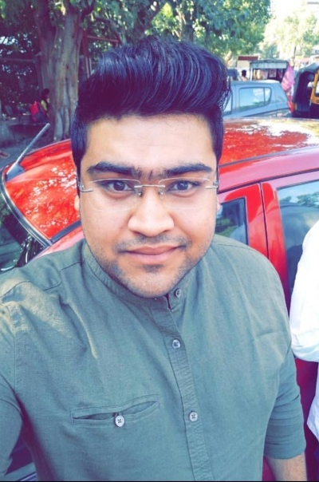
सफर...
Starring
Dr.Amodini Arora
Dr.Krushal Pabari
Dr.Aishwariya Koul
Dr.Sharad Rawat

Slide 22
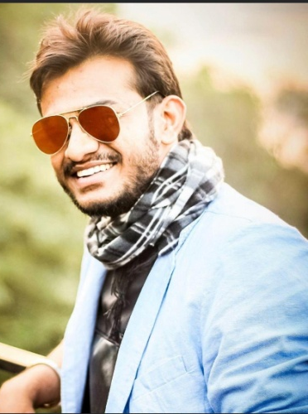
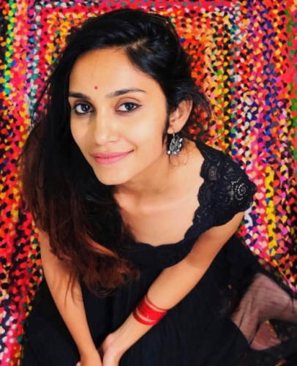
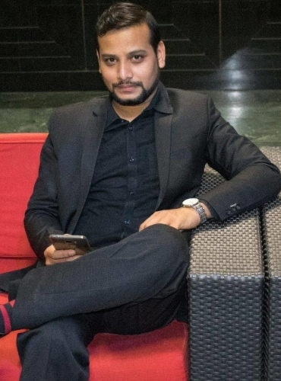
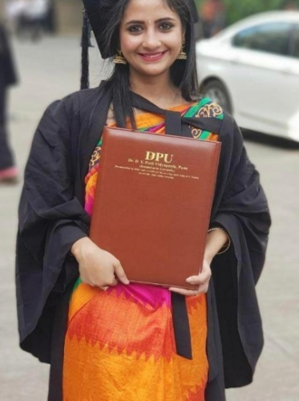
सफर...
Starring
Dr. Alok Gangurde
Dr. Samantha Dhulipala
Dr.Neelesh Kanaskar
Dr.Arpita Krishna

Slide 23
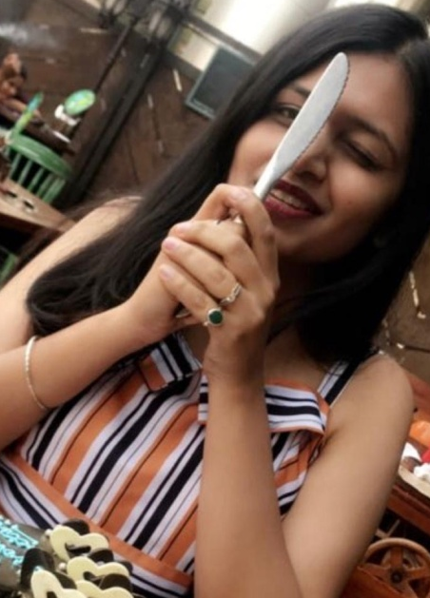
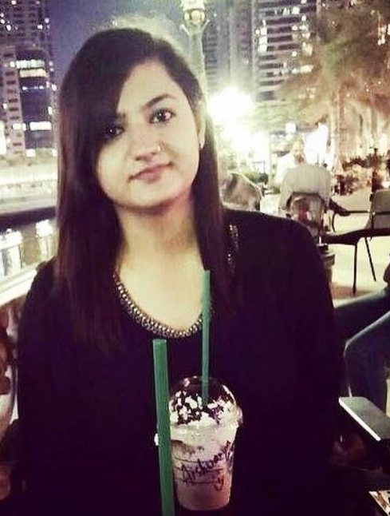
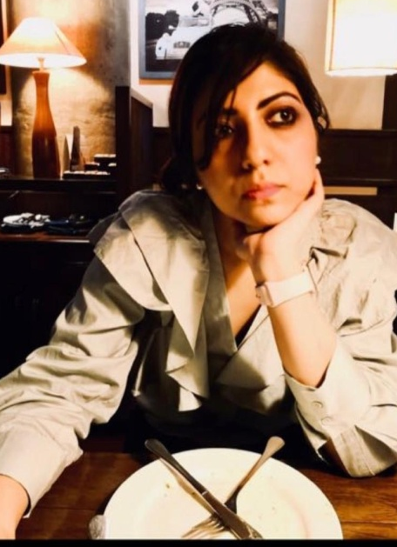
सफर...
Starring
Dr. Komal Khemchandani
Dr.Aishwarya Batra
Dr. Hakeem Sabreena
Dr.Harsh Vardhan Singh

Slide 24
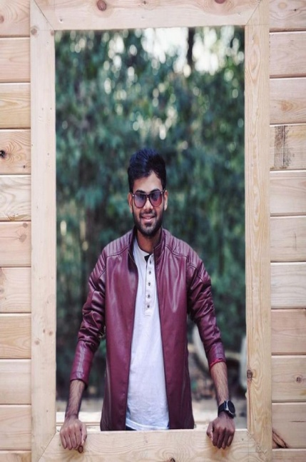
सफर...
Starring
Dr. Sagar Shah
Dr. Yurica Moirangthem
Dr. Sayoog Sukrethan
Dr. Sarang Gotecha

Slide 25
Coming Soon…

