Slide 1
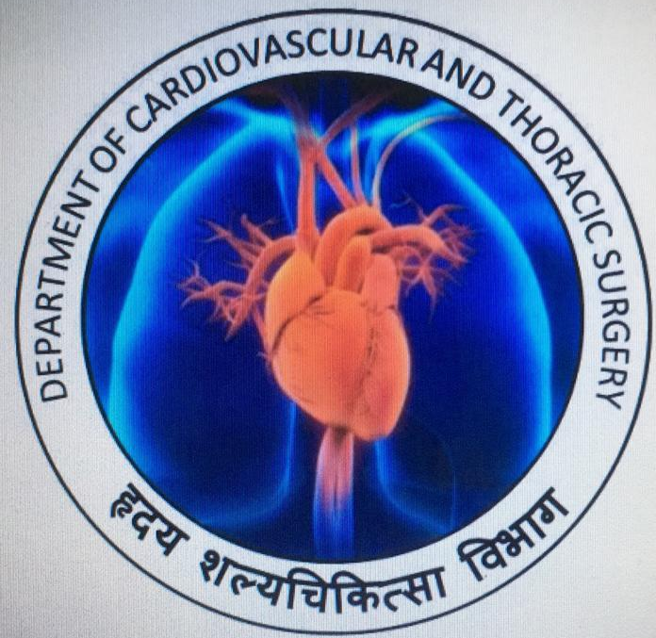
Congenital Heart Disease in Adults: 2 Rare Cases
Dr. Ranjit D. Pawar (MS, MCh– CVTS)
Assistant Professor
Dept. of CVTS

Slide 2
case- 1: COARCTATION OF AORTA
20 Yrs./ Male
Complaints: Headache, Giddiness, Dyspnoea on exertion
K/c/o HTN, taking Tab Amlo 5 mg OD X 2 yrs
No other significant personal/ family/ past history

Slide 3
Clinical examination:
Pulse: 90/min
BP: Upper Limbs- 190/120 mm Hg;
Lower Limb- 100/70 mm Hg
CVS: NAD
ECG: Left axis deviation, LVH strain pattern
2D ECHO: Concentric LVH
Narrowing of Prox. Descending aorta
COARCTATION of AORTA beyond left CCA

Slide 4
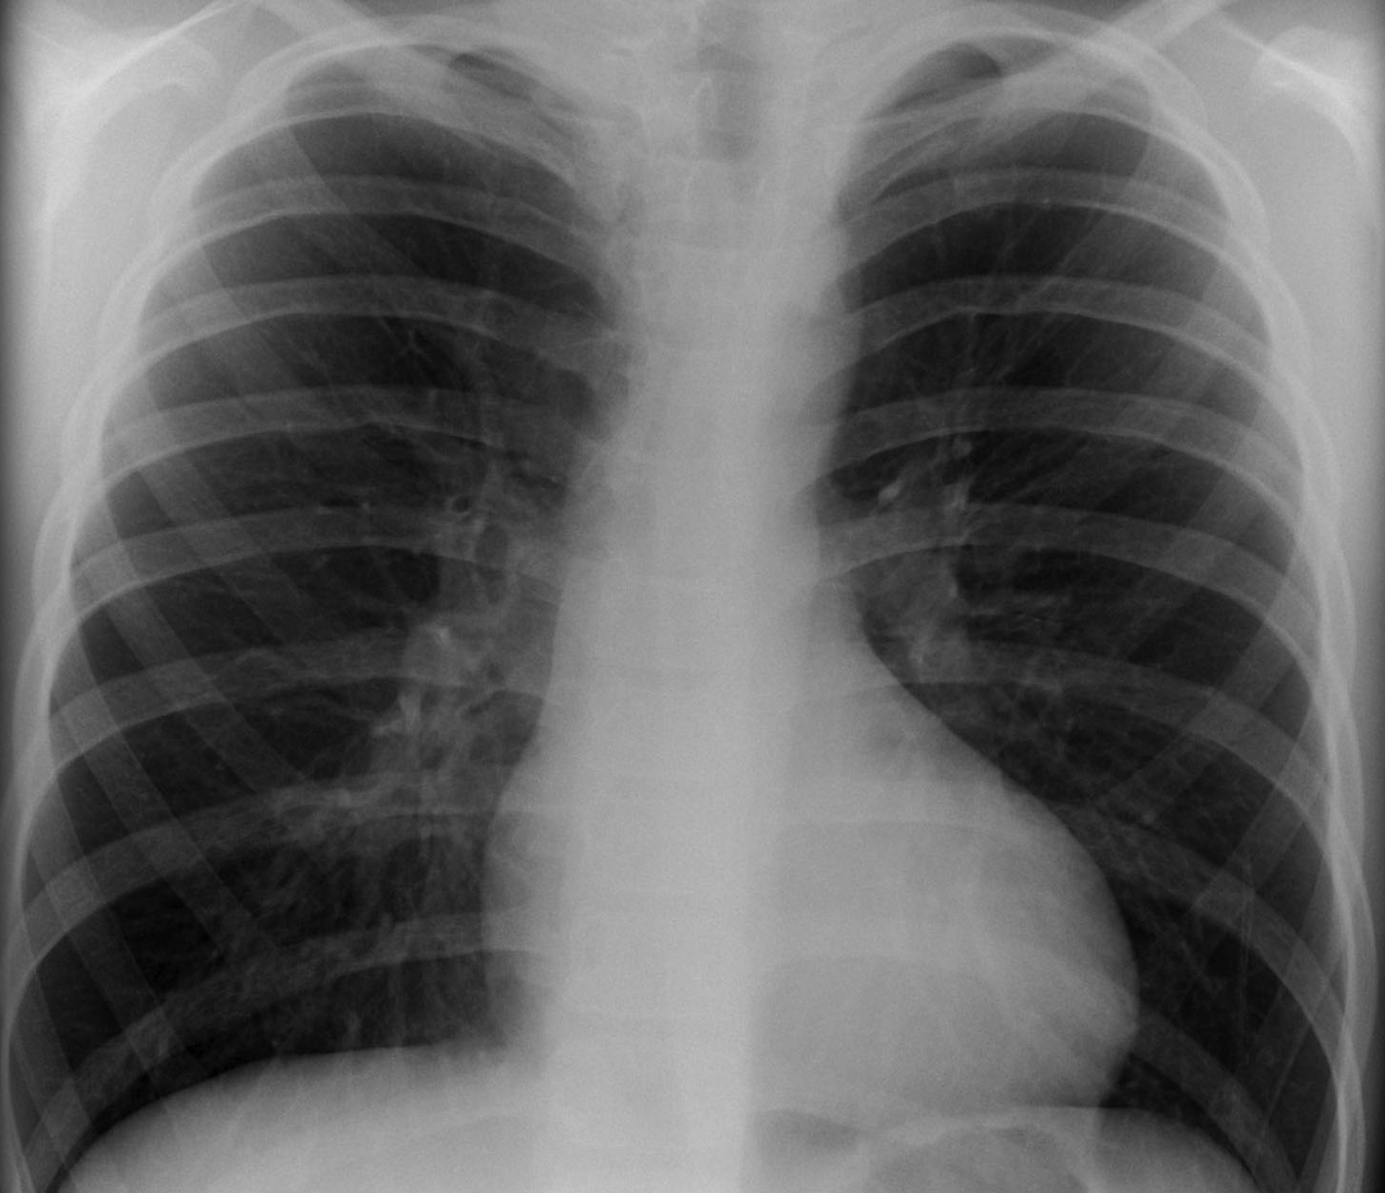
Chest X ray
2D Echo
Rib Notching

Slide 5
CT Aortogram
Post ductal Co-arctation of aorta
Distal transverse arch narrowed
Multiple dilated collateral channels

Slide 6
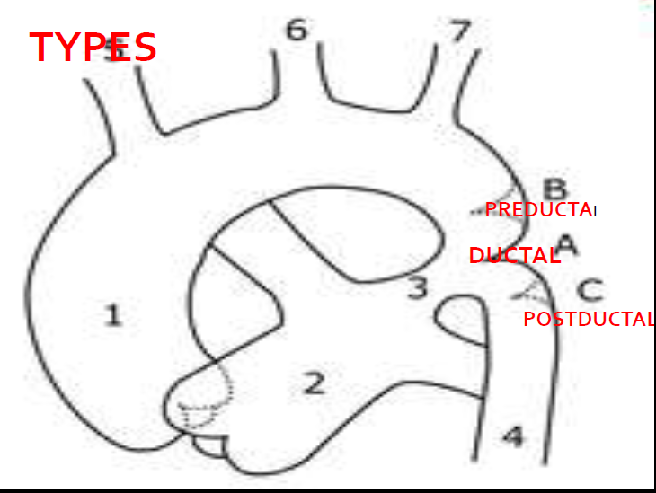
(DEFINITION):
Localised narrowing of the aortic arch, just distal or proximal to the ductus or ligamentum arteriosus
Notes:
Infancy: DEPENDS ON PATENCY OF PDA
○ ShocK and HF
○ METABOLIC DISTURBANCES
○ Hypo perfusion
○ Renal failure
Childhood:
Upper extrimity HTN
○ Widened pulse pressure
○ Varibility in rt and lt arm pressures
○ Murmurs
Others:
Intermittent claudication
▪Dyspnea on running

Slide 7
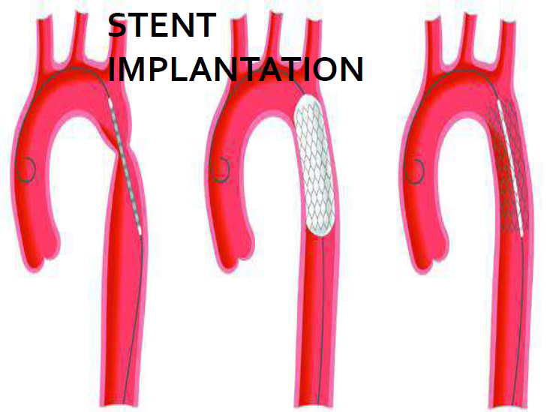
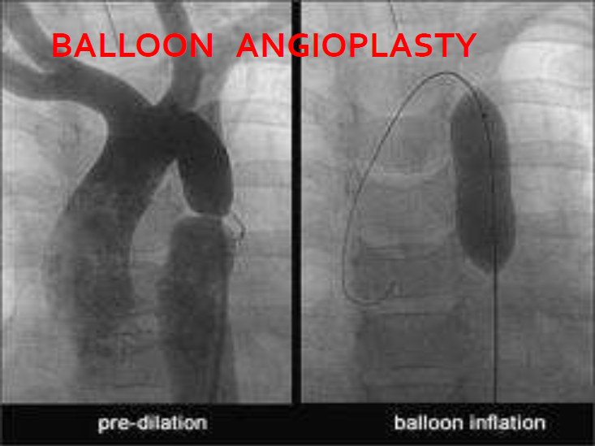

Slide 8
CT Aortogram:
Z SCORE
Prox Arch | 14 mm | -3.09
Distal Arch | 12 mm | -2.91
Isthmus | 3 mm | -10.50
Desc. Ao | 18 mm | 0.85

Slide 9
Management Considerations:
Long segment of narrowing
Not possible to mobilize adequate length for End- to- End anastomosis
Hypoplastic distal Transverse arch
Not suitable for proximal anastomosis
Dilated Tortous left subclavian Artery
Risky to handle- may cause torrential hemorrhage if damaged
Multiple dilated Collaterals
Intercostal arteries- important spinal cord blood supply
Left recurrent laryngeal nerve turns around ligamentum arteriosum

Slide 10
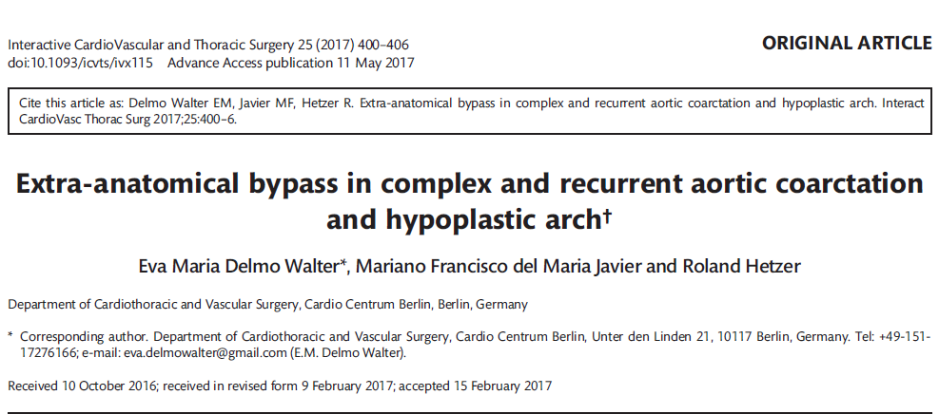
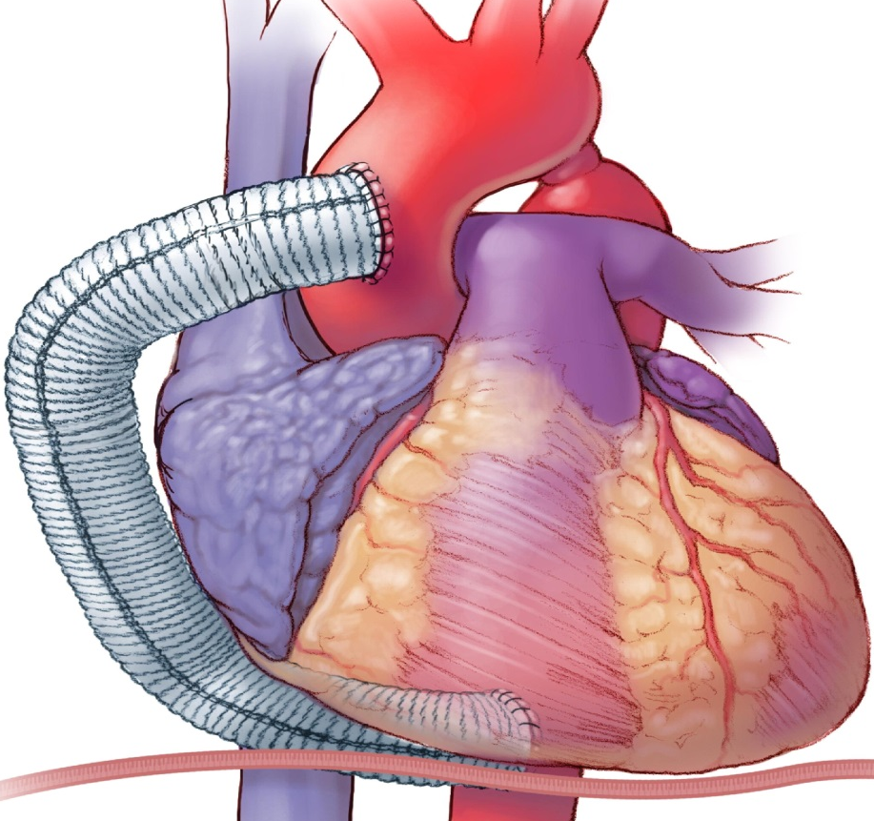
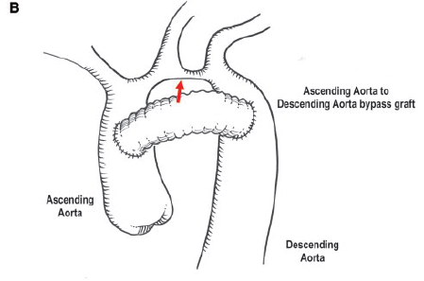
Alternative & Novel Approaches

Slide 11
Surgical Challenges:
Suitable proximal and distal Target zones
Distal landing zone behind left bronchial origin
Mobilize Left pulmonary hilum downwards
Preserving as many as intercostal arteries

Slide 13
Outcome:
Pt recovered well
Equalisation of BP in upper and lower extremities
discharged home on 5th post op day
3 month follow up done

Slide 14
case- 2: CORONARY ARTERIOVENOUS FISTULA
28 Yr/ Male
Chest Pain, Dyspnoea on exertion since 4 yrs, more since last 6 mths
No DM/ HTN/ Smoking/ Alcohol
No significant family history

Slide 15
Clinical Examination:
Pulse- 94/min
BP- 134/76 mm Hg
CVS- S1, S2 Normal.
Continuous murmur at Pulmonary area
ECG- WNL
2 D ECHO: LVEF-60%, PASP- 30 mm Hg, No PAH

Slide 16
Coronary Angiogram
Fistulous tract originating from Prox Diagonal & draining into superior chamber
Rest other coronaries Normal

Slide 17
What is Coronary AV Fistula
(DEFINITION):
Direct communication between a coronary artery and the lumen of any one of the four cardiac chambers or its tributaries
The fistula, if not present at birth, develops early in life.
Origin:
Right coronary A : 50 ~ 55%, Left coronary A : 35%
Drainage:
Right ventricle : 40% Right atrium : 25%
Pulmonary artery : 15-20%
Notes:
slowly increase in size, although there may be little change over a 10 to 15 year period.
2) Onset of dyspnea, heart failure, and angina can occur in young patients with large fistula.
3)The maximum incidence of congestive heart failure occurs in the fifth and sixth decades

Slide 18
CT Coronary Angiogram:

Slide 19
Surgery:

Slide 20
Fistula opening-
closed from inside the Pulmonary Artery
Fistula tract-
Flush ligation near origin from coronary artery with multiple clipping along tract

Slide 21
Outcome:
Patient discharge home on 5th POD
On regular follow up, Doing well
Symptom free at one month follow up

Slide 23
Coronary Arterio-venous Fistula
DEFINITION
Direct communication between
a coronary artery
and
the lumen of
any one of the four cardiac chambers
or
the coronary sinus or its tributary vein
or
Superior /inferior Vena Cava
or
pulmonary artery or Pulmonary veins close to the heart

Slide 24
Morphology
1. Coronary artery site : dilated, elongated, serpiginous
Right coronary A : 50 ~ 55%, Left coronary A : 35%
Both : 5%
2. Site of fistulous connection
Right coronary A : 50 ~ 55%, Left coronary A : 35%
Right ventricle : 40% Right atrium : 25%
Pulmonary artery : 15-20% Coronary sinus : 7%
SVC : 1% Left atrium : 5%
Left ventricle : 3% Other : rarely
3. Size & multiplicity of the fistula
2 ~ 5mm fibrous margin, single or multiple opening
4. Cardiac chamber : dilation in atrial, venous drain site
5. Bacterial endocarditis : 5%
6. most occur as isolated lesions

Slide 25
Natural history
The fistula, if not present at birth, develops early in life.
slowly increase in size, although there may be little change over a 10 to 15 year period.
Onset of dyspnea, heart failure, and angina can occur in young patients with large fistula
The maximum incidence of congestive heart failure occurs in the fifth and sixth decades.
Notes:
Spontaneous rupture and closure is very rare

Slide 26
Clinical features & diagnosis
1. Presentation: Most present late age in life
2. Symptoms:
Asymptomatic in young age
Mild cardiomegaly
Plethora on chest X-ray
DOE from Lt. to Rt. shunt
Angina (7%)
Myocardial infarction (3%)
Congestive heart failure (12 ~ 15%) in old age
3. Diagnosis: Continuous murmurs
EKG
Chest radiography
Echocardiography
Cardiac catheterization, and angiography

Slide 27
Technique of operation
1. Closed without CPB
When termination of a major coronary artery
branch into an easily accessible site
2. When CPB is used
when artery is dilated & tortuous
relatively inaccessible as in AV groove
when the fistula is in the course of coronary artery
when an aneurysm requires excision
Methods
a. Closure through arteriotomy & aneurysm repair
b. Closure through chamber

Slide 28
Surgical indications & results
1. Survival
◎ Early death
Hospital mortality : rare
Complication : rare
◎ Time related
Late results : excellent
2. Indications
Diagnosis is an indication for operation unless the shunt is very small (QP/QS<1.3)

Slide 29
There is localised narrowing of the aortic
arch, just distal or proximal to the ductus
or ligamentum arteriosus

Slide 31
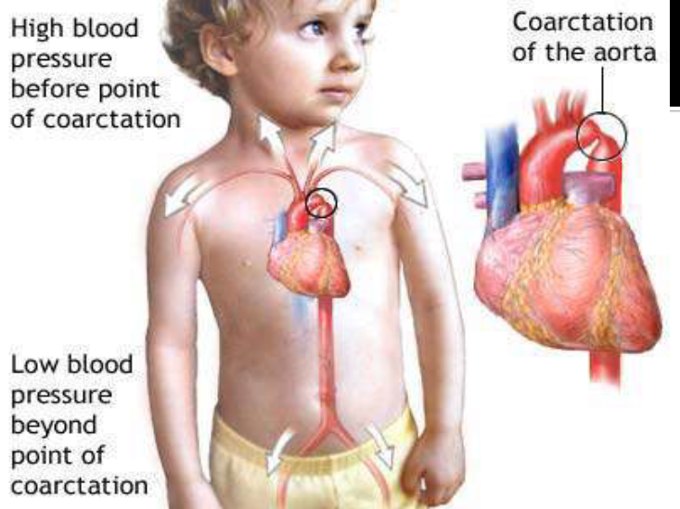

Slide 32
Clinical features
Infancy: DEPENDS ON PATENCY OF PDA
○ ShocK and HF
○ METABOLIC DISTURBANCES
○ Hypothermia
○ Hypoglycemia
○ Hypo perfusion
○ Renal failure
Childhood:
Upper extrimity HTN
○ Widened pulse pressure
○ Varibility in rt and lt arm pressures
○ Murmurs
Others:
Intermittent claudication (due to a
temporary inadequate supply of
oxygen to the muscles of the leg)
▪ Pain and weakness of legs and
▪Dyspnea on running

Slide 33
POTENTIAL COMPLIATIONS OF
SURGERY
■ Recoarctation
■ Paradoxical hypertension
■ Paraplegia
■ Recurrent laryngeal nerve injury
■ Left arm ischemia
■ Hemorrhage
■ Aneurysm formation
■ Chylothorax
■ Horner’s syndrome
■ Phrenic nerve injury
■ stroke

Slide 34
Turners syndrome
○ Bicuspid aortiv valve 30-40%
○ VSD
○ PDA
○ Aortic stenosis
○ Mitral stenosis
○ Intra cerebral associations

