Slide 1
ANAESTHETIC MANAGEMENT OF A CASE OF SEVERE KYPHOSCOLIOSIS FOR LEFT PERCUTANEOUS NEPHROLITHOTOMY (PCNL).
PRESENTOR :- Dr. Ashwini Khamborkar (JrIII anaesthesia)

Slide 2
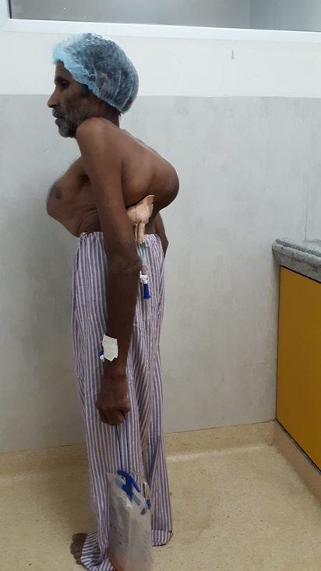
Chief complaints
50 years old male patient came to our hospital with the chief complaint of left sided abdominal pain since 6 months.
Patient was apparently alright 6 months back when he started having left sided abdominal pain.
Patient had no other complaints.
DJ stenting was done 10 days back under local anaesthesia.

Slide 3
Past history
Patient had no similar complaints in past.
Patient was not a known hypertensive, diabetic.
No history of any other medical illness.
Patient was not on any prolonged medications
NYHA grade-2

Slide 4
Personal history
Patient was not able to lie supine or in prone position since birth.
but he carries out his daily activities well.
Bowel bladder habits normal.
Sleep pattern normal.
Family history
Not significant

Slide 5
General examination
Patient was conscious cooperative well oriented with time place and person.
Weight-35 kg
Height- 135 cm
Pulse- 86 beats per minute. Normovolemic, regular.
Blood pressure- 130/80 mm/hg
No pallor, oedema, cyanosis, clubbing, lymphadenopathy.
Nephrostomy tube in situ on left side

Slide 6
Airway examination
Mouth opening :- 2 and half fingers
Neck movements- restricted
MPC-3
Poor Oral hygiene.

Slide 7
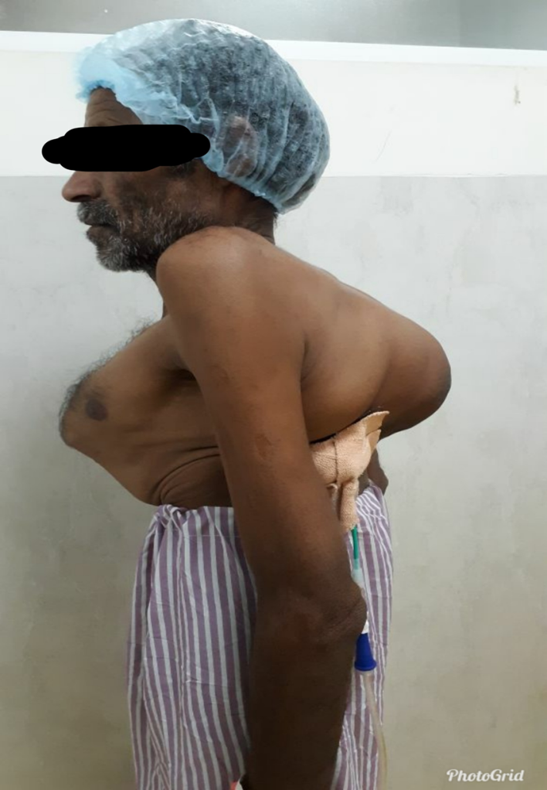
Systemic examination
Respiratory system.
INSPECTION
Shape
Profound pectus carinatum present.
Kyphoscoliosis present
Anteroposterior diameter is more that transverse diameter.
No scar, sinuses seen.
Respiratory rate
30/ min abdominothoracic, regular
Accessory muscles mainly sternocleidomastoids were involved.
Chest movements were bilaterally equal

Slide 8
PALPATION
Inspectary findings confirmed by palpation.
Chest movements decrease in all the areas.
TVF was normal.
No tenderness
PERCUSSION
Resonant note heard all over the lung field.
AUSCULTATION
Air entry bilaterally equal.
No adventitious sounds heard.

Slide 9
Cardio vascular system
S1, s2 heard normal.
No murmur.
Per abdominal examination
No organomegaly
No guarding or rigidity
Central nervous system
Conscious cooperative well oriented
No neuromuscular deficit

Slide 10
Investigation
Haemoglobin - 12.4 gm%
Platelets – 1.90 lakhs
Total Leucocyte count - 4800
Renal Function Test
sr. urea - 30
sr. creatinine – 1.04
Liver function test
total bilirubin – 0.29
direct bilirubin – 0.14
Sr. electrolytes. Na+/K+ - 141/4.6
Blood group- B ‘rh+’
Coagulation profile
Bleeding time- 1 min 32 sec
Clotting time- 4 min 35 sec
PT/INR- 13.8/ 1.0

Slide 11
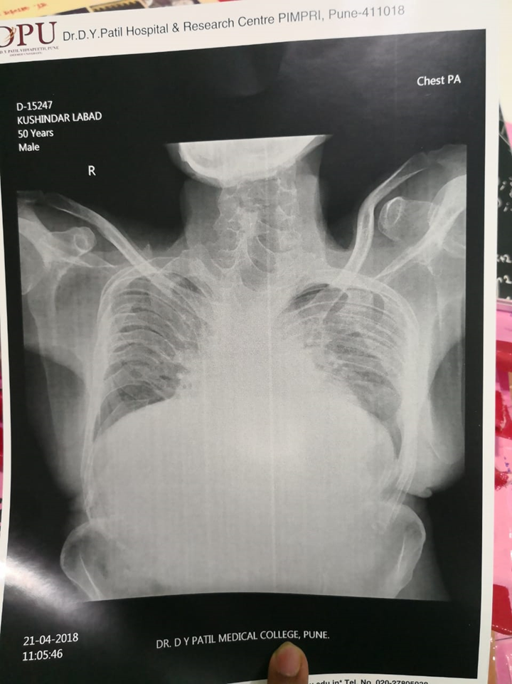
CXR- trachea appears to be shifted because of
obliquity of spine
lung fields are reduced.
Crowding of ribs more on left side than right
Broncho vascular markings increased.
ECG- normal study
2D echo- normal study. EF- 60%
PFT- Not able to perform
Breath holding time- 12 sec

Slide 12
Diagnosis
50 years old male patient with severe chest deformity posted for left sided PCNL.
Patient was accepted for surgery under ASA III with high risk, SICU ventilatory consent.

Slide 13
Anaesthetic challenges
Regional block is difficult due to distorted landmarks & anatomy.
And associated with complications such as
unpredictable block / failure rates
Possibility of high spinal anesthesia and if level goes high then it would affect respiratory muscles and makes it difficult to maintain acceptable spontaneous ventilation.
Difficulties in general anesthesia
Difficult airway management as
Our patient was not able to lie supine and it is difficult to intubate in lateral position.
Patient has a short neck and neck movements were restricted due to destructive vertebral body fusion.

Slide 14
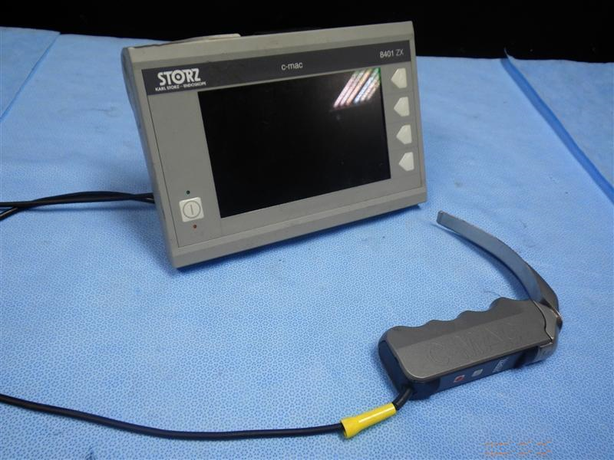
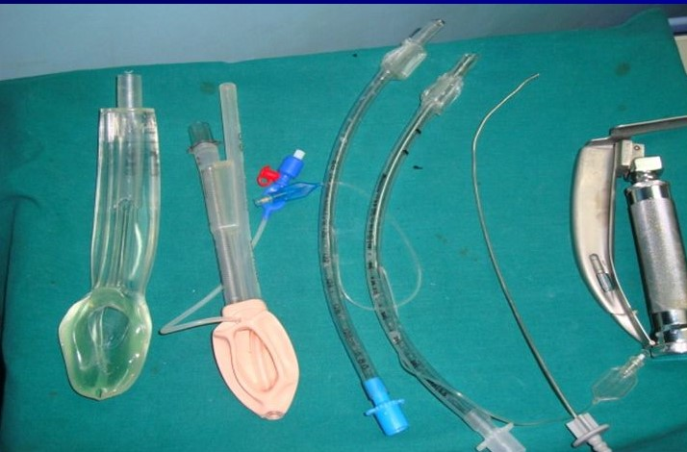
Preoperative preparation
General anaesthesia was planned.
Difficult intubation trolley along with c-mac video laryngoscope was kept ready.

Slide 15
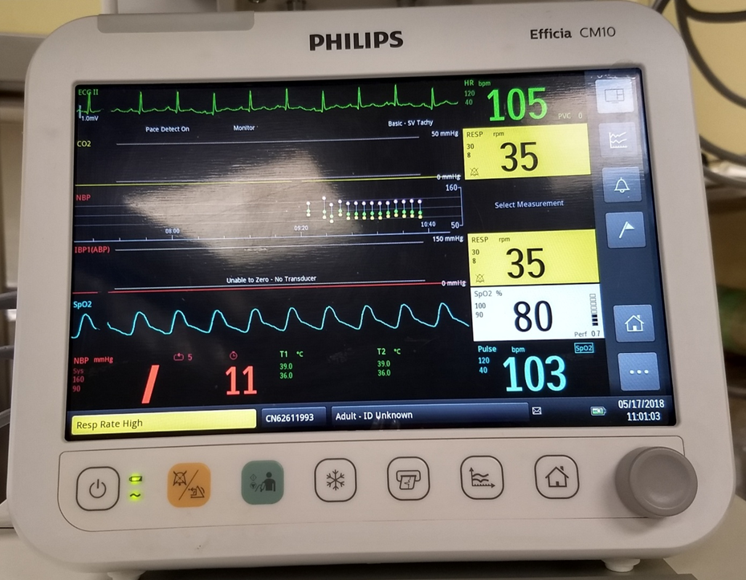
Preoperative preparation
Patient was kept nil by mouth for 6 hours.
After taking informed and high risk consent patient was shifted to operation room.
All monitors were attached.
Baseline vitals recorded
Pulse – 103/min
Blood pressure – 128/78mmHg
Sp02 – 80% on air
3 leads ECG – normal rhythm
Respiratory rate – 35/min

Slide 18
Anaesthetic management
In the lateral decubitus position in which patient is comfortable. Intravenous line was secured on left hand.
Patient preoxygenated with 100% oxygen for 5 min till spo2 becomes 100% to get the adequate apnoea time.
Premedication inj. Glycopyrrolate 0.14 mg, inj. Midazolam 0.7 mg, inj. Fentanyl 70 mcg.
Induced with inj. Propofol 100 mg.
After confirming that the patient could be ventilated well inj. Succinylcholine 70 mg in given as a relaxant.
With the help of assistant patients head was supported and extended laterally, laryngoscopy done with C-MAC video laryngoscope.
On video laryngoscopy only posterior part of vocal cords could be seen (Cormack & Lehane 2), intubation done with the help of bougie and cuffed flexometallic tube no 8 was put.

Slide 19
Patient’s chest and abdomen were supported with soft pillows in order to minimize abdominal pressure and preserve pulmonary compliance.
Maintained on oxygen, air and isoflurane as an inhalation agent.
Intraoperatively patient was stable and procedure was uneventful.
After the surgery patient was reversed with inj. Neostigmine 1.35 mg and inj. Glycopyrrolate 0.28 mg iv.
Patient extubated on table in the same lateral position and was maintaining spo2 90-92% on room air.
Patient shifted to SICU for 24 hrs post op monitoring and later on patient was shifted to ward.
Post op ABG showed mild respiratory acidosis.

Slide 21
Discussion
Kyphoscoliosis is a progressive spinal deformity characterized by anterior flexion and lateral curvature of the vertebral column.
It results due to disruption of balance between structural and dynamic components or the neuromuscular elements of spine.
The Severity of deformity is best determined by measuring cobb’s angle.
The incidence of kyphoscoliosis reaching an angle 35° is 1 in 1000, more than 70° is 1 in 10000

Slide 22
These patients have reduced lung compliance, smaller lung volumes and loss of thoracic elasticity, resulting in increased energy requirements for ventilation.
Severe long standing kyphotic deformities associated with V/Q mismatch, alveolar hypoventilation and Co2 retention and are more prone for respiratory failure.
Perioperative assessment should focus on cardiovascular, respiratory and neurological impairment related to deformity.

Slide 23
Cobb angle
Cobb angle measurement is the “gold standard” of scoliosis evaluation endorsed by Scoliosis Research Society.
Cobb’ s angle
< 10 ° : normal curvature
> 25 ° : ECHO evidence of increased pulmonary artery pressure
> 40 ° : surgical intervention required
> 65 ° : restrictive lung disease
>100 ° : dyspnoea on exertion
>120 ° : alveolar hypoventilation

Slide 24
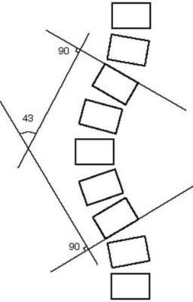

Slide 25
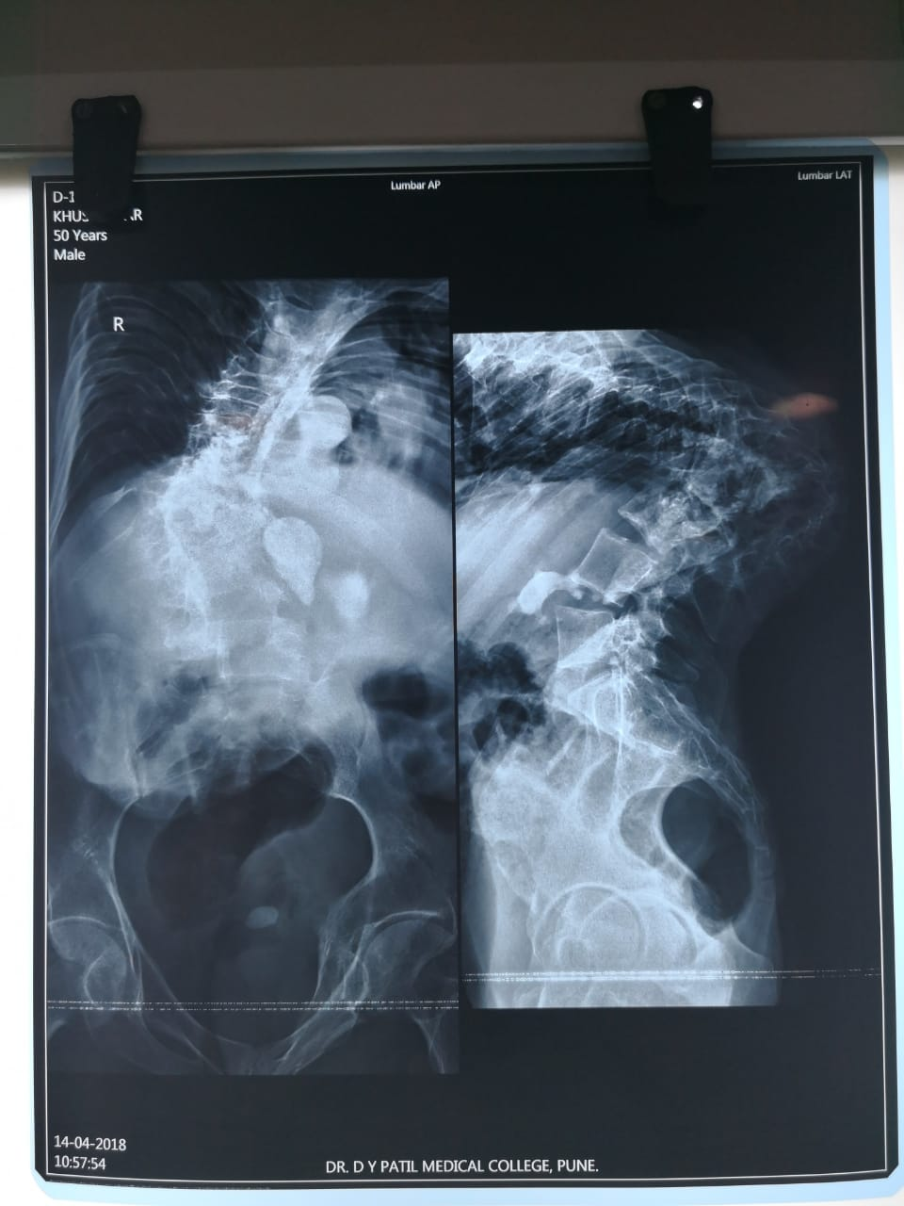

Slide 26
Take home massage
Severe kyphoscoliosis could be associated with difficulty in regional anaesthesia and airway management due to a distorted airway anatomy.
There are high possibility of respiratory and cardiovascular complications in the perioperative period.
Familiarity with special technique which may be used for tracheal intubation of patient with the difficult airway is must.
Successful difficult airway management needs early recognition, adequate preparation, planned and vigilant approach.

