Slide 1
A RARE CASE OF ASCITES Dr. Siva Krishna DEPARTMENT OF MEDICINE

Slide 2
CHIEF COMPLAINTS
22 yr/Female, Resident of Lonavala, came with chief complaints of:
Abdominal distension and Pain in abdomen since 3 days
No h/o loose stool, vomiting, fever
No h/o blood in stools
No h/o breathlessness

Slide 3
Past history
Family history
No H/O HTN/DM
No H/O TB/Asthma
No H/O Thyroid/Epilepsy
No H/O similar complaints in past
No H/O Jaundice
H/O Normal delivery 6 months back
No H/O OC Pills usage.
Not significant
No similar history in the family members

Slide 4
Personal history
Sleep normal
Appetite decreased
Bladder normal
Bowel normal
Mixed diet
No any addictions

Slide 5
On examination
Afebrile
Pulse: 92/min
BP: 110/70mmhg
RR: 18/min

Slide 6
General examination
No Pallor
No Icterus
No Edema
No Cyanosis, Clubbing, Lymphadenopathy.
No signs of Liver cell failure

Slide 7
Systemic examination
PA : Soft and distended, mild hepatomegaly
Shifting dullness present
No fluid thrill
CVS : Normal
RS : Normal vesicular breath sounds
CNS : Conscious oriented to time place and person

Slide 8
Lab investigations
Hb | 11.8 gm%
TLC | 7800
DLC | N:46 L:37 E:05 M:12
Platelet Count | 2.10 lakh
Hematocrit | 35.3
Blood urea/ Creatinine | 25/0.7
Total Bilirubin/Direct Bilirubin | 0.59/0.28
SGPT/SGOT | 28/24
Na+/ K+ | 134/3.7
Total Protein | 5.34
Albumin/Globulin | 3.01/2.31
Pt-Inr/aPtt | 1.0/39.8
Amylase/Lipase | 58/30
HIV/HbsAg/HCV | Negative

Slide 9
Ascitic fluid
Physical Appearance | Clear, pale yellow. No clots, coagulum or cobweb
R/M | Zero cells
Total Proteins/ Albumin | 2.5/1.4
Sugars | 128
ADA | 3.8
LDH | 65
Amylase/ Lipase | 28/64
Ascitic fluid suggestive of transudative nature
SAAG: 1.61

Slide 10
Radiological investigations
CXR: Normal
USG Abdomen & Pelvis:
Liver 16cms enlarged, with
normal echogenicity.
Portal veins-normal
Pseudo gall bladder wall thickening
Spleen, Pancreas, Kidney: Normal
Free fluid noted in pouch of Douglas, pelvis, perihepatic and perisplenic region.
Right sided minimal pleural effusion.

Slide 11
Color Doppler of Portal System
Liver 18cms, relative atrophy of left lobe of liver with enlargement of caudate lobe of liver.
Hepatic veins- Right hepatic vein appears thrombosed / thick
hyper echoic.
Middle hepatic vein appears patent.
Left hepatic vein- thrombosed.

Slide 12
IVC – normal, no thrombosis
Portal vein – 7mm with reversal of flow
Collaterals- intrahepatic venovenous collaterals seen with no flow s/o thrombosis.
Conclusion: Budd-Chiari Syndrome with portal hypertension.

Slide 13
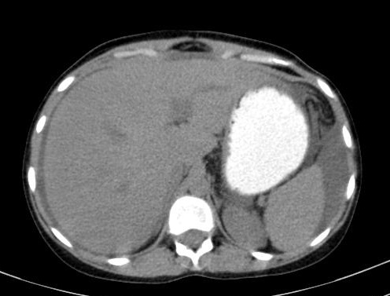
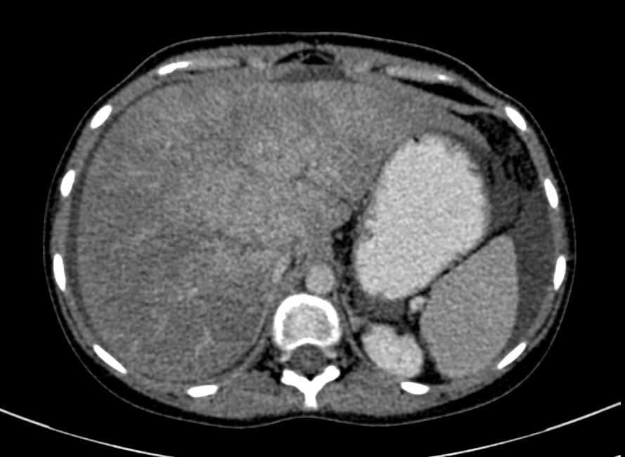
CECT A/P
A
B

Slide 14
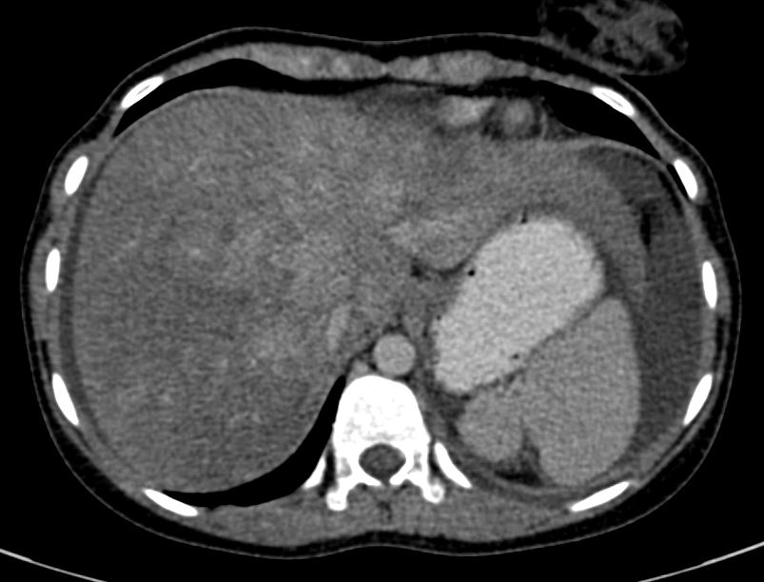
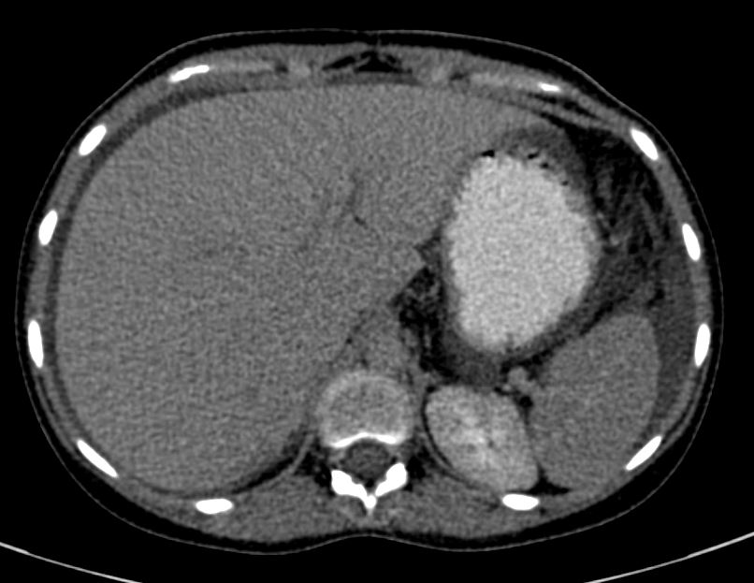
CECT A/P
c
D

Slide 15
On Upper GI endoscopy
Mild portal hypertensive gastropathy
Nodular pangastritis
Pro thrombotic profile was NORMAL
Diagnosis
Budd-chiari syndrome – most probable post partum etiology.

Slide 16
Treatment
Inj. Enoxaparin 0.6cc BD for 5 days & overlapped with
Tab. Acenocoumaral 2mg OD on day 3 of enoxaparin
Tab. Furosemide/Spironolactone 20/50mg BD
Tab. Propranolol 40mg OD

Slide 17
Follow up after one month
Patient had symptomatically improved.
Patient was continued on anticoagulation medication and INR was maintained between 2-3.
On USG: No evidence of ascites.

Slide 18
DISCUSSION
BUDD-CHIARI SYNDROME is a very rare condition affecting one in a million.
Presents with classical triad of Abdominal pain, Ascites, liver enlargement.
Etiology : Idiopathic in approximately 1/3rd of patients, Thrombotic diathesis, pregnancy, post partum, OCP, Chronic infection, Chronic inflammatory diseases, hematological disorders like Polycythemia rubra vera, Paroxysmal nocturnal hemoglobinuria, antiphospholipid antibody syndrome.

Slide 19
Clinical variants of Budd-chiari syndrome:
Acute and sub acute form : Characterized by rapid development of abdominal pain, ascites, hepatomegaly, jaundice and renal failure
Chronic form: Progressive ascites, 50% pt have renal impairment, Jaundice is absent.
Fulminant form: Hepatic failure present, ascites, tender hepatomegaly, jaundice, and renal failure.

Slide 20
References
Rajani R, Melin T, Björnsson E, Broomé U, Sangfelt P, Danielsson A, Gustavsson A, Grip O, Svensson H, Lööf L, Wallerstedt S, Almer SH (Feb 2009). "Budd–Chiari syndrome in Sweden: epidemiology, clinical characteristics and survival - an 18-year experience". Liver International. 29 (2): 253–9. doi:10.1111/j.1478-3231.2008.01838.x. PMID 18694401.
"Etiology, management, and outcome of the Budd–Chiari syndrome".
"Hepatic vein thrombosis (Budd–Chiari syndrome)".
"The Budd–Chiari syndrome: a review".
"Budd–Chiari syndrome: long-term survival and factors affecting mortality".
"Budd–Chiari Syndrome: clinical patterns and therapy".
"Budd–Chiari syndrome: etiology, diagnosis and management".
"Case records of the Massachusetts General Hospital. Weekly clinicopathological exercises. Case 51-1987. Progressive abdominal distention in a 51-year-old woman with polycythemia vera"

