Slide 1
MANAGEMENT OF A RARE CASE OF SIGMOID DIVERTICULAR PERFORATION – A MODERN TAKE
Dr.Varun Shetty
Department Of General Surgery
Dr.D.Y.Patil Hospital And Research Centre , Pimpri , Pune.

Slide 2
CASE REPORT - HISTORY
A 45 years old female came with chief complaint of
Pain in the left lower abdomen since 7 days.
Loose stools since 3 days.
Pain was acute in onset and had increased in intensity over the 7 days.
Associated with loose stools , 5-6 episodes/day , watery in consistency, containing mucous and not blood stained.
No history of
Altered bowel habbits
Nausea
Vomiting
Fever

Slide 3
CASE REPORT - HISTORY
No associated co-morbidities.
No history of any surgeries in the past.
H/O similar complaints 6 months ago for which she received conservative management.
No associated Menstrual or gynaecological complaints.

Slide 4
CASE REPORT – EXAMINATION
Patient was vitally stable..
BMI : 38 Kg/m²
P/A :
Tenderness + in Left Iliac Fossa and Periumbilical region.
Localized guarding in Left iliac fossa.
No rigidity.
No palpable lump.
No organomegaly.
Bowel sounds : Sluggish

Slide 5
CASE REPORT – MANAGEMENT
Routine hematological and biochemical Investigations were within normal limits.
USG ( Abdomen and Pelvis ) – Sluggish to absent peristalsis in the visualized bowel loops with free fluid collection in both iliac fossae.
CECT ( A+P ) s/o :
Diverticular disease involving sigmoid colon with evidence of wall thickening , fat stranding of pericolic fat and streak of intramural air s/o diverticular perforation.
Free fluid in pelvis and paracolic gutters.

Slide 6
MULTIPLE DIVERTICULI INVOLVING THE SIGMOID COLON WITH AIR FOCII WITHIN
ASSOCIATED WITH SURROUNDING FAT STRANDING
CECT FILM DEPICTING DIVERTICULITIS OF SIGMOID COLON

Slide 7
INTRA-OPERATIVE FINDINGS ON EXPLORATORY LAPAROTOMY
SITE OF PERFORATION WITH ADHERANT JEJUNUM AND
SEALING OFF WITH OMENTUM

Slide 8
CASE REPORT – OPERATIVE MANAGEMENT
Diagnostic Laparoscopy was performed to evaluate the condition of abdomen.
Laparoscopy revealed a sealed off diverticular perforation in the sigmoid colon with adherent loops of small bowel with inflammation extending upto the descending colon.
300ml of peritoneal collection were aspirated.

Slide 9
CASE REPORT – OPERATIVE MANAGEMENT
A thorough peritoneal lavage was performed and a laparoscopy assisted diverting loop ileostomy was performed in the same sitting.
Close monitoring of patient was done.
Stoma was healthy and functioning well.
Patient showed improvement in general condition and was discharged and called for follow up after 6 weeks.

Slide 10
CASE REPORT – OPERATIVE MANAGEMENT
Patient was then admitted after 6 weeks for definitive surgery i.e Left Hemicolectomy and Reversal of loop ileostomy.
CECT ( Abdomen + Pelvis ) revealed :
Ileostomy noted in RIF.
Sigmoid colon showed mural thickening with heterogenous post contrast enhancement.
Reduced inflammation and absent air foci as compared to previous scan.
Patient was then posted for Left Hemicolectomy.

Slide 11
MULTIPLE DIVERTICULI INVOLVING THE SIGMOID COLON WITH REDUCED INFLAMMATION
CECT FILM DEPICTING DIVERTICULITIS OF SIGMOID COLON AFTER 6 WEEKS OF INITIAL PROCEDURE

Slide 12
CASE REPORT – OPERATIVE MANAGEMENT
Intraoperative findings :
Diverticuli identified in the sigmoid colon.
No e/o inflammation of surrounding bowel.
Ascending and Transverse colon appeared normal.
Finally a Left Limited Colectomy with colorectal anastomosis was performed with reversal of diverting loop ileostomy in the same setting.
Procedure was uneventful and patient was managed for 3 days in the SICU.
Patient had an uneventful postoperative recovery.

Slide 13
INTRA-OPERATIVE FINDINGS ON EXPLORATORY LAPAROTOMY
INTRA-OPERATIVE IMAGE SHOWING SIGMOID COLON DIVERTICULI

Slide 14
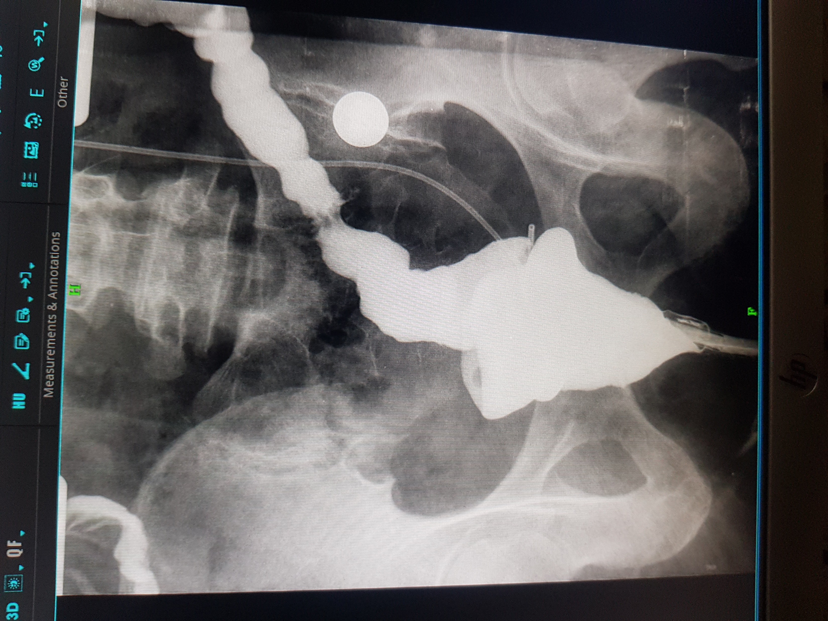
CASE REPORT- OPERATIVE MANAGEMENT
REPORT S/O:
Rectum and Colo-rectal Anastomosis were Opacified And Appear Normal.
No e/o any filling Defect , leak or stricture.
IC Junction Appears Normal.
FINDINGS ON BARIUM ENEMA STUDIES POST LEFT LIMITED COLECTOMY

Slide 15
CASE REPORT – OPERATIVE MANAGEMENT
Histopathology revealed :
Intense infiltrates with mononuclear inflammatory cells.
Findings s/o Diverticulitis with reaction following perforation .
Patient had an uneventful recovery and was discharged.

Slide 16
DISCUSSION
Diverticulitis affects 5-10% of population older than 45 years, 80 % of those older than 85 years.
However in the East the incidence is only 1-2% wherein perforation occurs only in 20% of these cases.
20% of patients have an episode of symptomatic diverticulitis.
Classically 95 % of all diverticuli occur in sigmoid colon.
The taeniae coalesce to form an enveloping muscular layer in the rectum. Much of the colonic wall is therefore devoid of longitudinal muscle and it is in these areas that diverticula form.

Slide 17
DISCUSSION
MODIFIED HINCHEY CLASSIFICATION BY SHER ET AL.
I | PERICOLIC ABSCESS
IIA | DISTANT ABSCESS AMENABLE TO PERCUTANEOUS DRAINAGE
IIB | COMPLEX ABSCESS ASSOCIATED WITH FISTULA
III | GENERALIZED PURULENT PERITONITIS
IV | FECAL PERITONITIS

Slide 18
DISCUSSION
?

Slide 19
DISCUSSION
As described in the above image there are no clear cut guidelines as to best manage a case of sigmoid diverticular perforation.
Conventional treatment protocol requires the patient to undergoe two to three laparotomies thus subjecting the patient to associated morbidity and mortality.
In our case we improvised thus reducing the number of laparotomies to one .

Slide 20
CONCLUSION
The treatment of complicated diverticular disease is diverse and subjective to the stage of presentation.
Thus management needs to be tailored to reduce the morbidity associated with conventional principles of management.

Slide 21
THANK YOU

