Slide 1
Extended reverse sural artery pedicled flap
- a Versatile and reproducible option for coverage of ankle and foot defects
Presenter - Dr Ashish Tyagi
Under guidance of Dr Bhushan Patil

Slide 2
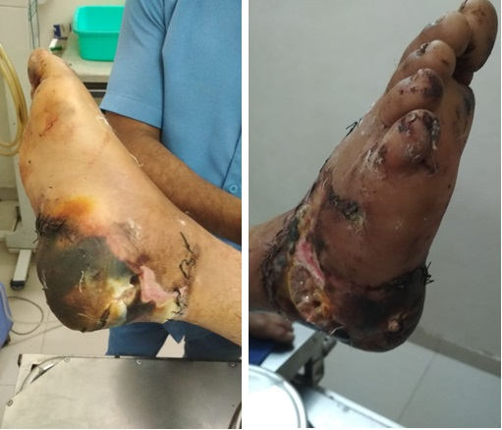
Case
20 year old male patient came with history of road traffic accident with injuries over right heel, hind foot and lateral malleolus.
Defect size of 12cm x 9cm with presence
of soft tissue gangrenous changes
No known comorbidities

Slide 3
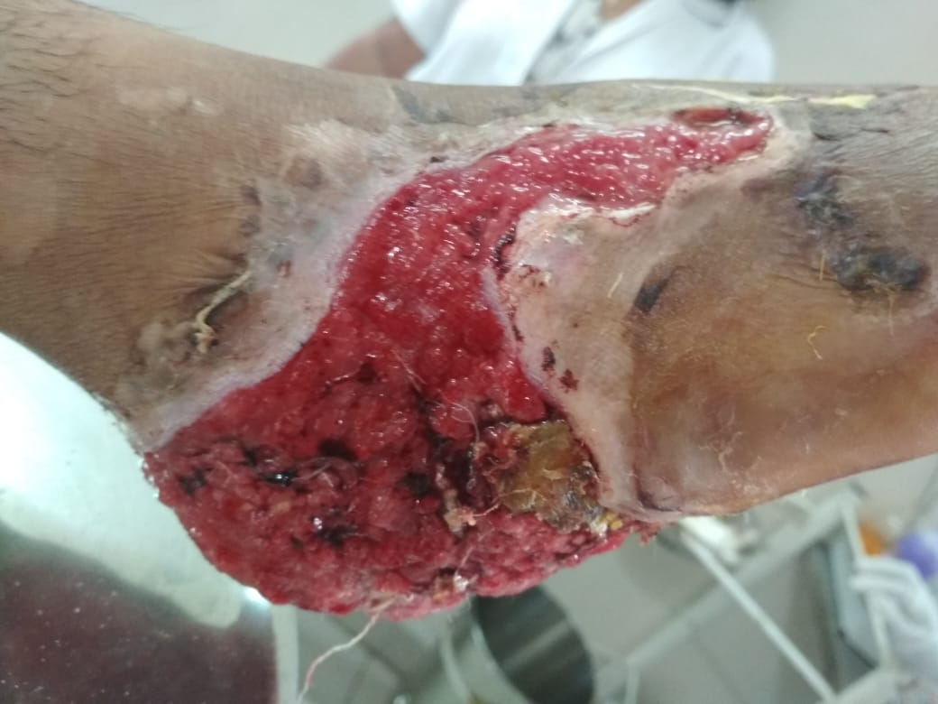
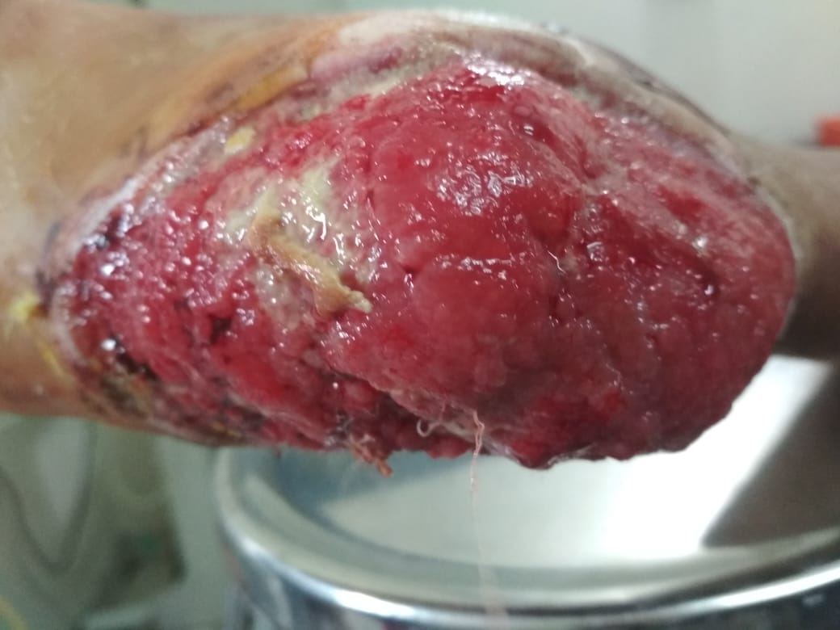
Haemoglobin- 11.9 gm/dl
Total WBC count- 9300/cmm
Platelets- 3.19lacs/cumm
Blood urea- 18mg/dl
Serum creatinine- 0.2 mg/dl
Serum bilirubin total- 0.24
Serum bilirubin direct- 0.07
Serum sodium- 140 mmol/l
Serum Postassium- 3.8 mmol/l

Slide 4
Surgery details
Preoperatively, the course of the sural nerve was marked along the line from the midline between gastrocnemius heads in the popliteal fossa to the point between the lateral malleolus and tendoachilles.
Perforator of the peroneal axis around 7-8cm from the lateral malleolus was also marked using handheld Doppler probe.
Debridement of the raw area was done and defect size measured. Flap was marked accordingly in the upper third of the calf with distal margin within 2-3cm from the popliteal crease. Reach of the flap was confirmed by planning in reverse.

Slide 5
The flap dissection was started from the distal most part of flap. Sural nerve and Lesser saphenous vein were identified and divided
The sural nerve was incorporated in the flap by dissecting it between the gastrocnemius heads subfascially.

Slide 6
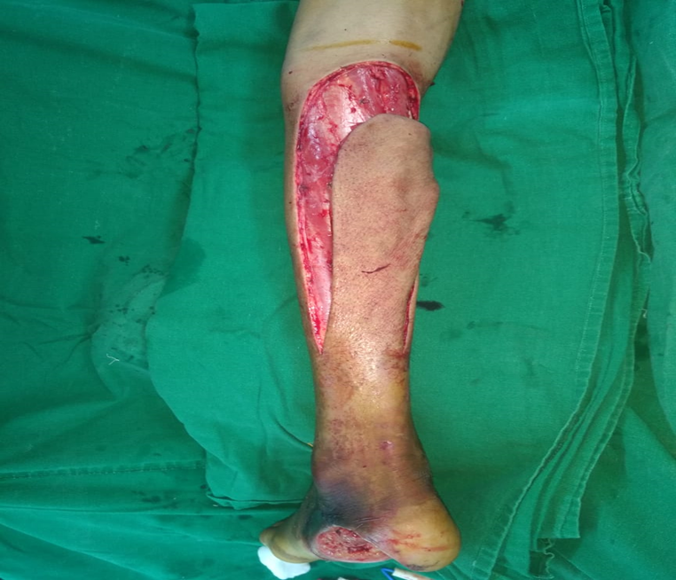
Perforators of the peroneal axis and musculocutaneous perforators through
gastrocnemius muscle were divided as the dissection progressed.
Dissection was completed till the pivot point as per marking (7-8cm from the
lateral malleolus)
The pedicle width of at least 5cm was maintained,
an inch on each side of the pivot perforator and
to include short saphenous vein.
The vascularity of the flap was confirmed at the
distal most part and Splint was applied to restrict
of the limb.

Slide 7
Pre-operative Pictures

Slide 8
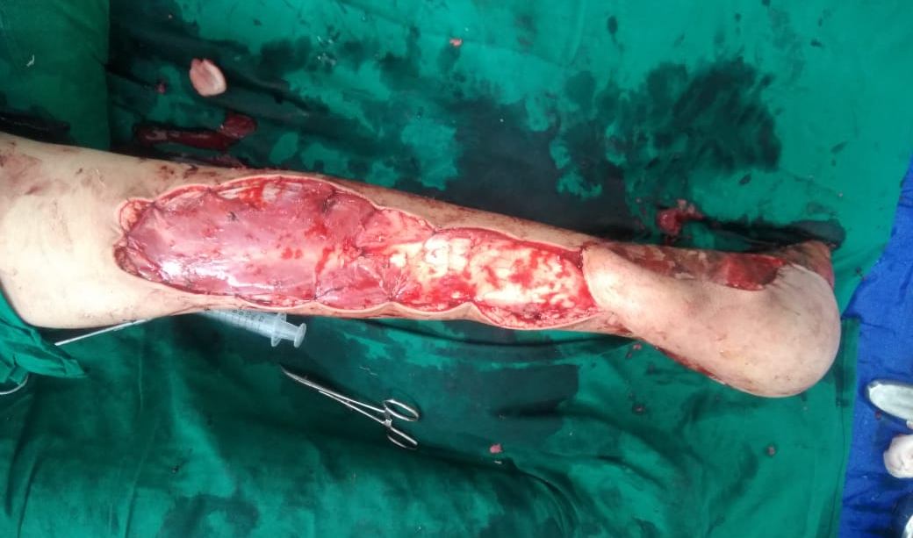
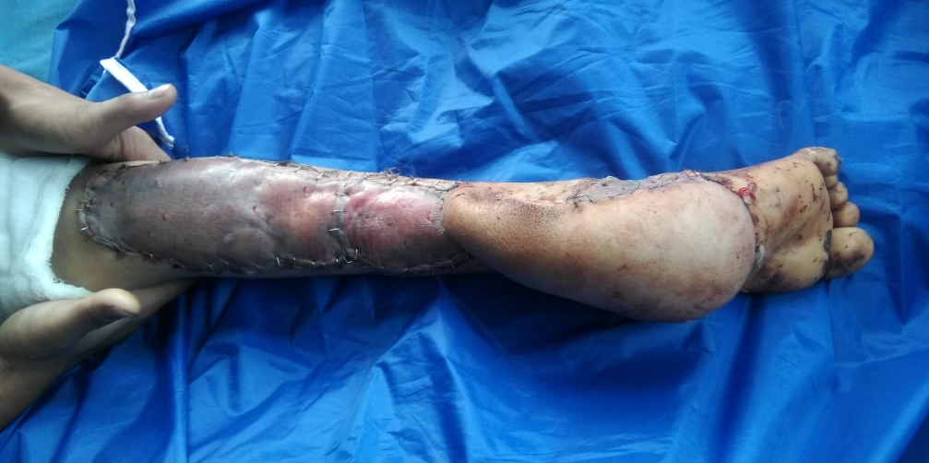
Post operative pictures

Slide 9
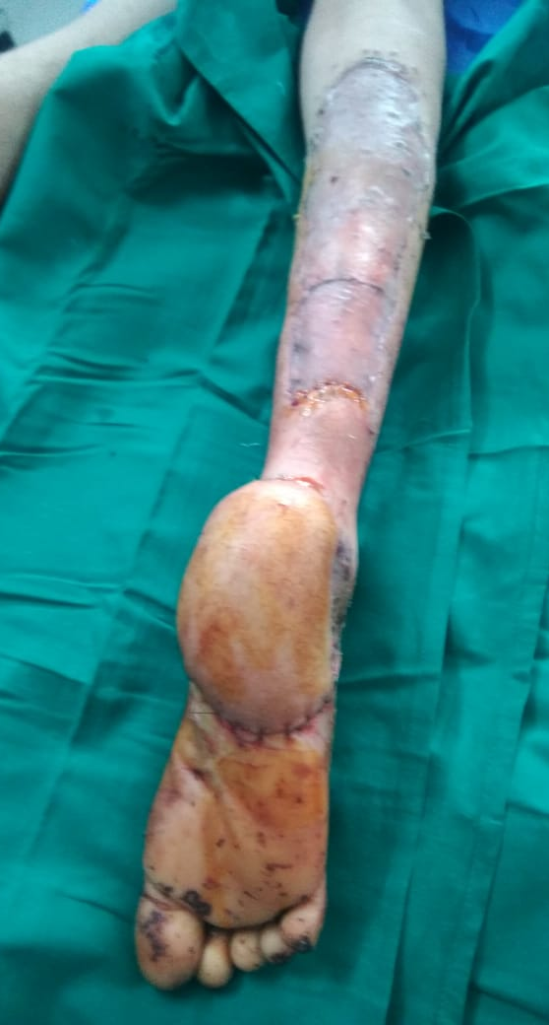
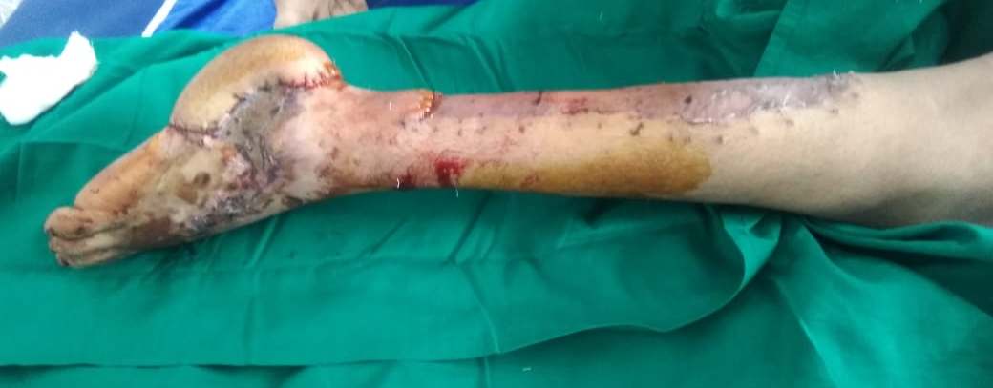
Before & After

Slide 10
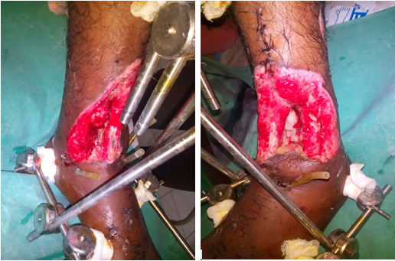
Another case : Good Cosmetic Result

Slide 11
Introduction : Ext RSA Flap.
Scarcity of the usable soft tissue around the lower third of the leg, ankle and foot presents a challenge for coverage of soft tissue defects in this part of lower extremity.
Use of free tissue transfer to cover these defects often need to sacrifice major vessel of the leg limiting its utility in addition to need of expertise and lengthy procedure hours. Hence, a more commonly used reliable and rapid coverage option for such defects around the ankle and foot is distally based sural pedicle flap.

Slide 12
Anatomy :
The RSA flap receives its blood supply from its communications with peroneal artery perforators around lateral malleolus.
The Extended part of the reverse sural artery flap is an adipo-fascio-cutaneus flap based on vascular axis of sural nerve.
We observed that its reach can be extended by including sural nerve in the distal most part of the flap by dissecting it along its course below the facia between the gastrocnemius heads.

Slide 13
Conclusion :
Soft tissue defects of the distal third of the leg, ankle, heel, and foot are difficult to reconstruct. The Ext RSA flap is a useful and reliable reconstructive option in patients with soft-tissue defects of the foot and lower leg.
This is a safe, easy and applicable method in defects around ankle and foot. The results have low rates of ischemia, venous congestion, dehiscence, infection and flap necrosis.

Slide 14


