Slide 1
Interesting Case:
Infective Endocarditis in a CKD patient with long standing dialysis catheter
Dr Ranjit Pawar
Asst Prof
Department of CVTS

Slide 2
Case Details
39 Yr old Male DOA-8/3/21
K/c/o CKD stage V d
On maintenance hemodialysis since 1 Yr through Permacath (Rt Subclavian vein)
C/O:
  Swellings on both legs X 1 mth
  Low grade fever on & off X 15 days
  Difficulty in breathing X 15 days

Slide 3
Examination Details
HR- 102/min, BP- 86/40 mm hg
CVS- S1,S2 N; No murmur
RS- b/l crepts+
CXR- b/l lung field basal haziness
Hb- 4.2, TLC- 5300, PLT- 131000
79% Neutrophilia
Urea- 109; Sr Creat- 11.33
Serology- Negative
Blood culture- Methicillin sensitive Staph auerus

Slide 4
Echocardiography
Trans Thoracic echo (9/3/21):
  EF 60%
  Vegetation on mitral Valve- AML 13X8 mm, PML- 11X9 mm
  Moderate Mitral regurgitation, No AR, TR.
  No PAH
TEE (12/3/21):
  MV vegetation confirmed
  Additional vegetation's at SVC catheter tip near SVC- RA junction
Diagnosis- Sub acute Bacterial Endocarditis

Slide 5
Medically optimized
Anemia correction
Inj Pipercillin+ Tazobactum X 7 days
Continued on Hemodialysis
Transferred to CVTS- Surgery planned
Vegetectomy with MV repair/replacement
Euro Score: 10 (Predicted mortality 14-19%)

Slide 6
Surgical Details
Underwent Surgery on 18/3/21
Intra Op-
  Dense pericardial adhesions
  Large Heart, dilated thickened RA, dilated RV
  Catheter tip thrombosed with vegetations at tip
  MV- 1cm vegetation sitting at A2 segment; PML was nearly destroyed , rolled up due to vegetations

Slide 7
Vegetectomy along with excision of permacath done. Rest of catheter pulled out percutaneously
MV was beyond repair.
MV excised & replaced with 27 mm TTK Chitra Single disc Mechanical prosthesis.

Slide 8
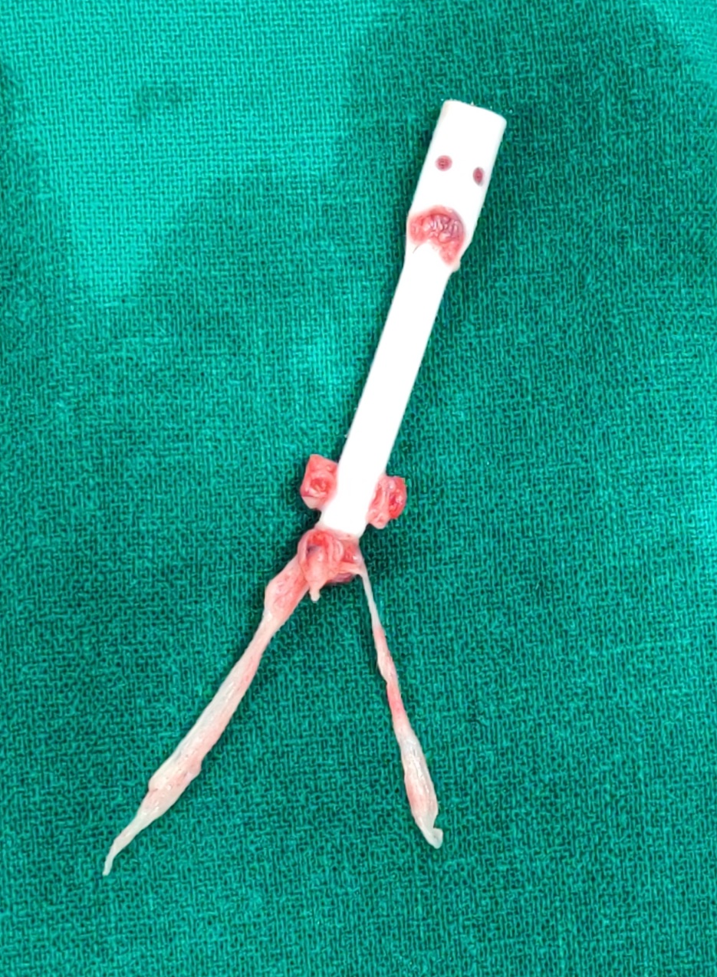
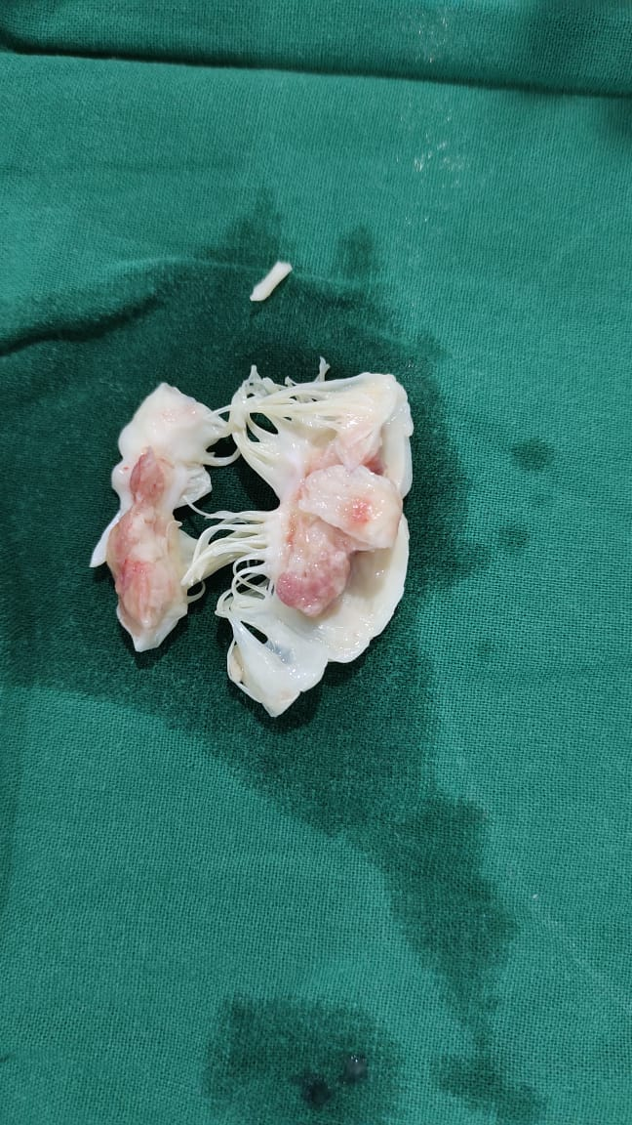
Excised Permacath tip
Excised Mitral Valve
AML with vegetation at tip
PML destroyed with vegetation

Slide 9
Post Op Course
Started with
  Inj Meropenem
  Inj Vancomycin
  Inj Tigecycline
  Inj Fluconazole all in renal dosage
Inotropes:
  Dopamine 5 mcg/kg/min
  Noradrenaline 0.1 mcg/kg/min
  Vasopressin- 2U/hr

Slide 10
Elective ventilation for 72 hrs, gradually weaned off , extubated on NIV support
Renal Management along with Nephrologist: Daily Dialysis on POD-0,1,2, alternate day thereafter
Inotropes weaned over 4 days
Drains removed on POD-7th
Transferred back to Nephro on POD 10th

Slide 11
Fever on & off intermittently
Increasing dyspnoea since POD 12th
CXR- B/l pleural effusion
USG Chest- Moderate Pleural effusion ( Rt > Lt)
Pulmonary medicine opinion sought; B/l ICD insertion done
Deranged coagulation profile, Vit K, FFP given
Persistent fever

Slide 12
Noted altered sensorium on POD 15th
Neurologist Opinion sought- Suspected Embolic stroke- Advised CT
CT Brain:
  Multiple embolic stroke (? Septic) Minimum hemorrhage
  ?? Cortical Laminar Necrosis
Persistent Sepsis, Deteriorating hemodynamics, started on Nor ad, Dopa infusion
Pt was reintuabted on POD 22nd, Succumbed to septic shock & died on 11/4/21 (POD 24th)

Slide 13
Take home points:
Infective endocarditis is a known complication with long standing i.v. catheters such as dialysis catheter
Early mortality associated with IE ranges from 15-20%, with reported operative mortality for active endocarditis 4-30%
Higher mortality with incremental risk factors like older age, renal dysfunction, longer CPB time, insidious onset of infection
A team approach with involvement of multiple specialties is necessary in patients with multiple comorbidities

Slide 14
Operative treatment is actually Combined Medical+ Surgical treatment
Indications for surgery:
  Remove
  Restore or reconstruct
  Reverse the hemodynamic abnormality
Repairs are less successful in active endocarditis than in healed stage
Few patients may have continuing sepsis despite adequate cardiac operation, Peripheral mycotic aneurysms can be a potential source

