Slide 1
Chordoid Meningioma
A Deceptive Nasal Mass

Slide 2
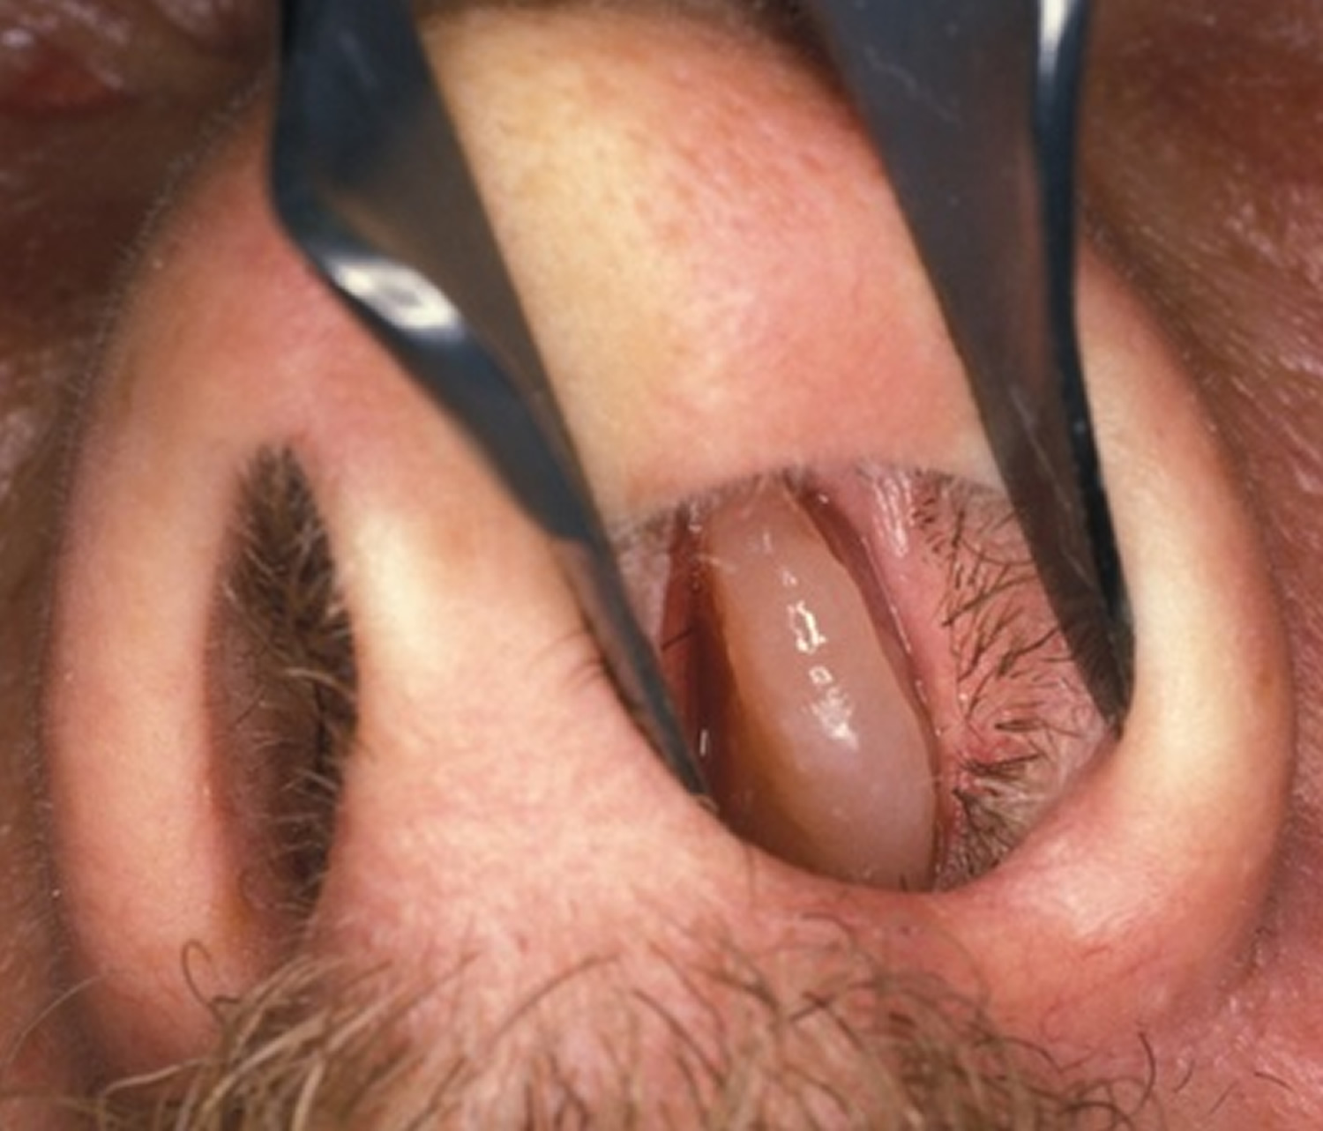
Case Report
A 32 years old male patient presented with complaint of Nasal Obstruction, Difficulty in Breathing and 4-5 episodes of epistaxis since 6 months
On Anterior Rhinoscopy- A Pinkish Polypoidal mass was present in left nasal cavity

Slide 3
On Posterior Rhinoscopy- A Polypoidal mass from left nasal cavity was projecting in left nasopharyngeal air space
On Probe Test- Mass was arising from lateral wall of nose
On Diagnostic Nasal Endoscopy (DNE)- Firm pinkish polypoidal mass visualized in left nasal cavity, coming from middle meatus with no attachment on floor, roof and medial wall of nasal cavity
Ear and Throat Examination- No Abnormality Detected
On Indirect Laryngoscopy- No Abnormality Detected

Slide 4
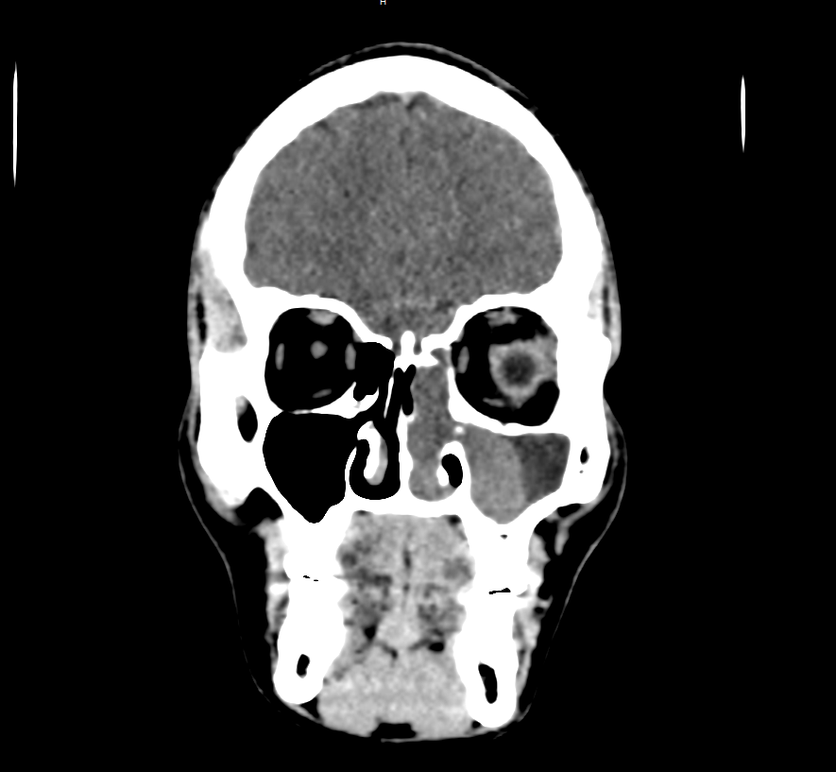
Investigation
CT Paranasal Sinus (Plain and Contrast) - An ill-defined polypoidal non-enhancing soft tissue density lesion was noted in left maxillary sinus and left ethmoidal sinus extending into the left nasal cavity involving the middle meatus causing mild deviation of nasal septum to right side. It was causing widening of ostium at medial wall of left maxillary sinus. Left nasal air space is obliterated

Slide 5
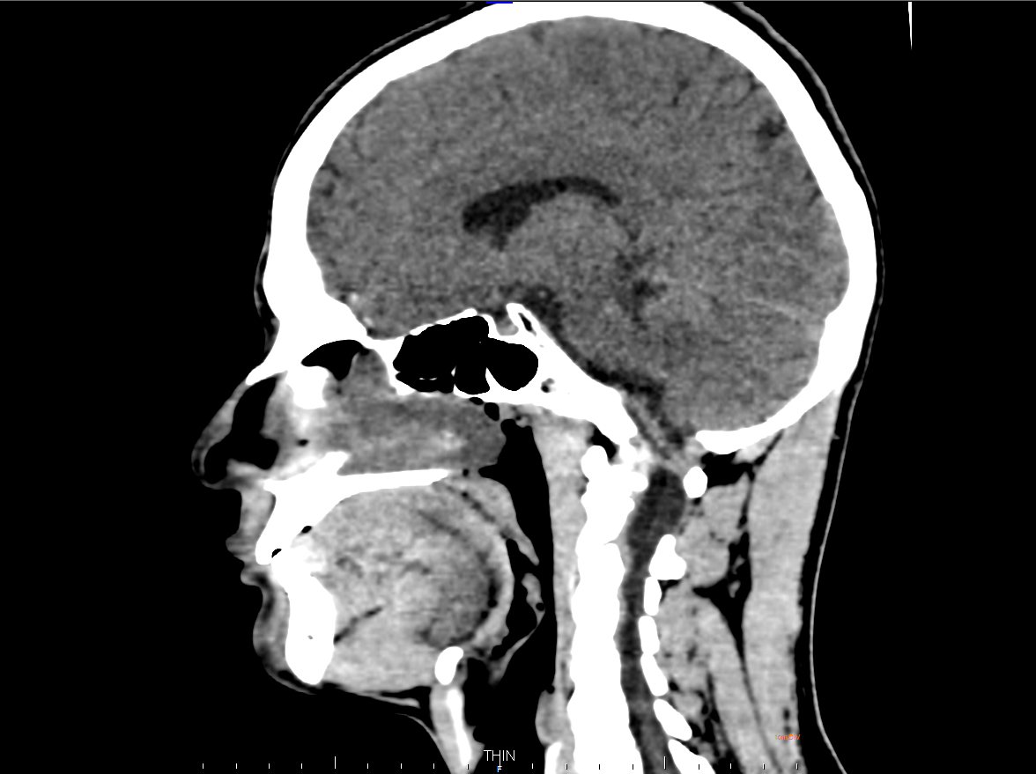

Slide 6
Biopsy- Angiomatous Polyp
All Routine Blood Investigation was normal
Patient was posted for Endoscopic Excision of Nasal Mass With Functional Endoscopic Sinus Surgery (FESS)

Slide 7
Intraoperative
Endoscopic Excision of Nasal Mass along with Functional Endoscopic Sinus Surgery (FESS) was performed on patient
Uncinectomy was done on left side, maxillary ostium widened and nasal polyp was removed from left maxillary sinus and left nasal cavity in toto
Left Anterior Ethmoidal cells were removed
Right Nasal cavity, Maxillary and Ethmoidal Sinus appear normal on endoscopy

Slide 9
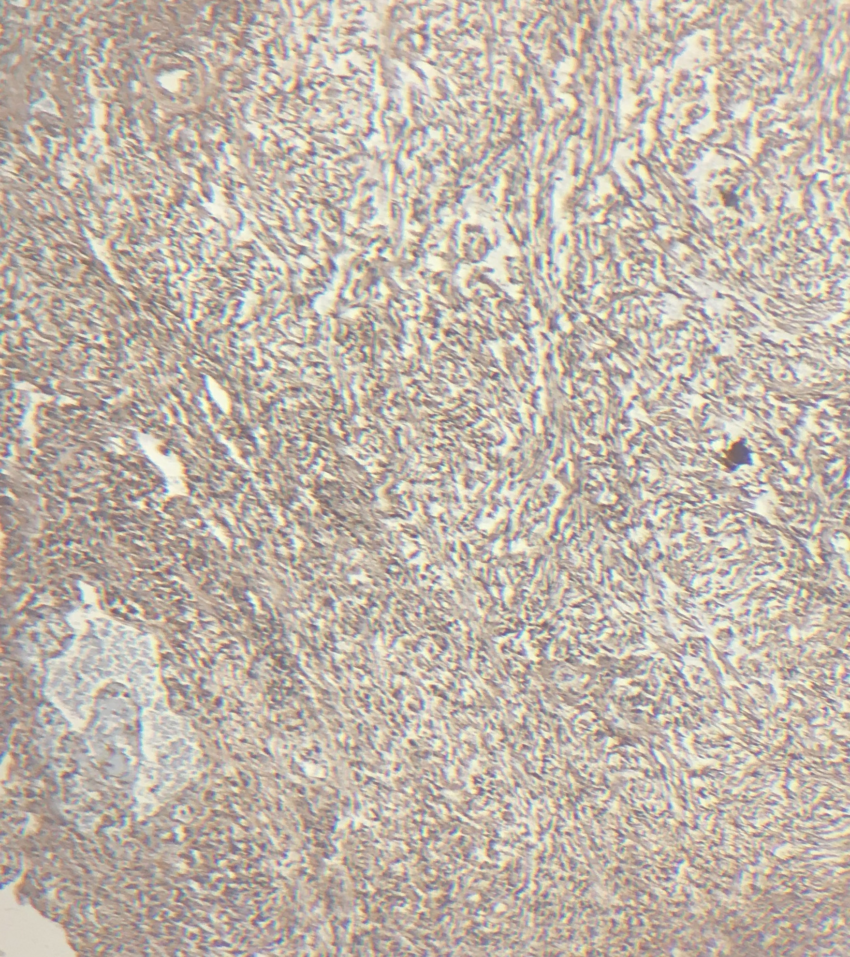
Histopathological Examination
Immunohistochemical stain for specimen-
Tumour cells are positive for-
Epithelial Membrane Antigen (EMA)
S-100
Vimentin
PR
Tumour cells are negative for-
CK 7
CK 20
CEA
HPE of specimen shows CHORDOID MENINGIOMA

Slide 10
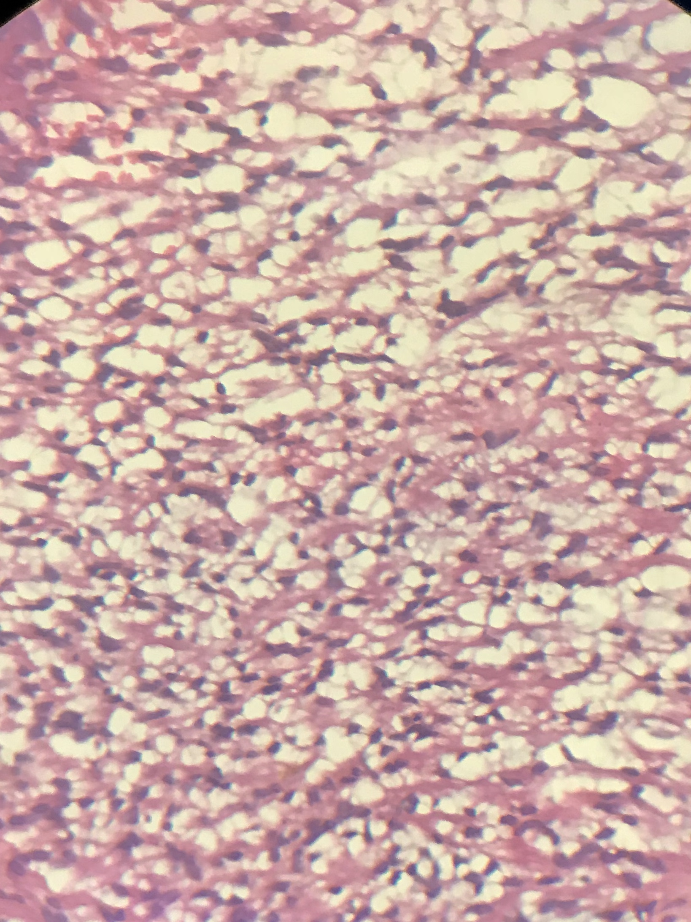
Meningothelial cells arranged in cords displaying fused cytoplasmic membranes and indistinguishable cellular borders. The nuclei look bland; however this is by definition a Grade II meningioma

Slide 11
Patient followed up after 7 days and 3 weeks, Diagnostic nasal endoscopic (DNE) was done on follow up
MRI Brain was done after HPE diagnosis of Chordoid Meningioma, to rule out any intracranial connection of Meningioma
No Intracranial and Extracranial mass visualised
No growth or mass visualized on DNE
Patient was asymptomatic

Slide 12
Discussion
Meningiomas are nonglial tumors of the central nervous system, representing 24–30% of all intracranial neoplasms
Chordoid Meningioma are grade II atypical meningiomas according to the WHO’s classification
They have been reported to occur extracranially in only 1-2% of cases and 20% of extracranial meningiomas are secondary extensions of intracranial tumors
They arise from the arachnoid cap cells (meningocytes) that are derived from the neural crest
These tumors are more common in females and have bimodal age distribution with first peak at the second decade of life and second peak during fifth through seventh decades

Slide 14
Pathogenesis of Extra Cranial Meningioma
During embryogenesis, when arachnoidal cells that are present in the sheaths of nerves or vessels emerge through the skull foramina, the displaced Pacchionian bodies are detached, pinched off or entrapped in an extracranial location
They have been reported to occur in the Sino Nasal Tract, Cranial bones, Middle Ear, Scalp, Soft tissues of the face, neck and parotid gland

Slide 15
Symptoms depend on the anatomic site of involvement
Meningioma involving Sino Nasal Tract present with-
Nasal Obstruction
Anosmia
Facial Pain
Nasal Discharge
Epistaxis

Slide 16
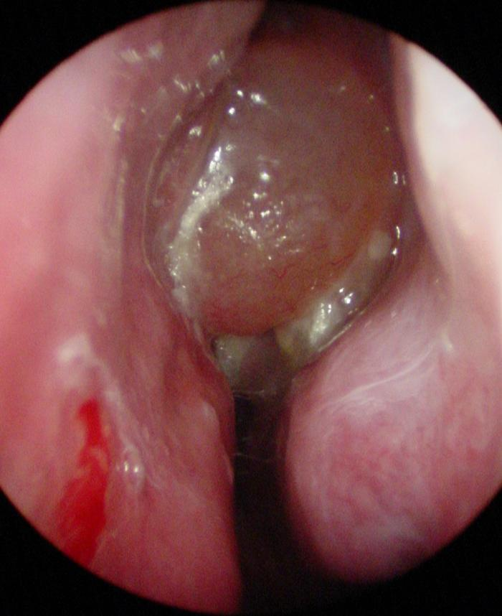
Nasal Endoscopy usually shows a firm reddish pink to grey mass in the nasal cavity which could be globular or lobulated but well circumscribed with displacement and without infiltration into the surrounding tissues

Slide 17
Radiological findings are usually nonspecific and include clouding or opacification of the sinuses, bony sclerosis, and focal destruction of the surrounding sinusoidal or nasal cavity bony tissues

Slide 18
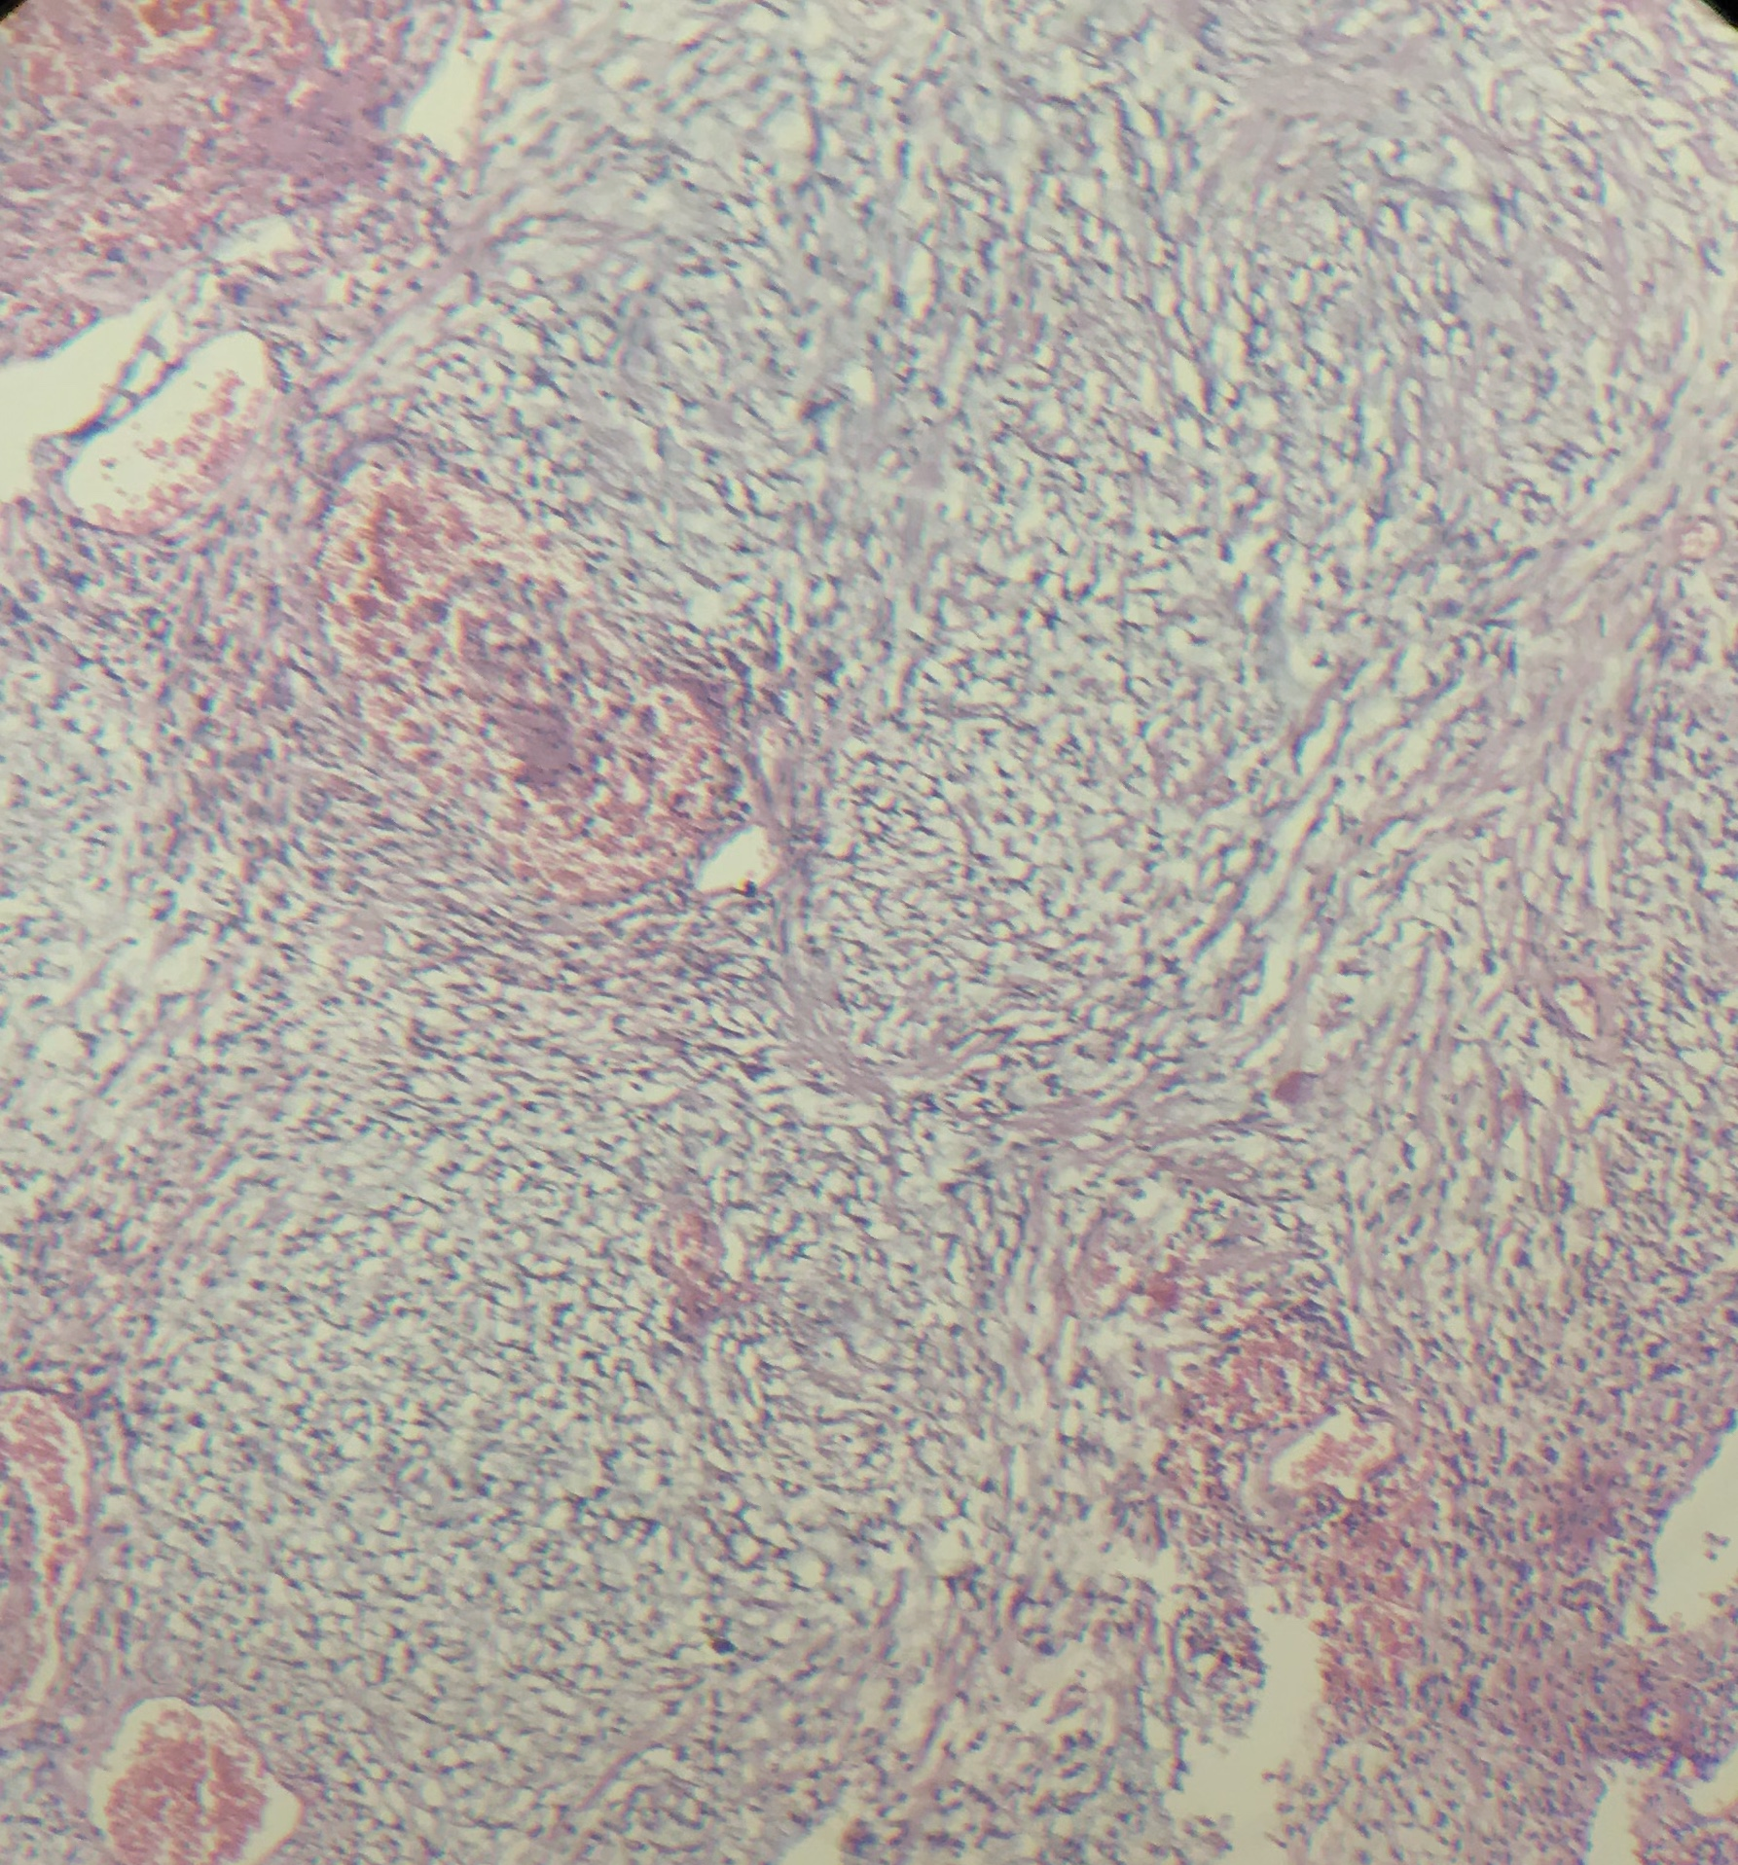
The differential diagnosis of Sino nasal tract meningiomas includes Mucocele, Olfactory Neuroblastoma, Carcinoma, Haemangioma, Sarcoma and Angiofibroma
Histopathology and Immunohistochemistry are confirmatory. Meningiomas are strongly immunoreactive to Vimentin, EMA (epithelial membrane antigen) and Pancytokeratin

Slide 19
Growth of the tumour is slow, hence surgical excision is treatment of choice
Complete excision of these masses may be accomplished by Endoscopic, Open or a combination of both approaches
Radiation therapy has been suggested to improve survival in meningiomas of central nervous system

Slide 20
Conclusion
Extra cranial Meningioma is rare neoplasm, frequently misdiagnosed, resulting in inappropriate clinical management
Histopathological evaluation of biopsy is must in all cases of nasal mass for accurate diagnosis and management, as significant lesions like Chordoid Meningioma may be missed on clinical and radiological evaluation

Slide 21
Thank You

