Slide 1
Good afternoon…

Slide 2
Current concepts and treatment of Acute Myocardial Infarction
Dr. Pranav Shende
Third Year Cardiology Resident

Slide 3
Agenda
Criteria for diagnosis of MI
Classification of MI
Aetiology
Presentation of MI
Clinical examination
Cardiac Biomarkers
ECG Manifestations

Slide 4
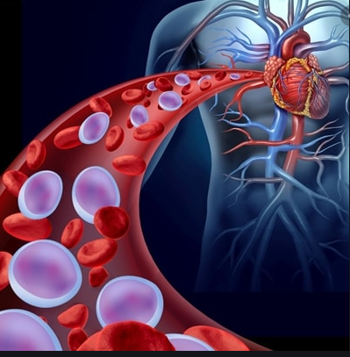
ACUTE MYOCARDIAL INFARCTION
when there is evidence of myocardial necrosis in a clinical setting consistent with acute myocardial ischemia.

Slide 5
CRITERIA FOR DIAGNOSIS
Rise and or fall in cardiac biomarker values with atleast one value above the 99th percentile URL
with at least one of the following—
Symptoms of ischemia
New or presumed new significant ST-T changes or new LBBB
Development of pathologic Q waves on the ECG
Imaging evidence of new loss of viable myocardium or new regional wall motion abnormality
Identification of an intracoronary thrombus by angiography or autopsy

Slide 6
CLASSIFICATION
Type 1: Spontaneous Myocardial Infarction
related to atherosclerotic plaque rupture, ulceration, fissuring, erosion, or dissection
The patient may have underlying severe CAD or non-obstructive or no CAD
Type 2: Myocardial Infarction Secondary to Ischemic Imbalance
condition other than CAD contributes to an imbalance between myocardial oxygen supply and/or demand
Type 3: Myocardial Infarction Resulting in Death When Biomarker Values Are Unavailable
Notes:
The patient may have underlying severe CAD but on occasion nonobstructive or no CAD.

Slide 7
Type 4a: Myocardial Infarction Related to Percutaneous Coronary Intervention.
Type 4b: Myocardial Infarction Related to Stent Thrombosis.
Type 5: Myocardial Infarction Related to Coronary Artery Bypass Grafting.

Slide 8
Causes of Myocardial Infarction Without Coronary Atherosclerosis
A) Coronary Artery Disease Other than Atherosclerosis
B) Emboli to Coronary Arteries
Arteritis:
Trauma to coronary arteries:
Laceration ,Thrombosis, Iatrogenic, Radiation
Coronary mural thickening with metabolic disease or intimal proliferative disease –
Luminal narrowing by other mechanisms—
Prinzmetal angina
Spasm after nitroglycerin withdrawal
Dissection of the aorta
Dissection of the coronary artery
Infective endocarditis
Nonbacterial thrombotic endocarditis
Mural thrombus from the left atrium, left ventricle, or pulmonary veins
Prosthetic valve emboli
Cardiac myxoma
Paradoxical emboli
Papillary fibroelastoma of the aortic valve (“fixed embolus”)
Thrombi from intracardiac catheters or guidewires
Notes:
Luetic
Granulomatous (Takayasu disease)
Polyarteritis nodosa
Mucocutaneous lymph node ( KAWASAKI)
Disseminated lupus erythematosus
Ankylosing spondylitis
Mucopolysaccharidoses (Hurler disease)
Homocystinuria
Fabry disease
Amyloidosis
Juvenile intimal sclerosis
Intimal hyperplasia associated with contraceptive steroids or with the postpartum period
Pseudoxanthoma elasticum
Coronary fibrosis caused by radiation therapy

Slide 9
E)Hematologic (In Situ Thrombosis)
D) Myocardial Oxygen Demand-Supply Disproportion
Anomalous origin of the left coronary from the pulmonary artery
Left coronary artery from the anterior sinus of Valsalva
Coronary arteriovenous and arteriocameral fistulas
Coronary artery aneurysms
Aortic stenosis
Aortic insufficiency
Carbon monoxide poisoning
Thyrotoxicosis
Prolonged hypotension
Takotsubo cardiomyopathy
C) Congenital Coronary Artery Anomalies
F) Miscellaneous
Polycythemia vera
Thrombocytosis
Disseminated intravascular coagulation
Hypercoagulability, thrombosis, thrombocytopenic purpura
Cocaine abuse
Myocardial contusion
Complication of cardiac catheterization
Notes:
Bland white garland syndrome

Slide 10
Classical Presentation of MI
Morning
Prodromal symptoms
Nature of the pain
Location
Radiation
Relief
Associated symptoms

Slide 11
ATYPICAL PRESENTATIONS IN STEMI
Heart failure
Classic angina pectoris prolonged episode
Atypical location of the pain
Manifestations resembling stroke
Apprehension and nervousness
Sudden mania or psychosis
Syncope
Overwhelming weakness
Acute indigestion
Peripheral embolization

Slide 12
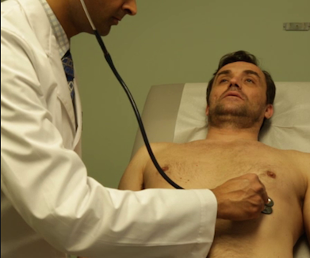
Clinical Examination
General Appearance- anxious distress
Angina, MI(Levine sign), failure , shock
Vitals
JVP-
Carotid pulse- MR, ruptuted IVS, LVF
Palpation –
Auscultation-
Heart sounds-
S1- soft
S2- can be paradoxically split in LBBB
S3- implied LVF
S4- Almost Universally present in MI
Murmurs –
short systolic murmur of MR
Holosystolic murmur of Ruptured IVS and TR
Friction Rubs

Slide 13
KILLIP’S CLASSIFICATION
This is a prognostic classification scheme proposed by Sir Thomas Killip in 1967.
Killip class I (6%) -patients are free of rales and S3.
Killip class II (17%) -includes patients with rales ( mild to moderate degree) and may or may not have an S₃
Killip class III (38%) -patients have rales in >50% of the lung field and frequently have pulmonary edema.
Killip class IV (81%) -patients have cardiogenic shock.

Slide 14
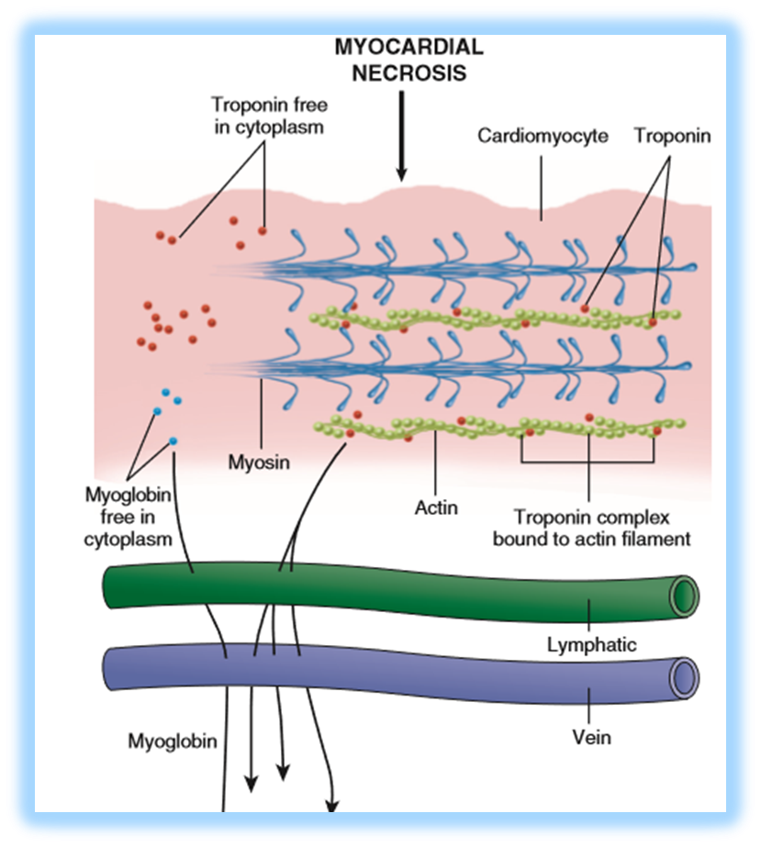
CARDIAC BIOMARKERS
Clinicians should not wait for the results of biomarker assays to initiate treatment of patients with STEMI.
Available cardiac biomarkers
Myoglobins
CKMB
Troponins I and T
Newer cardiac biomarkers
High sensitivity troponins

Slide 15
Parameter | Myoglobins | CKMB | Cardiac Troponins
Onset | Within hour | 3 hrs | 3 to 12 hrs
Peak | 1 to 4 hrs | 12 to 24 hrs | 12 to 24 hrs
Decline | After 24 hrs | After 3 days | 8 to 21 days for trop T 7 to 14 days for Trop I
Advantage | Early Biomarker for STEMI | more rapid appearance and disappearance from the blood, can be used (1) in patients presenting early after symptom onset (2) to time the onset of injury if the troponin is increased (3) to detect reinfarction later in the hospital course. | late diagnosis of MI
Notes:
The MB isoenzyme of CK is present in largest concentration in myocardium, although small amounts (1%-2%) can be found in skeletal muscle, tongue, small intestine, and diaphragm
There are two isoforms of cardiac troponin: T and I.

Slide 16
Parameter | Myoglobins | CKMB | Cardiac Troponins
Limitations | Can not be used in isolation | Cardiac after cardioversion cardiac surgery, myopericarditis, percutaneous coronary intervention (PCI) occasionally after rapid tachycardia Noncardiac Hypothyroidism extensive skeletal muscle trauma ,rhabdomyolysis, the muscular dystrophies, and some other neuromuscular disorders | 1)ACUTE DISEASE Cardiac and vascular Acute heart failure Acute aortic dissection Takotsubo, carditis, CVA Critical illness--- hypotension,GI bleed, TTP Respiratory Acute PE, ARDS Muscular Rhabdomyolysis Infectious sepsis, viral illness Toxic exposure – CO, H2S 2) CHRONIC DISEASE Chronic heart failure Cardiac infiltrative disorders Hypertension ,Diabetes Hypothyroidism End stage renal disease 3) MYOCARDIAL INJURY Chemotherapy, Envenomation Endurance athletics

Slide 17
Newer cardiac biomarkers
1) HIGH SENSITIVITY CARDIAC TROPONIN—
Enable more precise measurement of very low concentrations of cardiac-specific troponin.
High sensitivity with low specificity for MI
Detects troponin release earlier than older generation assays
Aids in discriminating acute myocardial injury from chronically elevated values.
2) h FABP
Involved in intracellular buffering and transport of long chain fatty acids
Protects cardiac muscles from long chain fatty acids
Rise within 3 hrs
Returns to normal within 12 to 24 hrs
3) GPBB- Glycogen Phosphorylase enzme BB
Role – to provide fuel in requirements like Hypoxia and Hypoglycemia
Rises in 1-4 hrs Peaks in 6-10 hrs Declines in 1-2days

Slide 18
Other Biomarkers
Ischemia modified Albumins
S100A from Calcium Binding Proteins
Choline
Irisine
Copeptine
Adropine
PAPP-A
CRP, TNF, IL6, CD40, MPO, CAM, O LDL
Glutathione, Homocystein, Fibrinogen, Ddimer, PCT,

Slide 20
ECG MANIFESTATIONS OF MI
IN THE ABSENCE OF LBBB---
1)New ST elevation at the J point in two contiguous leads with the following cut points—
≥ 0.1 mV in all leads except V2 and V3
In V2 and V3 the cut off points are—
≥0.2 mV in men ≥ 40yrs
≥0.25 mV in men < 40yrs
≥0.15 mV in women
2) ST and T wave changes—
New horizontal or downsloping ST depression ≥0.05 mV in two contiguous leads
T-wave inversion ≥0.1 mV in two contiguous leads with a prominent R wave or R/S ratio > 1

Slide 21
STEMI- Antero-Septal Myocardial Infarction

Slide 24
AWMI with Wrap Around LAD

Slide 26
De Winters Sign

Slide 28
RV infarction—
ST-segment elevation in the right precordial leads (V1, V3R through V6R) is a relatively sensitive and specific sign of RV infarction.
Occasionally, ST-segment elevation in leads V2 and V3 results from acute RV infarction; this appears to occur only when injury to the left inferior wall is minimal.
RV infarction appears to reduce the anterior ST-segment depression often observed with inferior wall MI.
A QS or QR pattern in leads V3R and/or V4R also suggests RV myocardial necrosis but has less predictive accuracy than does ST-segment elevation in these leads.

Slide 29
STEMI- IWMI with CHB

Slide 30
STEMI- IWMI with RVMI with CHB
ECG with Right sided leads

Slide 31
IN THE SETTING OF LBBB POINTS
ST segment elevation ≥1mm and
concordant with the QRS complex 5
2) ST segment depression ≥1mm in
lead V1, V2, V3 3
3) ST segment elevation ≥5mm and
discordant with the QRS complex 2
A score of ≥3 had a specificity of 98% for acute MI

Slide 34
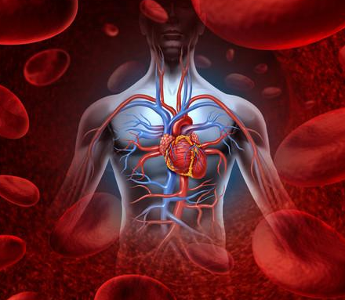
to be continued…..

