Slide 1
SUCCESS STORIES…

Slide 2
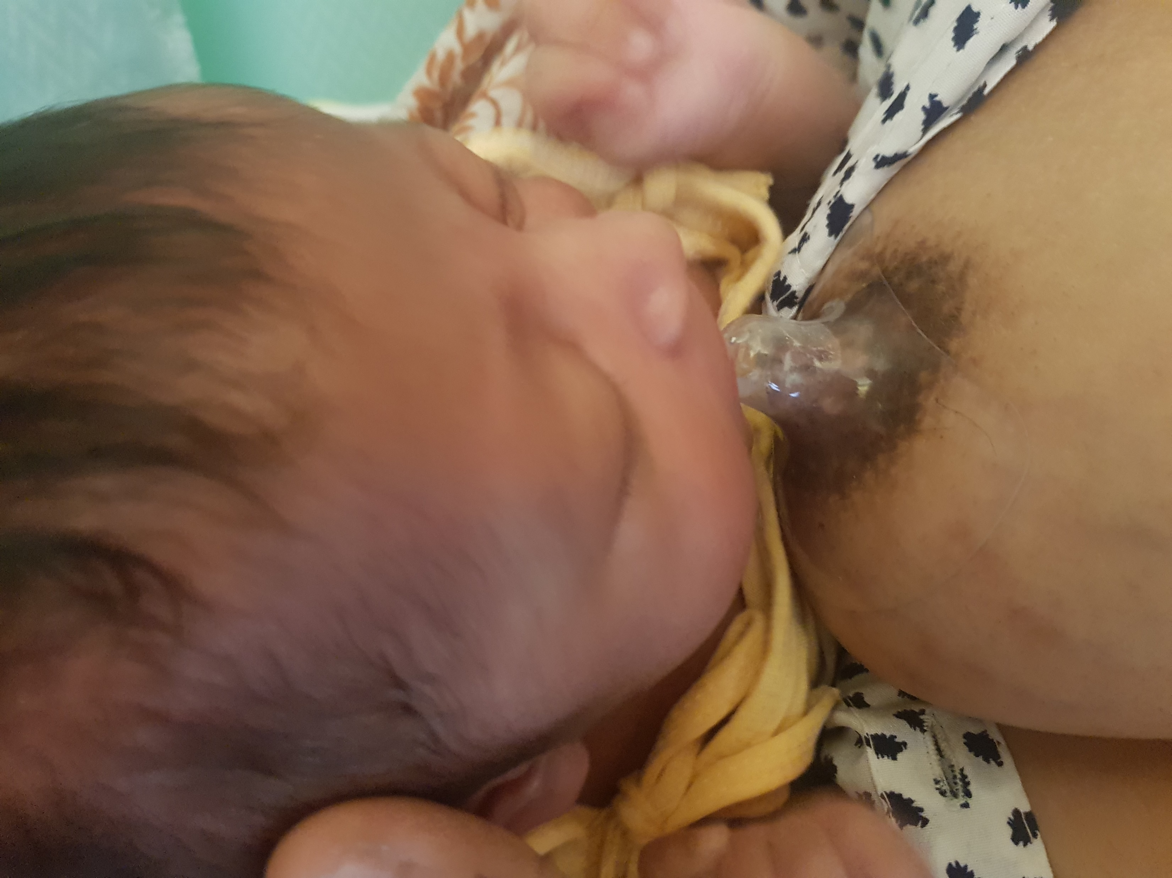
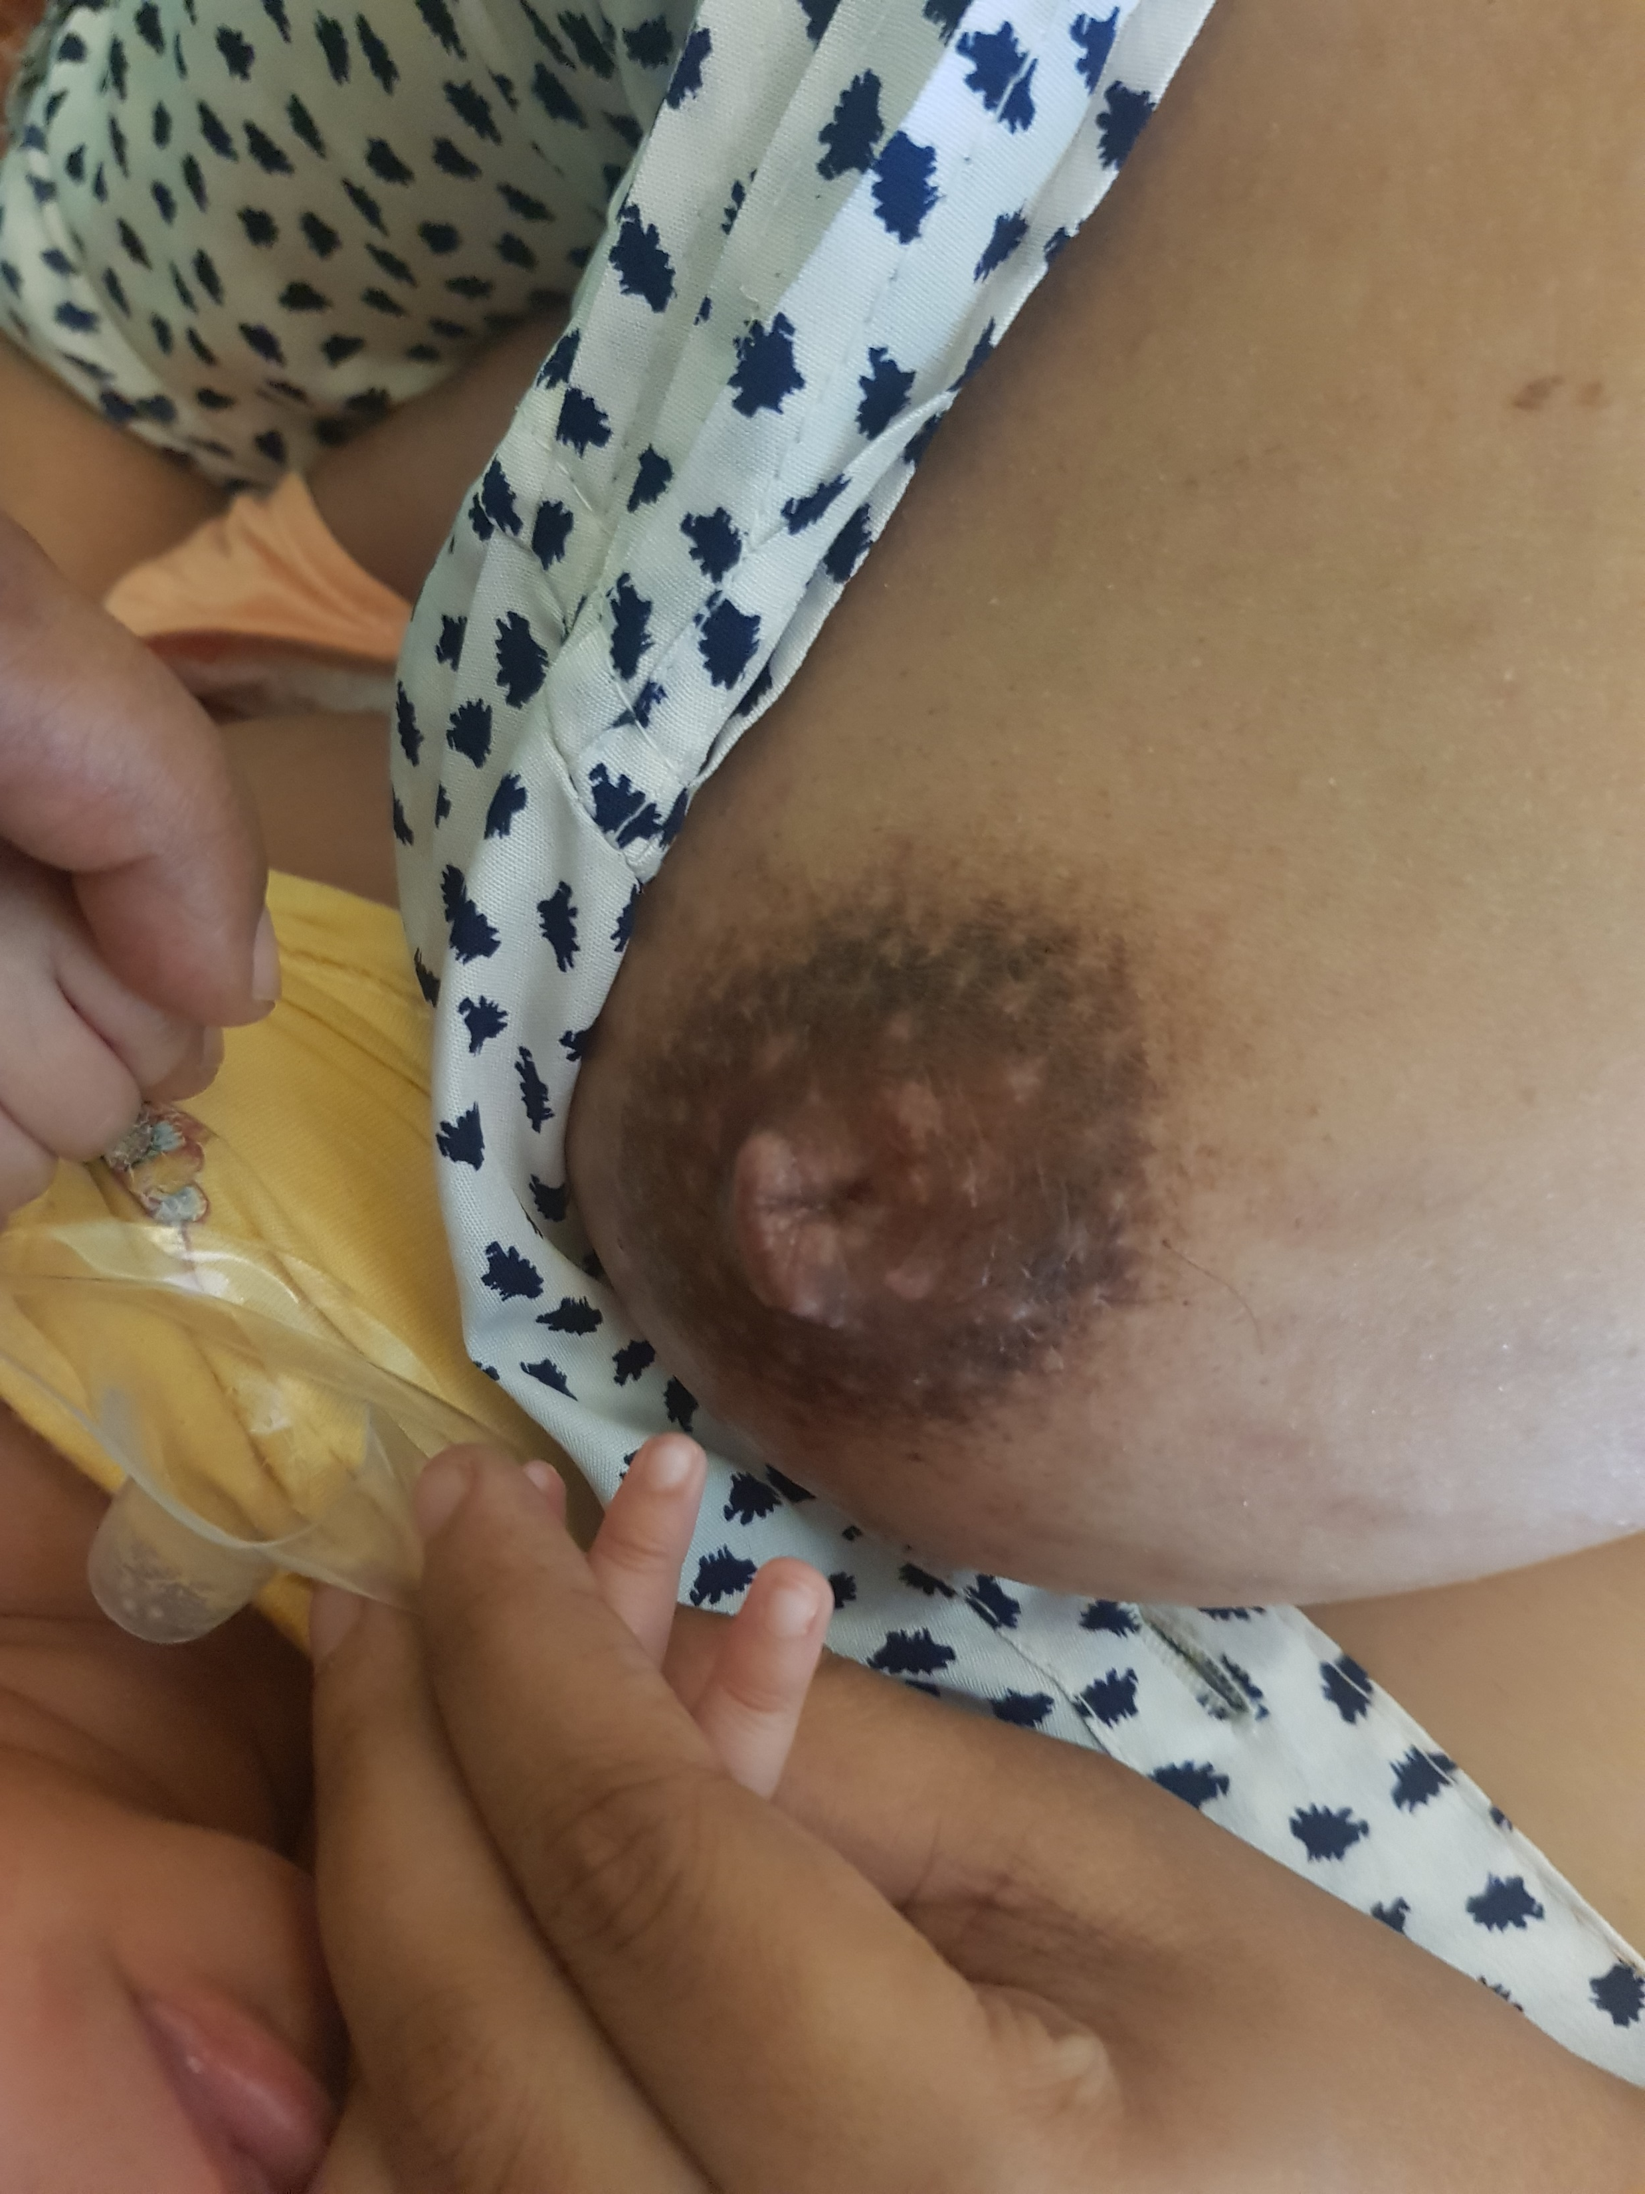
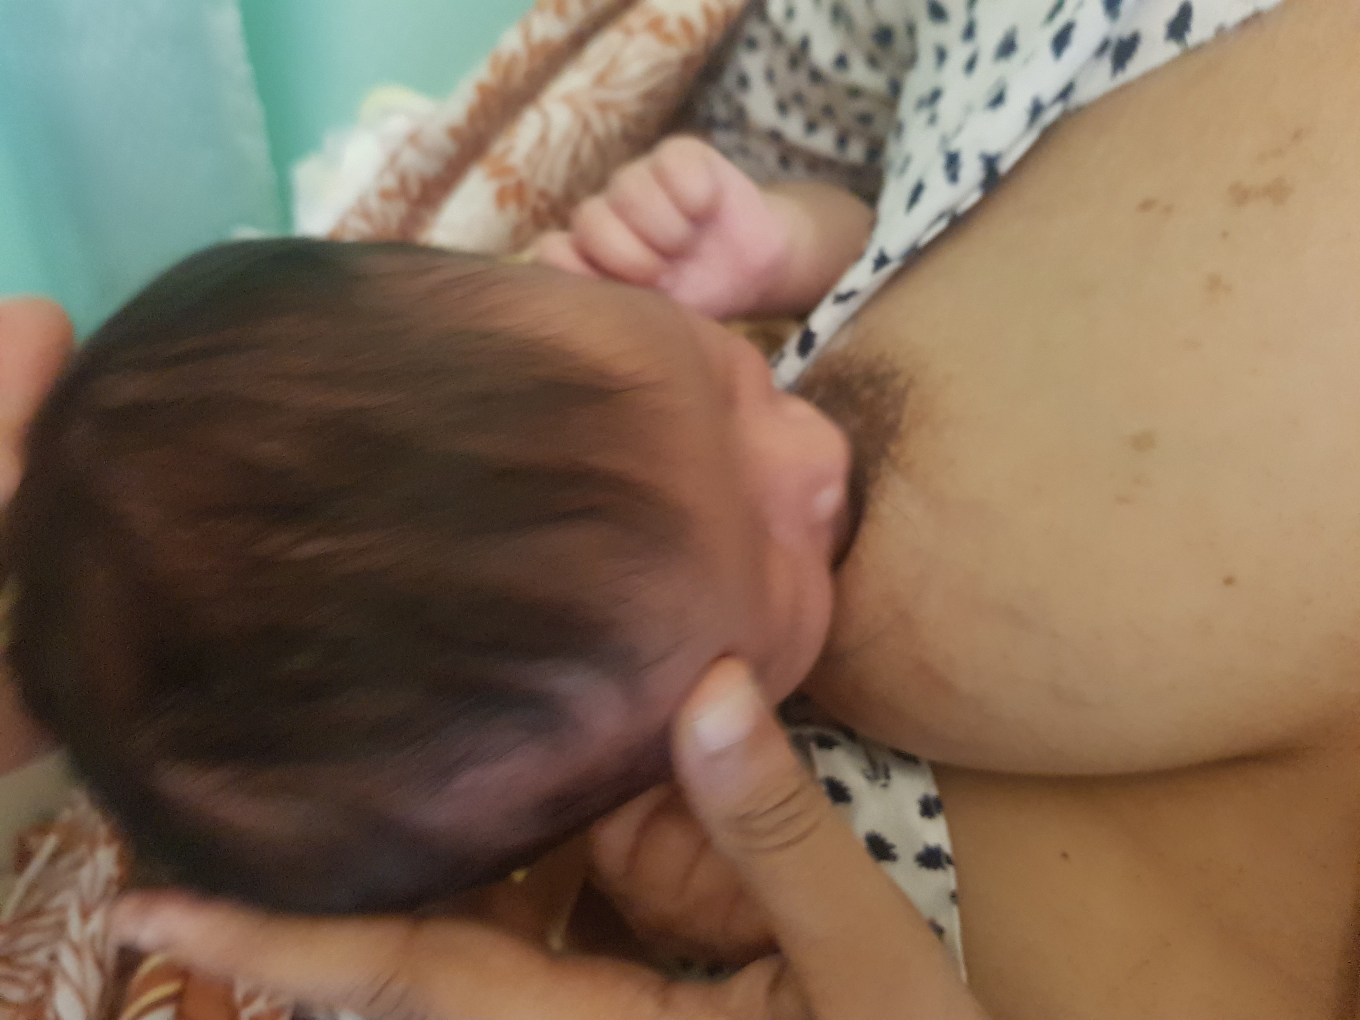
USE OF NIPPLE SHIELD

Slide 3
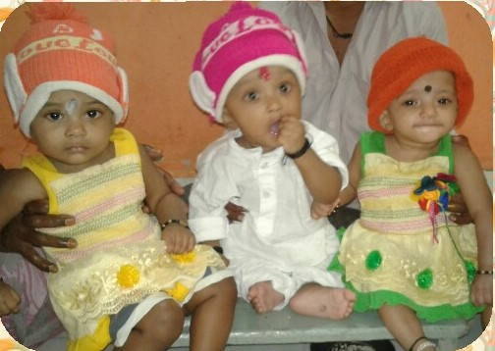
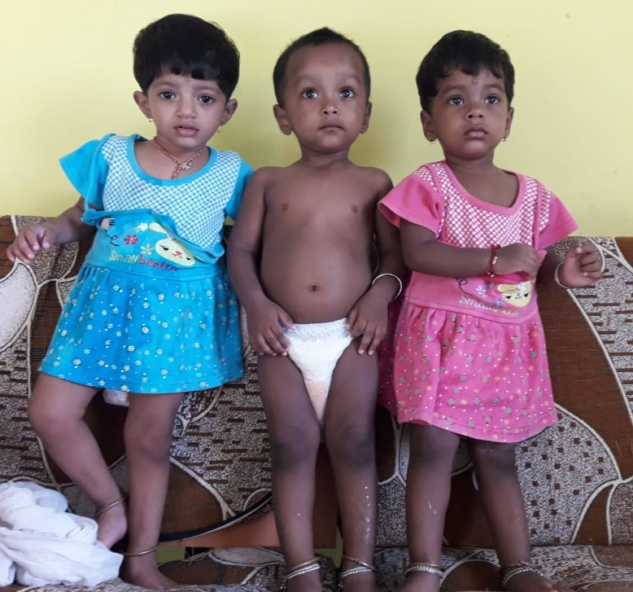
TRIPLETS
Triplets of 900gm each
Total 32 Litres of PDHM provided during NICU stay and after discharge
5th Birthday
(Photo courtesy :Parents)

Slide 4
Mother with previous breast abscess operated keloid helped with successful BF
Mother with breast engorgement helped with cold compresses, oil massage and expression with electric pump

Slide 5
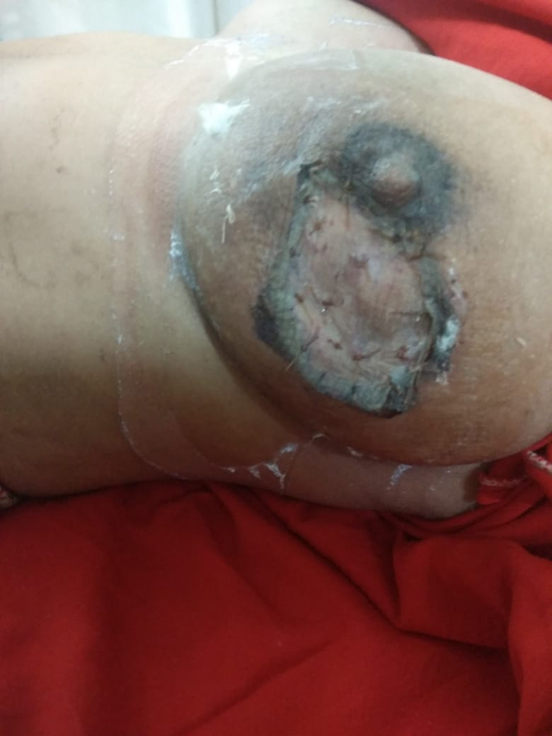
A referred CASE OF Large Breast Abscess:
This mother was delivered in an outskirt village of Pune City. She visited YHMB after referral from OBGYN OPD.
LC has seen her wound as seen in left side of picture.
She was helped with expression from unaffected breast and was comforted for the breast milk leakage on left side.
Referred to surgery OPD with Dr. Daksha Nirhale, treated for the extensive wound with skin graft and was discharged without compromising her lactation.

Slide 6
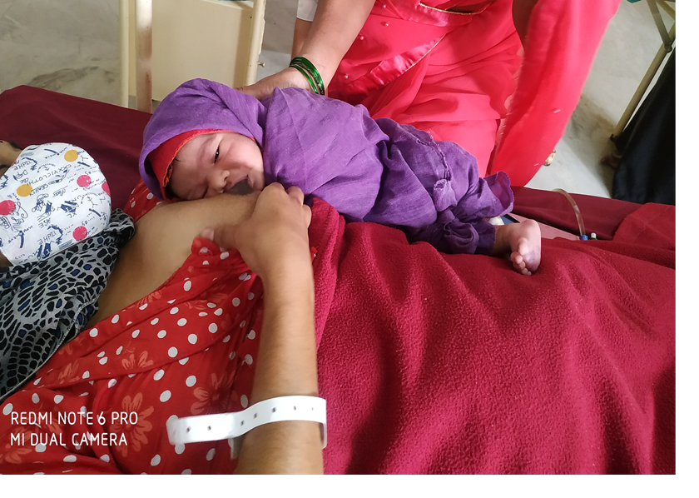
Early initiation of BF after Lower Segment caesarean section

Slide 7
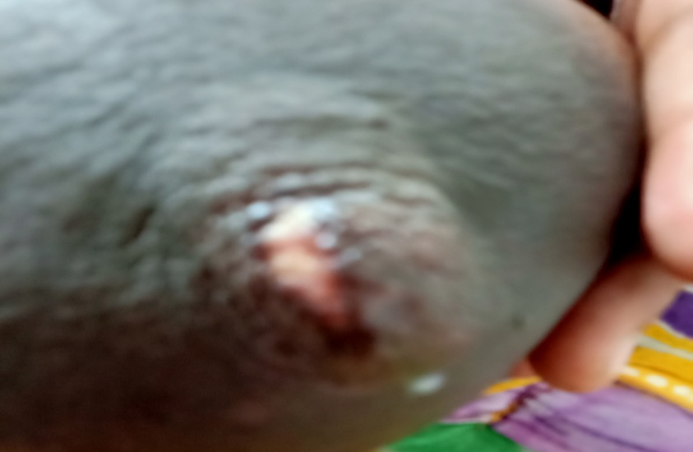
BF demonstration
Back massage for mothers
Support to problems of nipple such as Crack nipple
Involvement of father as BF support

Slide 8
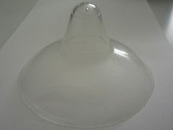
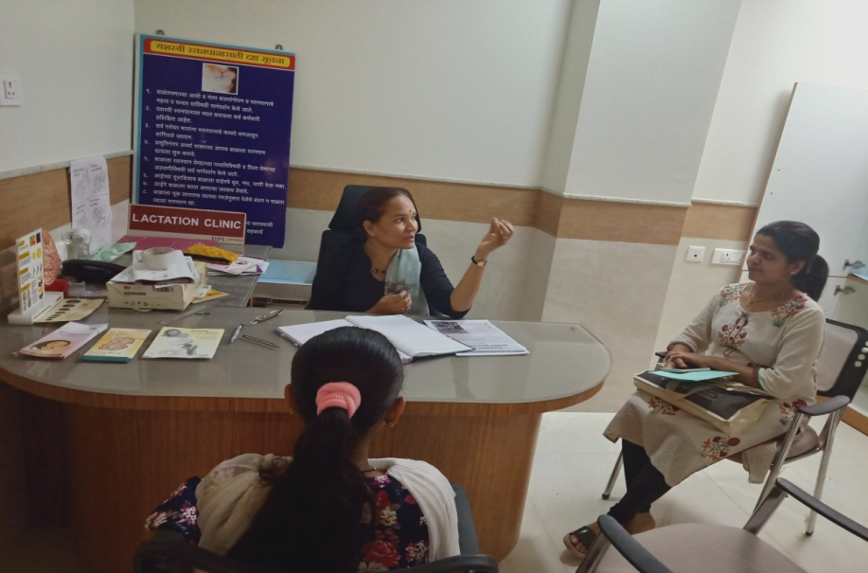
Inverted nipple helped with
Nipple shield
Empowering With Informed Decision On Breast Feeding
Baby Latch With Nipple Shield

Slide 9
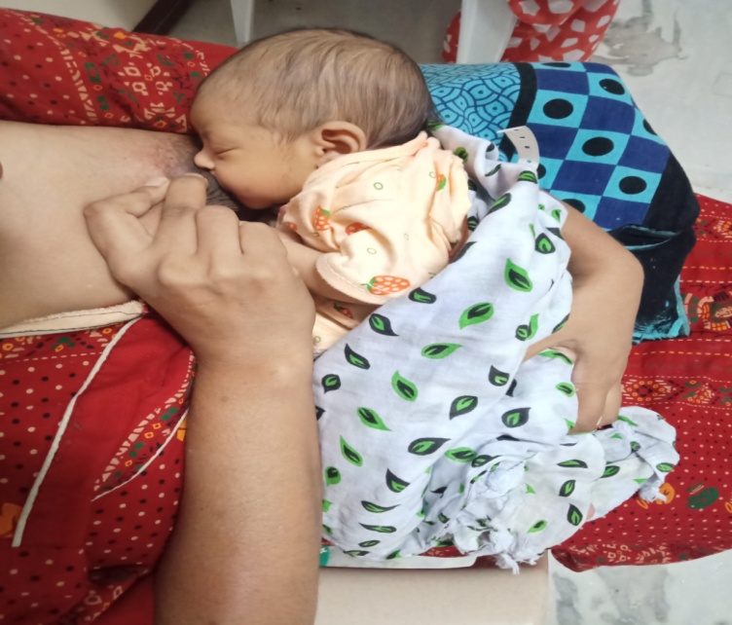
Success Stories At A Glance
Video of Breastfeeding on Flat nipples
Mothers with Breast Abscess

Slide 10
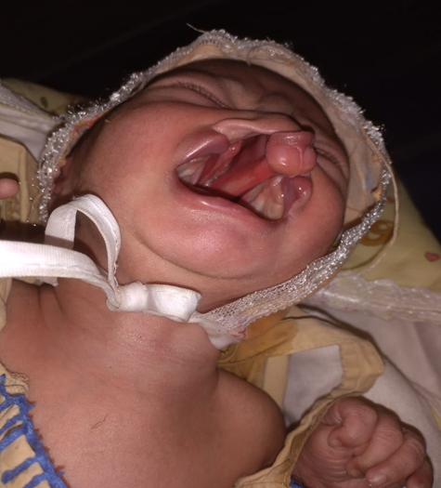
Success Stories At A Glance
Mother with bilateral nipple erosion due to faulty latch helped with nipple shields and improved attachment of baby.
Baby with cleft lip and cleft palate helped with dental reference and obturator feeding. Mother helped

Slide 11
EMPOWERING MOTHERS FOR EXCLUSIVE BF WITH SUPPORT

